Slide 1
PEC: Best Practices
Heather Peters, M.Ed, Ph.D

Slide 2
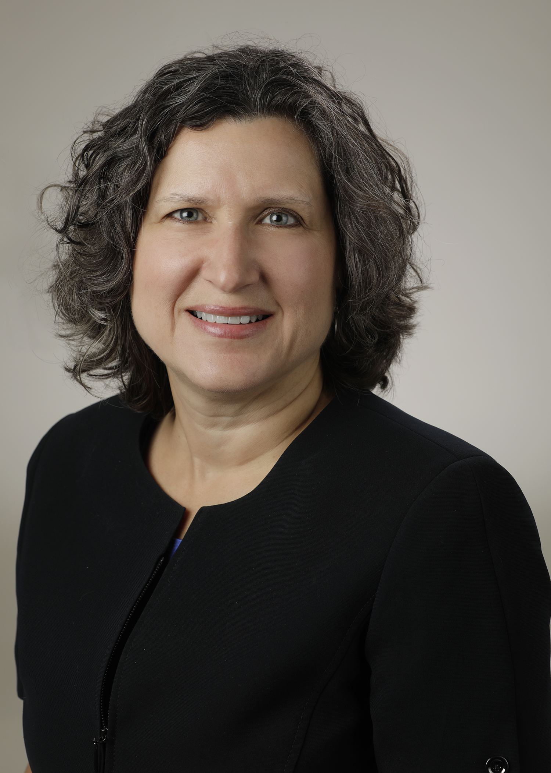
Introducing Your Presenter…
Heather Peters, M.Ed, Ph.D
GME Consultant
Former GME Director & DIO
Seasoned speaker at ACGME & subspecialty national meetings
Areas of Expertise: GME Strategic Planning; Program Evaluation; and Faculty Development
3 decades in education; Masters of Education in curriculum & evaluations, PhD concentration in secondary education & adult learning theories

Slide 3
Learning Objectives
Discuss Background and Intent of Program Evaluation & Improvement
Review revised APE requirements
Examine the ACGME program structure
Look at some Best Practices for
Reviewing the program’s curriculum (rotation/service evaluations)
Resolving difficult program issues
Leveraging the PEC to be the “trainee voice for change”
Take-away Tools
2020 APE Template from Partners
Sample PEC slides for educating PEC members
Sample PEC slides for Rotation/Service Evaluations
Poster: 5 Ways to Leverage Your PEC

Slide 4
Program Evaluation & Improvement
PEC must have at least 2 faculty, one of whom is a core faculty member
At least one resident/fellow
Responsibilities of PEC:
advisor to PD, through program oversight
review of the program’s self-determined goals & progress
developing new goals, based on outcomes
SWOT
“continuous improvement process”
Presented by Partners in Medical Education, Inc. 2020

Slide 5
Background and Intent
In order to achieve its mission and train quality physicians, a program must evaluate its performance and plan for improvement in the Annual Program Evaluation.
Performance of residents and faculty members is a reflection of program quality and the (program should use metrics) that reflect the goals that a program has set for itself.
The Program Evaluation Committee utilizes outcome parameters and other data to assess the program’s progress toward achievement of its goals and aims.
BOTTOM LINE – The ACGME has taken the concept of the self-study and now expects this to be done by the PEC each year!

Slide 6
Curriculum
Outcomes from Previous APE
ACGME letters of notification, citations, AFIs
Quality and safety of patient care
aggregate trainee and faculty:
well-being
recruitment & retention
workforce diversity
engagement in QI and PS
scholarly activity
ACGME trainee and faculty surveys
written evaluations of the program
achievement of the Milestones
in-training exams
board pass and certification rates
graduate performance
Aggregate faculty:
evaluation
professional development
Aggregate Trainee:
APE Components (2019 CPRs)
Tool: Draft APE from Partners

Slide 7
Key Take-Away
This CANNOT be accomplished in one or even 2 meetings per year!

Slide 8
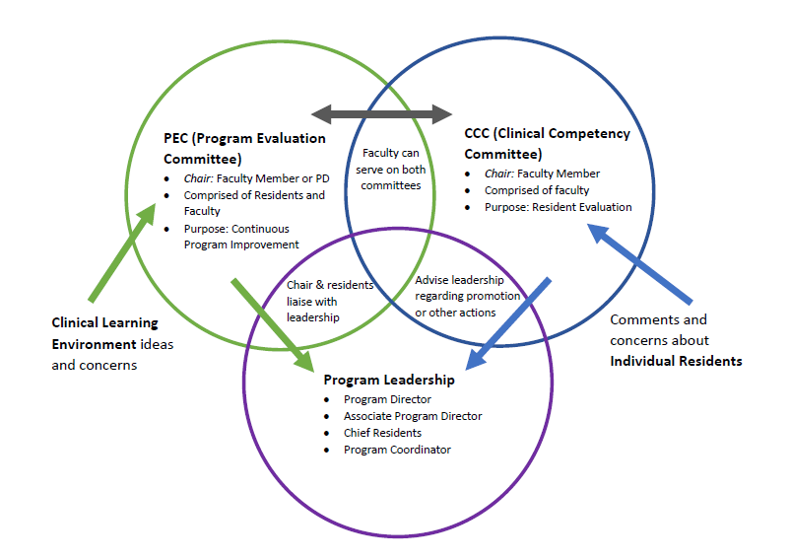
PROGRAM STRUCTURE

Slide 9
Best Practices

Slide 10
Rotation/Service Presentations at PEC
COLLECT DATA
PEC PRESENTATION BY ROTATION DIRECTOR
ACT
COLLECT DATA
PEC PRESENTATION BY ROTATION DIRECTOR
ACT

Slide 11
Rotation/Service Presentations at PEC
COLLECT DATA
PEC PRESENTATION BY ROTATION DIRECTOR
ACT
COLLECT DATA
PEC PRESENTATION BY ROTATION DIRECTOR
ACT
Collecting Data:
End of rotation evaluations
Invite residents to PEC meeting

Slide 12
Rotation/Service Presentations at PEC
COLLECT DATA
PEC PRESENTATION BY ROTATION DIRECTOR
ACT
COLLECT DATA
PEC PRESENTATION BY ROTATION DIRECTOR
ACT
Provide data to Rotation Director
Provide slide templates to Rotation Director
Invite residents who recently completed the rotation
Rotation Director should provide improvement items
Tool: Sample slide set from a rotation director’s presentation

Slide 13
Rotation/Service Presentations at PEC
COLLECT DATA
PEC PRESENTATION BY ROTATION DIRECTOR
ACT
COLLECT DATA
PEC PRESENTATION BY ROTATION DIRECTOR
ACT
Give time to implement improvement plans
Include the improvement items in follow-up reports
Possibly add the items to the end of rotation evaluations

Slide 14
DO
Tool: Sample slide set for PEC agenda/structure
Educate PEC members about their role and responsibities
Follow up on APE action items as part of your standing PEC agenda
Have multiple residents on the PEC to give them a voice in program improvement (one or more per training year)
Invite representatives from the hospital to PEC meetings to discuss the issues
Be respectful of other’s viewpoints
Bring an open mind
Be prepared with possible solutions
Be in touch with your peers/colleagues so that your voice reflects their thoughts
Be professional when discussing the business of the committee outside the committee

Slide 15
DO
Educate PEC members about their role and responsibities
Follow up on APE action items as part of your standing PEC agenda
Have lots of residents on the PEC to give them a voice in program improvement (one or more per training year)
Invite representatives from the hospital to PEC meetings to discuss the issues
This will allow the program to keep the action items from the APE in the forefront.
Each meeting some updates on the action plans can be provided.
This does not need to be a long part of the meeting.

Slide 16
DO
Educate PEC members about their role and responsibities
Follow up on APE action items as part of your standing PEC agenda
Include as many of the residents on the PEC to give them a voice in program improvement (one or more per training year)
Invite representatives from the hospital to PEC meetings to discuss the issues
More residents will provide a deeper level of resident perspective
At least one per training year and an alternate in case the resident off-site, on vacation or post-call
Invite residents who just completed the rotation on the agenda to be discussed
Open meetings for all residents, even those not selected to be voting members, are appreciated by the residents

Slide 17
DO
Educate PEC members about their role and responsibities
Follow up on APE action items as part of your standing PEC agenda
Include as many of the residents on the PEC to give them a voice in program improvement (one or more per training year)
Invite representatives from the hospital to PEC meetings to discuss the issues
This is the place to have the discussions with those that represent the “other side” of the situation
Residents need to understand that their perspectives need to be tempered by the perspective of the other side of the situation.

Slide 18
DON’T
Conduct a PEC meeting without an agenda
Expect that all issues will be resolved in one PEC meeting – that’s the nature of change – it takes time
Require the PD to chair the PEC – this is a great opportunity to train a fledging leader
PEC meetings without agendas turn into grievance sessions which is not the purpose of this committee.

Slide 19
DON’T
Conduct a PEC meeting without an agenda
Expect that all issues will be resolved in one PEC meeting – that’s the nature of change – it takes time
Require the PD to chair the PEC – this is a great opportunity to train a fledging leader
Chronic issues are difficult and complex. Accept that it will take more than one meeting to resolve these issues.

Slide 20
DON’T
Conduct a PEC meeting without an agenda
Expect that all issues will be resolved in one PEC meeting – that’s the nature of change – it takes time
Require the PD to chair the PEC – this is a great opportunity to train a fledging leader
Succession planning is essential to the continued health of a program

Slide 21
Closing Comments
Exercise Patience: It will take some time to for the program to understand the redesign of the PEC. This is a long-term project. The result, of more engaged trainees and faculty, is worth the ups and downs.
Expect some Push-Back: When you ask for more meetings, the program leadership and faculty may not be receptive. Be prepared to discuss the new requirements for the APE that will need to be addressed. Use slides from this presentation to guide your discussion.
Tool: Poster – 5 Ways to Leverage Your PEC

Slide 22
Questions??

Slide 23
Upcoming Live Webinars
Research and Scholarly Process in a Nutshell: Getting Started Thursday, February 13, 2020 12:00pm – 1:00pm EST
Ask Partners – Spring Freebie Tuesday, March 10, 2020 12:00pm – 1:00pm EST
Lessons Learned: Accepting Displaced Orphan Residents Thursday, March 24, 2020 12:00pm – 1:00pm EST
On-Demand Webinars
Crafting “Top Notch” Goals, Objectives and Evaluations
Feedback – From the Top Down
Evolving Resident Well-Being
We All Need Scholar Activity, Including Coordinators
Preparing for the 10 Year Site Visit
Meet the Experts – Fall Freebie
Jump Start Your GMEC
Creating a Diverse Workforce
APE Reconstructed
Digging for Data 101
NEW Faculty Development Series
15 Minutes to Effective Feedback
Toolbox for Teaching Millennials
Taking Supervision to the Next Level
Contact us today to learn how our Educational
Passports can save you time & money!
724-864-7320
www.PartnersInMedEd.com
23

Slide 24
Partners in Medical Education, Inc. provides comprehensive consulting services to the GME community.
Partners in Medical Education
724-864-7320 | info@PartnersInMedEd.com
Heather Peters, M.Ed, Ph.D
heather@partnersinmeded.com
www.PartnersInMedEd.com

