Slide 1
Please Note…
Please make sure your Start Video is OFF when logging into the WebEx platform.
Here is what it should look like
ALSO
It is NORMAL to not hear any sound until the webinar starts at 12:00 noon EST.
Your phone line is muted, but you can always chat to the host, BJ Schwartz, if you have any questions or concerns during this time.

Slide 2
Successful Planning and Tracking of Scholarly Activity
Heather Peters, M.Ed, Ph.D
Grace Brannan, Ph.D

Slide 3
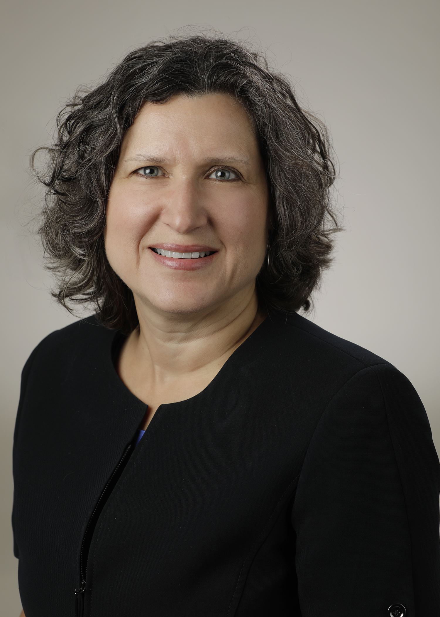
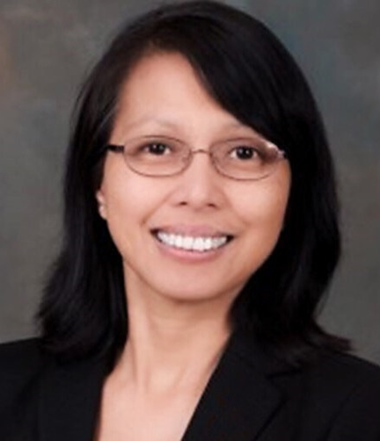
Introducing Your Presenters…
Heather Peters, M.Ed., Ph.D
GME Consultant
Grace Brannan, Ph.D
GME Consultant
Expertise in project management and tracking outcomes across the GME environment
Advised multiple programs and institutions on how to resolve scholarly activity citations
Developed GME strategic plans which included scholarly activity component

Slide 4
LEARNING OBJECTIVES
DISCUSS recommended outcomes for scholarly activities
OUTLINE elements for planning a robust scholarly activity environment
DESCRIBE the challenges for tracking scholarly activities
OUTLINE the solutions remediating the challenges
ACGME table for scholarly activity requirements by specialty
Email templates for obtaining faculty and trainee scholarly activity for ADS updates
Table of Scholarly activities for ADS updates

Slide 5
Scholarly Activity Outcomes
This Photo by Unknown Author is licensed under CC BY

Slide 6
What does the ACGME Expect for Faculty?
Depends on your specialty…
(1) faculty participation in grand rounds, posters, workshops, quality improvement presentations, podium presentations, grant leadership, non-peer-reviewed print/electronic resources, articles or publications, book chapters, textbooks, webinars, service on professional committees, or serving as a journal reviewer, journal editorial board member, or editor;
(2) peer-reviewed publication.

Slide 7
How much is enough?
Common Citation across specialties
Environment of Inquiry – “Quality Measure”
Role:
Program Director: Minimum of one project per year
Core Faculty: Minimum of one project every two years
Non-core: Minimum of one project every three years
Graduates: At least half of graduates should be producing a project during residency

Slide 8
Planning for Scholarly Activity
Planning by Nick Youngson CC BY-SA 3.0 Alpha Stock Images

Slide 9
Assess Faculty and Trainees’ Strengths and Needs
What is their scholarly background?
Who are potential scholarly champions?
Who needs assistance?
What kind of assistance is needed?

Slide 10
Assess the Program and Institution’s Resources
Are the resources available
Within the Program?
Within the Hospital?
From the SI?
From the hospital system?
From academic partners?
Outside?
Do you have a budget for these resources?

Slide 11
GMEC Oversight
Addressed in the AIR – major responsibility of the Sponsoring Institution to support the SA of all programs

Slide 12
Solutions for the Challenges to Planning and Tracking Scholarly Activity
https://colpittsclinical.com/wp-content/uploads/2017/08/problem-solution-image.jpg

Slide 13
Annual ADS Update: Scholarly Activity
Key Points for the Program Coordinator:
Track all year (frequent reminders to faculty, faculty meeting activity)
Send emails to capture faculty data – see email templates
Share information for your faculty with your participating sites as you need their data in return

Slide 14
Annual ADS Update: Scholarly Activity
Key Points for the Program Director:
Program Director scholarly activity is scrutinized in all specialties – stay active
Keep faculty accountable for their scholarly activity
Faculty job description
Annual Review
Mentoring resident research
Focus energies on junior/new faculty
Encourage the development of research questions in every patient care activity (rounds, point of care)

Slide 15
Annual ADS Update: Scholarly Activity
Key Points for the Faculty:
Know the scholarly expectation for the specialty
Develop an area of interest
Seek out training for gaps in comfort/knowledge about scholarly activity
Be active in seeking out residents to mentor
Foster discussions with learners that ask scholarly questions

Slide 16
Sponsoring Institution Oversight
Special Review Component
GMEC: Determine internal numbers
AIR (Annual Institutional Review)
Track across institution (program citation report)
Needs Assessments/Planning at the Institutional Level
Have a standing SA item on their action plans
Celebrate successes

Slide 17
Best Practices for Boosting Scholarly Activity

Slide 18
Setting Strategies
Keeping the end in mind
Link efforts to ACGME requirements
Continuous education
Update all core and non-core faculty, residents, and core faculty about the ACGME requirements and how to meet those requirements
Identify external and Internal collaborators
QI Department, affiliate universities
What are doable projects?

Slide 19
Creating a Structure
Research Committee
Establish a GME-IRB relationship
Shared drives to store documents
Create a tracking mechanism

Slide 20
Tracking Mechanisms
Keeping the end in mind
Outcomes
Annual ADS report
Faculty CV
Process and Progress
Tracking individual projects
Tracking individual researchers
Residency Management System
Engage your Librarian

Slide 21
Faculty Roster Strategies
Collaboration
As long as everyone has a significant intellectual contribution
Tracking should hit multiple endpoints
Update CV
Update annual ADS

Slide 22
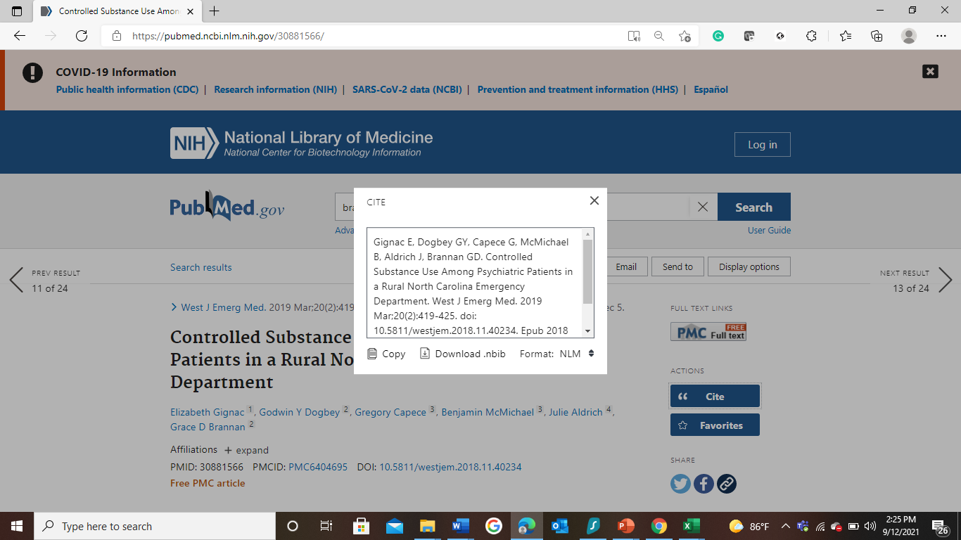
Using PubMed to format individual outcomes

Slide 23
Tips for Tracking Outcomes- ADS
Faculty Scholarly Activity | PMID |  |  |  | Other Publications | Conference Presentations | Other Presentations | Chapters / Textbooks | Grant Leadership | Leadership or Peer-Review Role | Formal Courses
 | Enter up to four PMIDs |  |  |  | Respond with total number |  |  |  |  | Respond with Yes/No
Faculty Name | PMID 1 | PMID 2 | PMID 3 | PMID 4 | Other Publications | Conference Presentations | Other Presentations | Chapters / Textbooks | Grant Leadership | Leadership or Peer-Review Role | Formal Courses
Grace Brannan | Gignac E, Dogbey GY, Capece G, McMichael B, Aldrich J, Brannan GD. Controlled Substance Use Among Psychiatric Patients in a Rural North Carolina Emergency Department. West J Emerg Med. 2019 Mar;20(2):419-425. doi: 10.5811/westjem.2018.11.40234. Epub 2018 Dec 5. PMID: 30881566; PMCID: PMC6404695. | Klenzak, S., Danelisen, I., Brannan, G.D., Holland, M.A., van Tilburg, M.A. Management of gastroesophageal reflux disease: Patient and physician communication challenges and shared decision making. World J Clin Cases 2018; 6(15): 892-900. PMID: 30568943 |  |  |  | Brannan, G.D., Rao, A., Brooks, E., Mills, L., Harnden, A., Alderson, T. and McQuiston, J. A systematic review of quality improvement education for medical students: Kirkpatrick’s learning model. Advances in Evidence Synthesis: special issue. Cochrane Database of Systematic Reviews 2020;(9 Suppl 1):272. https://doi.org/10.1002/14651858.CD202001
 |  |  |  |  |  | Rao, A., Brannan, G.D., Mills, L., Brooks, E., Harnden, A., Alderson, T., McQuiston, J. A. “Systematic Review of Quality Improvement Education for Medical Students: What are Institutions Teaching?” 61st European Organization for Quality Congress: Rediscovering Quality. Lisbon, Portugal. October 23-24, 2019.

Slide 24
Tips for Tracking Outcomes-Faculty CV
Sections: | Academic Appointments | Concise Summary of Role/Responsibilities in Program | Current Professional Activities / Committees | Bibliographies | Articles | Participation in Local, Regional and National Activities / Presentations / Abstracts / Grants
Faculty Member Name | Please list the past ten years of academic appointments (employment), beginning with your current position. |  | Please list up to ten activities and committees within the past five years | Please list the most representative Peer Reviewed Publications / Journal Articles from the last 5 years, with a limit of 10. Separate entries with a double line break. Do not leave blank. If none, please enter NONE. | Please list selected review articles, chapters and/or textbooks from the past 5 years, with a limit of 10. Separate entries with a double line break. Do not leave blank. If none, please enter NONE. | Please list participation in local, regional and national activities/presentations from the past 5 years, with a limit of 10. Separate entries with a double line break. Do not leave blank. If none, please enter NONE.
Grace Brannan |  |  |  |  | Gignac E, Dogbey GY, Capece G, McMichael B, Aldrich J, Brannan GD. Controlled Substance Use Among Psychiatric Patients in a Rural North Carolina Emergency Department. West J Emerg Med. 2019 Mar;20(2):419-425. doi: 10.5811/westjem.2018.11.40234. Epub 2018 Dec 5. PMID: 30881566; PMCID: PMC6404695. | Brannan, G.D., Rao, A., Brooks, E., Mills, L., Harnden, A., Alderson, T. and McQuiston, J. A systematic review of quality improvement education for medical students: Kirkpatrick’s learning model. Advances in Evidence Synthesis: special issue. Cochrane Database of Systematic Reviews 2020;(9 Suppl 1):272. https://doi.org/10.1002/14651858.CD202001
 |  |  |  |  | Klenzak, S., Danelisen, I., Brannan, G.D., Holland, M.A., van Tilburg, M.A. Management of gastroesophageal reflux disease: Patient and physician communication challenges and shared decision making. World J Clin Cases 2018; 6(15): 892-900. PMID: 30568943. | Rao, A., Brannan, G.D., Mills, L., Brooks, E., Harnden, A., Alderson, T., McQuiston, J. A. “Systematic Review of Quality Improvement Education for Medical Students: What are Institutions Teaching?” 61st European Organization for Quality Congress: Rediscovering Quality. Lisbon, Portugal. October 23-24, 2019.

Slide 25
Process Tracking
Project Title | Research Team | Faculty Lead | Proposal Development | IRB Submitted | IRB Approved | Data Analysis | Poster Presented | Paper Submitted | Paper Accepted

Slide 26
Resources
ACGME Table of Scholarly Activity Requirements by Specialty
Email Templates
2021 ADS Scholarly Activity Table Categories
Faculty
Trainee
Presented by Partners in Medical Education, Inc. 2021

Slide 27
Take Home Points
Scholarly Activity Planning/Tracking is everyone’s responsibility
Scholarly Activity is fundamental to all GME programs and therefore fundamental to the sponsoring institution

Slide 28
Thank You Any Questions?

Slide 29
Upcoming Live Webinar
A Successful Coordinator? You Must Be C-C-Crazy!
Tuesday, November 2, 2021
Meet the Experts – Fall Freebie
Thursday, November 18, 2021
Moral Injury in Healthcare
Thursday, December 9, 2021
Streamlining Your Special Review
Thursday, December 16, 2021
Latest On-Demand Webinars
A Day in the Life of A DIO
Site Visits – What to Expect in 2021
ADS Update 2021
GME Grants and Funding Sources
Survey Research
Impactful AIR & APE – Bridging Data & Action
GMEC Checkups – QIPS Edition
ACGME Surveys – What Now?
Other Approaches to CCC & Evaluation
Lessons Learned from the Pandemic: Planning for the Next Disaster
Ask Partners – Spring Freebie
Digging for Data Part 3
How to Maximize Virtual Learning Part 2
Faculty Development Series
15 Minutes to Effective Feedback
Toolbox for Teaching Millennials
Taking Supervision to the Next Level
Contact us today to learn how our Educational
Passports can save you time & money!
724-864-7320
www.PartnersInMedEd.com
Presented by Partners in Medical Education, Inc. 2021
29

Slide 30
Partners in Medical Education, Inc. provides
comprehensive consulting services
to the GME community.
Partners in Medical Education
724-864-7320 | info@PartnersInMedEd.com
Heather Peters, M.Ed., Ph.D
Heather@PartnersInMedEd.com
Grace Brannan, Ph.D
Grace@PartnersInMedEd.com
www.PartnersInMedEd.com

