Slide 1
Program Director’s Guide to Milestones Assessment & The Role of the CCC
PARTNERS IN MEDICAL EDUCATION, INC.
Presented by:
Lawrence Davis, MD, FACR

Slide 2
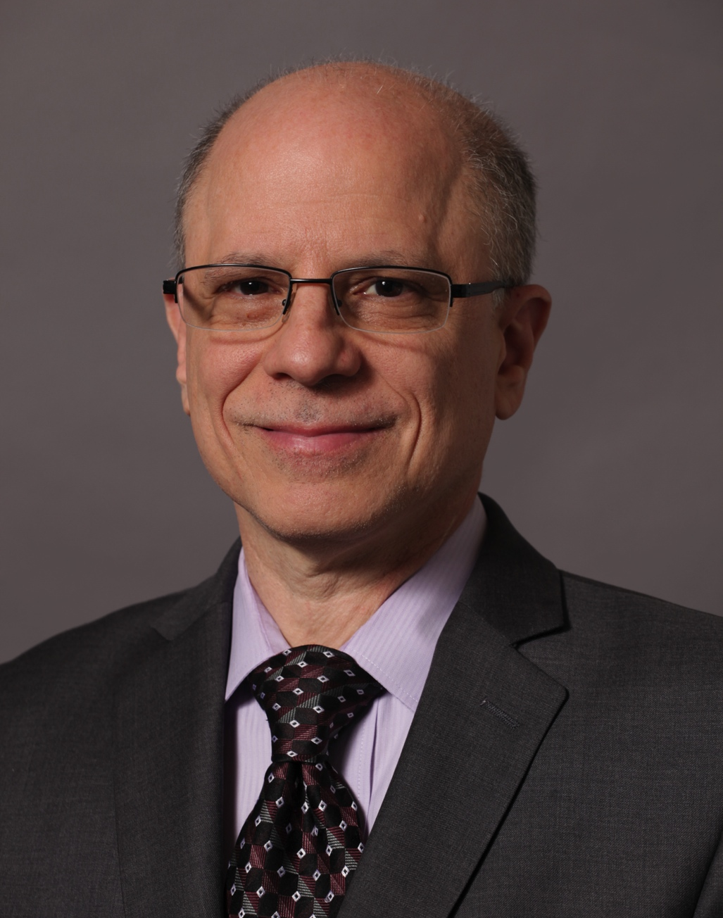
Introducing Your Presenter…
Lawrence Davis, MD, FACR
25+ years experience as an educator and proponent for GME and resident/faculty education, at both the Regional and National level
Over 20 years experience as a Diagnostic Radiology Program Director, as well as the VP of the American College of Radiology, and President of the Association of Program Directors in Radiology
Former Chair of the ACGME RRC for Radiology, who spearheaded the transition nationally for Radiology related to the Milestone Project and implementation of the Next Accreditation System.

Slide 3
Webinar Objectives
By the end of the session the attendees will be able to:
Discuss the development of the ACGME Milestones
Describe actions training programs can take to adapt to the milestones requirement
Define the responsibilities and functions of the CCC

Slide 5
Milestone Development – Why?
Part of the ACGME Next Accreditation System (NAS)
Measurable outcomes based documentation of trainee performance

Slide 6
Milestone Development – What?
Discreet educational outcomes expected through the continuum of training
Based on the 6 Core competencies
Notes:
As resident or fellow progresses toward competency and independent practice

Slide 8
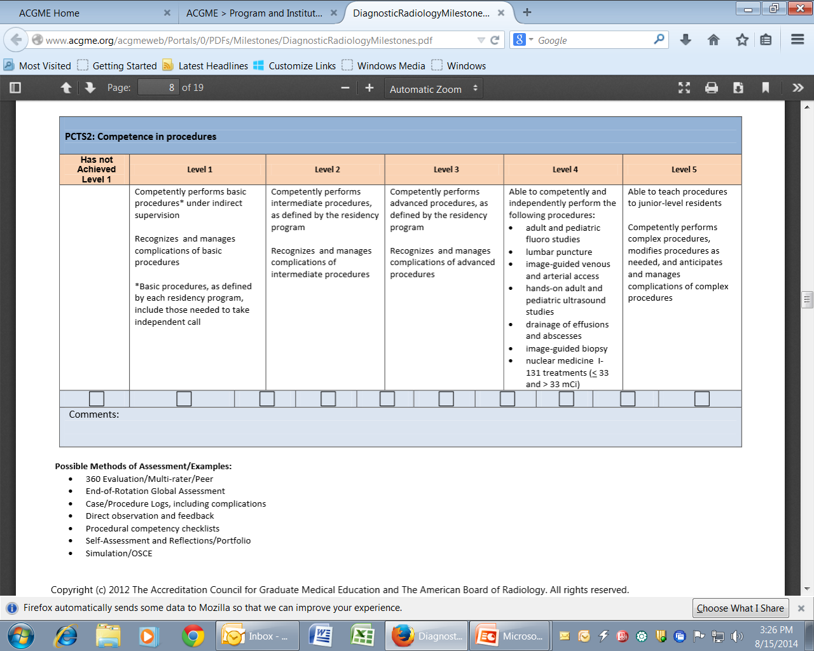
Radiology
Notes:
Novice to expert

Slide 9
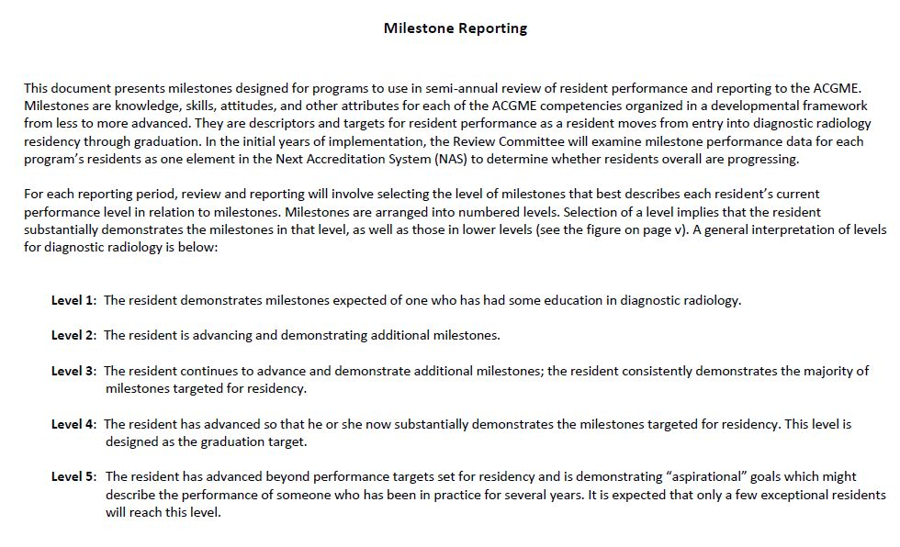

Slide 10
Internal Medicine
Notes:
A general interpretation of each column for internal medicine is as follows:
Critical Deficiencies: These learner behaviors are not within the spectrum of developing competence. Instead they indicate significant deficiencies in a resident’s performance.
Column 2: Describes behaviors of an early learner.
Column 3: Describes behaviors of a resident who is advancing and demonstrating improvement in performance related to milestones.
Ready for Unsupervised Practice: Describes behaviors of a resident who substantially demonstrates the milestones identified for a physician who is ready for unsupervised practice. This column is designed as the graduation target, but the resident may display these milestones at any point during residency.
Aspirational: Describes behaviors of a resident who has advanced beyond those milestones that describe unsupervised practice. These milestones reflect the competence of an expert or role model and can be used by programs to facilitate further professional growth. It is expected that only a few exceptional residents will demonstrate these milestones behaviors.
For each ACGME competency domain, programs will also be asked to provide a summative evaluation of each resident’s learning trajectory.

Slide 11
Surgery

Slide 12
Milestone Development – What?
Graduation “targets” not “ requirements” marking transition from GME into lifelong learning and Maintenance of Certification (MOC)
Some are “Aspirational”

Slide 13
Milestone Development – Who?
Specialty specific milestones working groups and some advisory groups
Separate working group for core program and each dependent fellowship program

Slide 15
Milestone Development Value
Behavior anchors Program Directors (PDs) can use to assess trainees-assure achievement of required skills and attributes
Help guide curriculum development
Indicator of how good the teaching is – did trainees learn what we thought we taught them

Slide 16
Milestone Development Value
Allows extension of “cycle length” – key component of the Next Accreditation System (NAS)
Allows more objective feedback to trainees
Allows early identification of trainee having trouble – “no trainee left behind”

Slide 17
Milestone Development How Can Programs Adapt?
PD appoints Clinical Competency Committee (CCC)
Team based activity
Notes:
Using a committee will increase the chances for a more balanced evaluation of each resident

Slide 18
Notes:
CCC

Slide 19
Clinical Competency Committee
V.A.1.a At a minimum CCC must be composed of 3 members of the program faculty
V.A.1.a.(1) Others eligible for appointment to the committee include faculty from other programs & non-physician members of the health care team if they are program faculty
Notes:
Radiation physicist
Clinical psychologist

Slide 20
Clinical Competency Committee
V.A.1.b There must be a written description of the responsibilities of the CCC
V.A.1.b.(1) The Clinical Competency Committee should:

Slide 21
Clinical Competency Committee
V.A.1.b.(1).(a) Review all resident evaluations semi- annually
V.A.1.b.(1).(b) Prepare and assure the reporting of milestones evaluation of each resident semi-annually to ACGME
V.A.1.b.(1).(c) Advise the PD regarding resident progress, including promotion, remediation, and dismissal

Slide 22
Clinical Competency Committee Composition
Size and makeup depends on program size and complexity
Program Coordinators (PCs) should be “support only” not voting members
Residents-under active discussion by ACGME
Notes:
One size doesn’t fit all!
Residents- NOT PEERS can include extra year chief resident??
Chief residents may attend CCC meetings if they have completed a core residency program in their specialty discipline, possess a faculty appointment from the program, and are eligible for specialty board certification. They cannot be members of the CCC.”
the August 2014 updated FAQ on the ACGME website under the Milestones link

Slide 23
Clinical Competency Committee Composition
Broad representation of sites and divisions
Senior and junior faculty
My own program’s experience
Notes:
One size doesn’t fit all!
My program experience:
40 resident 10 members with membership of all 10 divisions
Split equally between 2 campuses
Senior faculty and engaged junior faculty
PD and 2 PCs and physicist

Slide 24
Clinical Competency Committee Composition
Should program Director chair the CCC?
ACGME not prescriptive
Anesthesia – NO!! (ABA rule)
My program – Yes
Depends on personality of PD – must be a facilitator and NOT monopolize the discussion

Slide 25
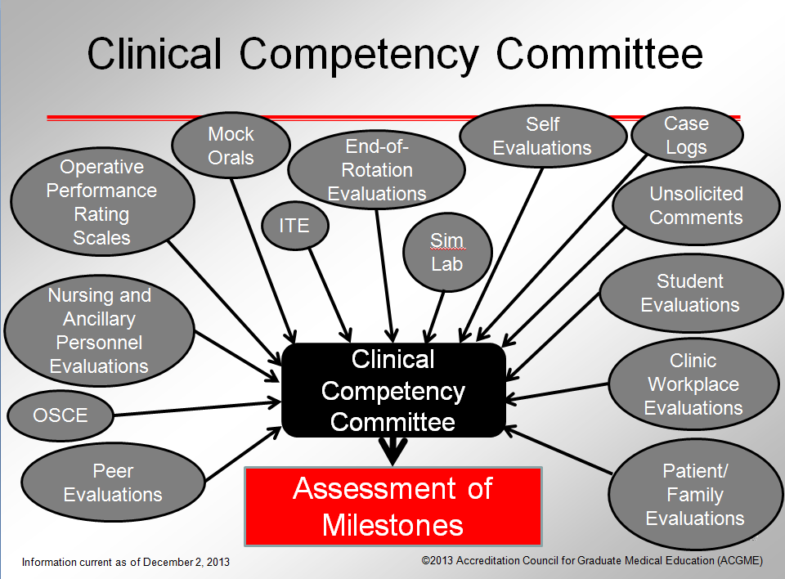
Clinical Competency Committee Function
Notes:
Review all data elements/evaluations that relate to the milestones

Slide 26
Clinical Competency Committee Function
Does committee have to discuss each trainee at length?
One process doesn’t fit all: large core program vs. small fellowship program
ACGME estimates 60-90 minutes per resident

Slide 27
Clinical Competency Committee Function
My program’s experience
40 residents x 90 minutes x 11 faculty = 660 faculty hours
Pre review of each resident by a team of 2 reviewers
Each team creates consensus report on every assigned resident
All data coordinated by Program Coordinators
Notes:
82 8 hr days= 4 months

Slide 28
Clinical Competency Committee Function
My program’s experience
Consent agenda- brief presentation and discussion of residents without issues
In-depth discussion of residents with issues as identified by team or any committee member
Key: team members must have worked with assigned resident during evaluation period
Key: ALL residents are discussed by CCC

Slide 29
Clinical Competency Committee Time Commitment
My program’s experience
Committee members – pre-work ~10 hours over 2 weeks
Committee meetings – two 90 minute meetings each cycle
Milestone reporting periods
Nov 1- Dec 31
May 1 – June 15

Slide 30
Clinical Competency Committee Time Commitment
My program’s experience – PD
~ 20 hours for each cycle
Nag all faculty and residents to turn in all required evaluation data
Nag each team to finalize consensus reports
Review all consensus reports before CCC meeting
Organize meeting and agenda
Review final milestone levels for accuracy before submitted to ACGME
Notes:
Review final milestone levels for accuracy before submitted to ACGME—STRESS THIS!!!

Slide 31
Clinical Competency Committee Time Commitment
My program’s experience – PC
~ 24 hours total for 2 PCs for each cycle
Gather and coordinate all data elements
Distribute to and collect data/consensus reports from each CCC team
Prepare for meeting
Coordinate final milestone results
Enter milestone levels into ACGME website

Slide 32
Hover mouse over radio-buttons to show narratives
Selects appropriate protocols and contrast agent/dose for intermediate imaging as defined by the residency program

Slide 33
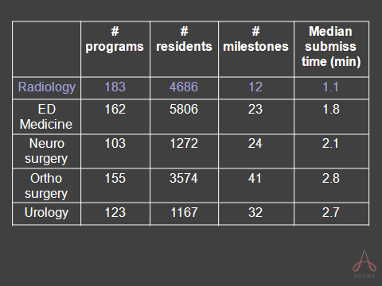

Slide 34
Milestone Development How Can Programs Adapt
Engage and rely on CCC
Review Program Requirements (PRs) & Milestones document with CCC
Discuss process to be used with CCC
Define evaluation tools to be used for each milestone

Slide 35
Milestone Development How Can Programs Adapt
Educate the faculty
Educate the residents
Review each Milestone with all the program’s faculty and residents
What they mean
What evaluation tools will be used
Educate them AGAIN and AGAIN!

Slide 36
Milestone Development How Can Programs Adapt
Adapt current evaluation tools
Create and adopt new evaluation tools
Standardize how all CCC members assign appropriate milestone levels – BE EXPLICIT
Notes:
Adapt current evaluation tools—EG New Innovations
Create and adopt new evaluation tools-program creates own, use those from Prog Dir society or College

Slide 37
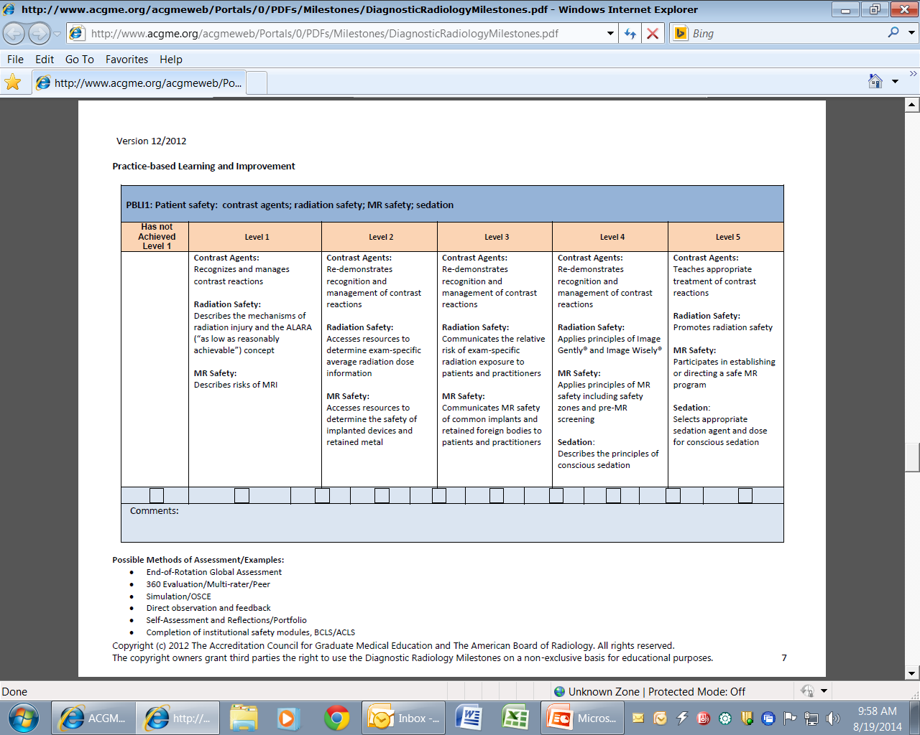
Notes:
Contrast- Simulation
Rad/MRI safety created a 3 institution on line MRI and rad safety test
Sedation- on line hosp module

Slide 38
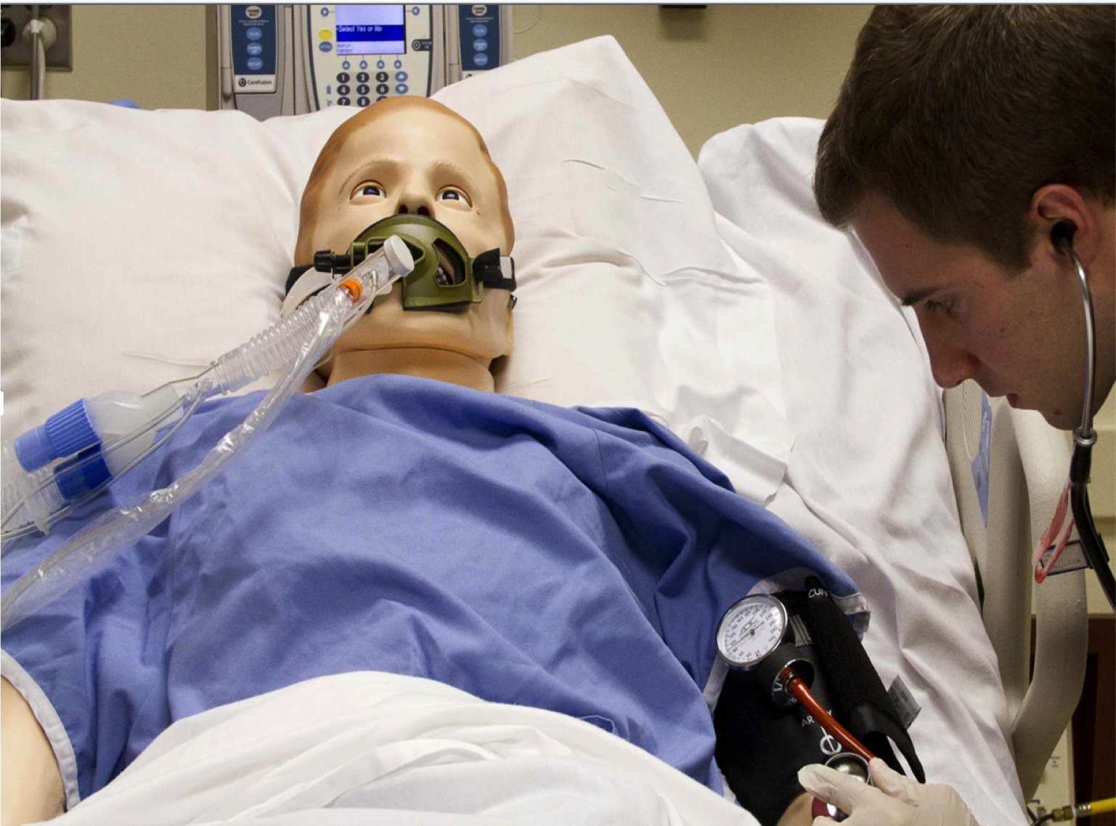
Notes:
Contrast- Simulation
Rad/MRI safety created a 3 institution on line MRI and rad safety test
Sedation- on line hosp module

Slide 39
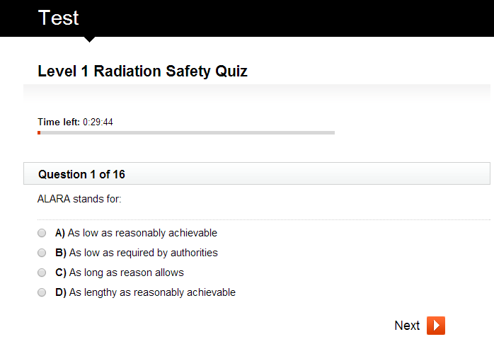
Notes:
Contrast- Simulation
Rad/MRI safety created a 3 institution on line MRI and rad safety test
Sedation- on line hosp module
MY DATA

Slide 40
Notes:
Contrast- Simulation
Rad/MRI safety created a 3 institution on line MRI and rad safety test
Sedation- on line hosp module

Slide 41
Milestone Development What do the Programs Get Back
Narrative description of each resident’s milestone accomplishments
Eventually graphical depiction of where each resident stands compared to peers
National normative data will take years
Notes:
Spider graphs

Slide 42
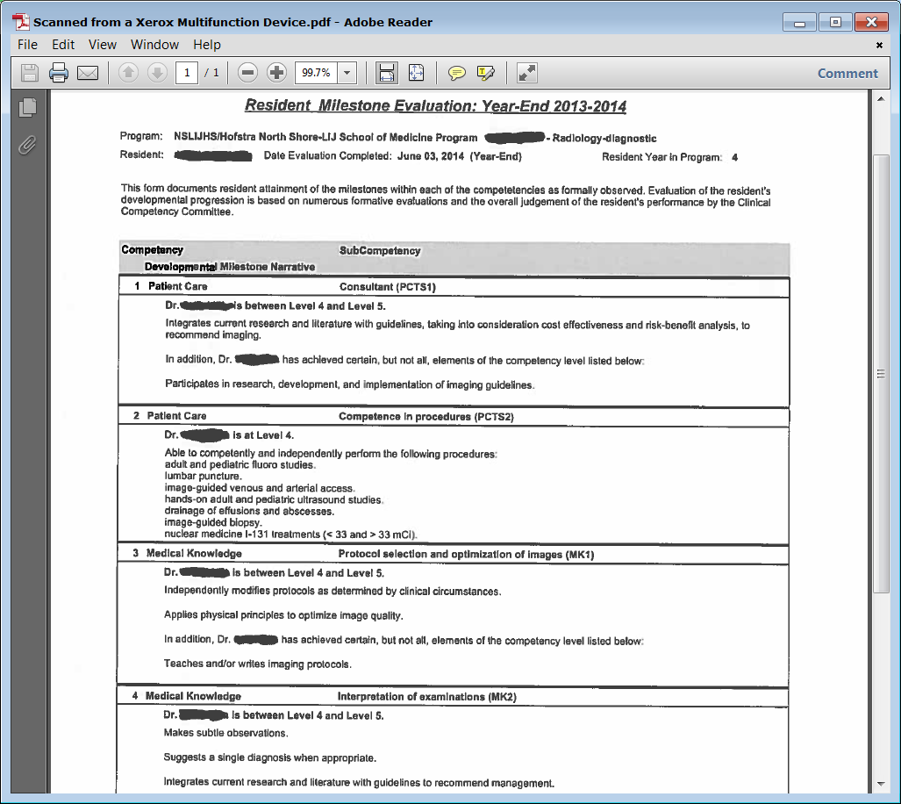

Slide 43
Milestone Data What the RRC Does
Residency Review Committee (RRC) will not “DING” a program if residents don’t all meet milestone expectations
Enter data accurately
RRC expects to see individual residents in ALL programs not meeting all milestone expectations

Slide 44
Milestone Data What the RRC Does
RRC will expect to see progress on milestone attainment of programs trainee cohort over time
For residents who are below expectation, it is the program’s responsibility to work with them and help them attain appropriate milestone level
RRC will NOT take adverse action solely on the basis of milestone report

Slide 45
Singapore End of PGY-1, Mid PGY-2 Year Evaluation,
Overall Rating of Patient Care and Technical Skills
across All Specialties
Expert
Proficient
Competent
Advanced
Beginner
Novice
n=122 paired observations
(100%)
Increase the Accreditation Emphasis on Educational Outcomes
Notes:
ACGME data

Slide 46
Singapore Milestone Data, End of PGY 1 to Mid Year PGY 2 All Specialties (n=122, 100%)
Professionalism Communications Med Knowl Pt Care/Tech Sk PBLI SBP
Notes:
ACGME data

Slide 47
Milestone Project - Summary
Major change from subjective to outcomes based objective evaluation process
Helps guide curriculum development and assess quality of instruction
Allows objective feedback to trainee
Allows early identification of trainee in trouble
Notes:
assess quality of instruction- objective measure—did they learn what we thought we taught them

Slide 48
Milestone Project - Summary
Team based activity – rely on CCC
Process details depend of size and complexity of program
Adapt current and create and adopt new evaluation tools
Educate faculty and trainees
Educate CCC members

Slide 49
Partners’ Online Education
Upcoming Live Webinars
The IOM Report
Thursday, October 23, 2014
12:00 pm – 1:00 pm EST
Unified Accreditation System
Thursday, October 30, 2014
12:00 pm – 1:00 pm EST
“Meet the Experts” – Fall Freebie
Thursday, November 6, 2014
12:00 pm – 1:00 pm EST
Annual Institutional Review (AIR)
Tuesday, November 18, 2014
12:00 pm – 1:30 pm EST
Visit our website to see our full schedule!
www.PartnersInMedEd.com
On-Demand Webinars
How to Implement
Milestone Assessments
Introduction to GME for
New Program Coordinators
Navigating NAS: Keep Your
Eyes on the Dashboard
Annual Program Evaluation
Annual Institutional Review
GME Financing – The Basics
GMEC – What’s New?
Contact us today to learn
our Education Passports
can save you time & money!
724-864-7320

Slide 50
Partners in Medical Education, Inc. provides comprehensive consulting services to the GME community. For more information, contact us at:
724-864-7320
Info@PartnersInMedEd.com
www.PartnersInMedEd.com

