Slide 1
Working with the Struggling Learner Remediation, Probation, etc.
PARTNERS IN MEDICAL EDUCATION, INC.
Heather Peters, M.Ed., Ph.D.

Slide 2
Introducing Your Presenter…
Heather Peters, M.Ed, Ph.D
GME Consultant
GME Director & DIO
Seasoned speaker at ACGME & sub-specialty national meetings
Institutional and Program accreditation experience
3 decades in education; Masters of Education in curriculum & evaluations, PhD concentration in secondary education & adult learning theories

Slide 3
Webinar Goals
How to remediate the “difficult to remediate”
How to tie the remediation/probation to competencies
When to move from remediation to probation
What to do when you have a resident who is simply in the wrong specialty
Provide some additional diagnostic tools for struggling learners

Slide 4
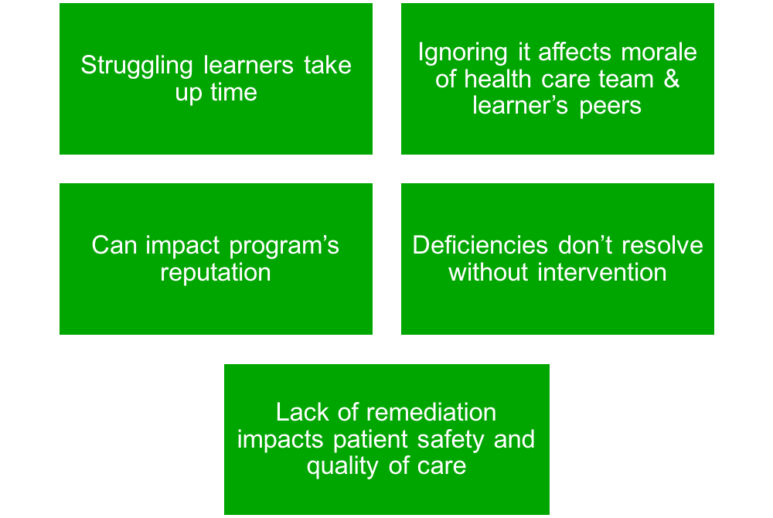
Importance of Learner Remediation
Our obligation is to educate all learners

Slide 5
Prevalence
17-20% of medical trainees will experience difficulty during residency due to learning/behavior issues
50% will seek help
How do we reach the other 50%?

Slide 6
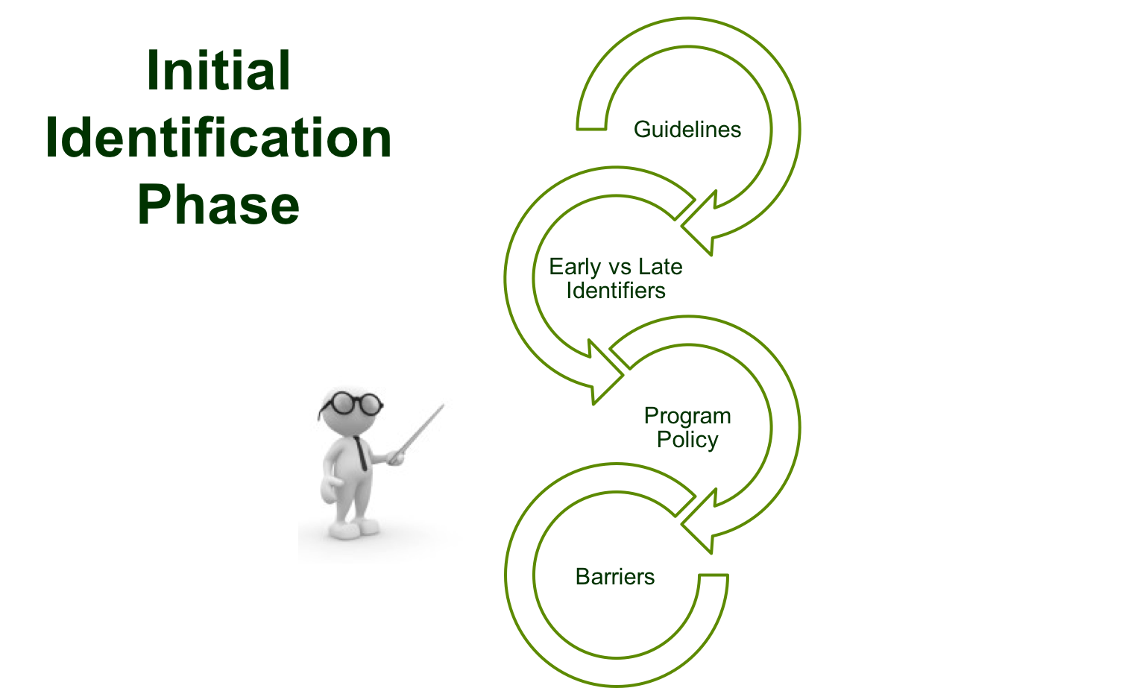

Slide 7
Initial Identification Phase Guidelines
Beginning of residency -- focused observation time for all residents
Review meeting in the first few months of residency
Evaluations in the first few months of residency are maybe the most important
Instruct chief residents on how to spot deficits for the purpose of support, not remediation
Tools
“Presenting Behavior Aligned with Competencies”
“Alarm Bells for Trainees”

Slide 8
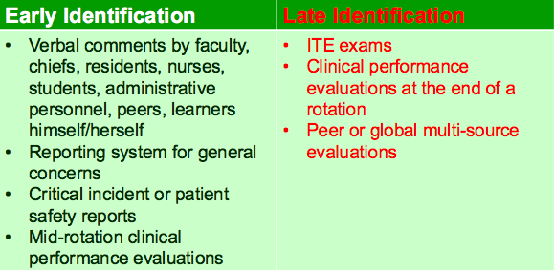
Common Identifiers during Initial Identification Stage

Slide 9
60%

Slide 10
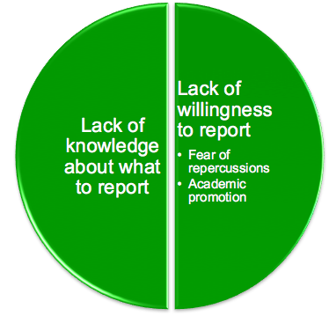
Faculty-Faculty-Faculty

Slide 11
Policy Issues to Consider
Program policy for remediation and probation deal with early identification of issues?
Section in your faculty manual that discusses early identification of struggling learners?
NOTE: Remember to align institutional and program policies for remediation and probation.

Slide 12
Period of Educational Support (Observation)
We have determined that there might be issues, now what….

Slide 14
Educational Interview
Private and confidential
Not one evaluates or makes promotion decisions
Inform about where this information will go
Areas to cover:
Medical knowledge (USMLE)
Learning styles
Time management
Interpersonal skills
Past learning experiences (undergrad, medical school)
If the resident is willing, discuss the following (needs to be conveyed that this is optional):
Diagnosed learning differences
Medications that might interfere with focus and concentration
Family history of learning differences
Counseling history

Slide 15
Using Competencies
Use tools provided to see which presenting behaviors are indicative of certain competencies
Presenting Behavior Aligned with Competencies
Alarm Bells for Trainees

Slide 16
Assess Self-Awareness
Assessing self-awareness will guide your support plan
Learners with limited or no self-awareness will be more difficult to support:
Use a “friend”
Comparison (self vs attending/chief resident)
Well-being Committee

Slide 17
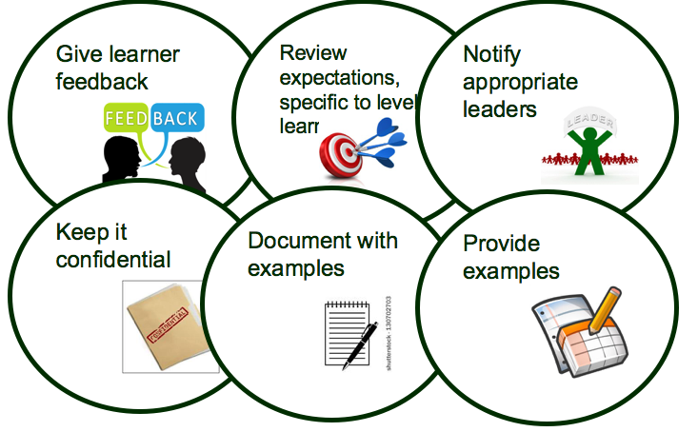
Responsibilities of Educators

Slide 18
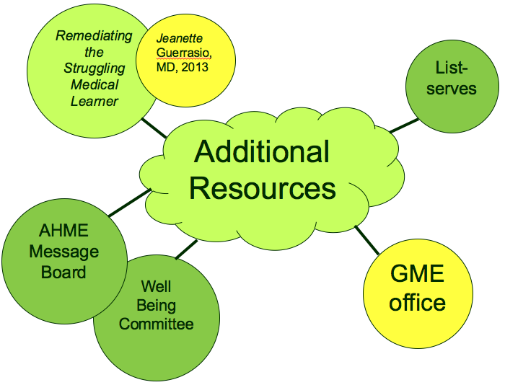

Slide 19
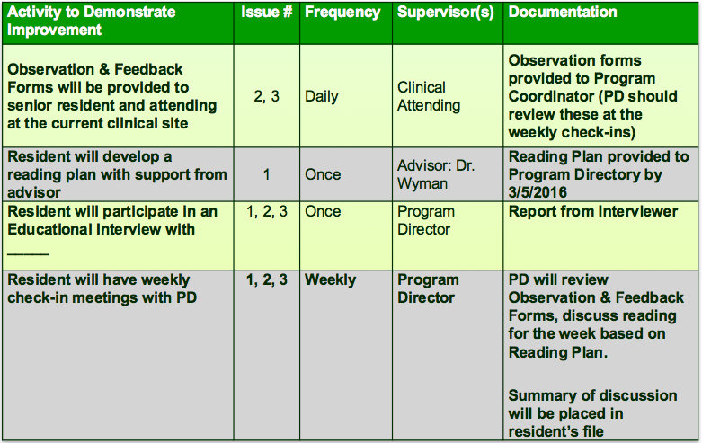
Sample Improvement Plan

Slide 20
Time for Probation?
These situations might mean it’s time for probation:
Learner working at his/her capacity and not making significant progress
Career change indicated?
Learner is not interested in remediation
Egregious reasons that are outlined in your institutional policies
Straight to Probation
Non-compliant with treatment of a severe psychiatric disorders or substance abuse
Mental health or physical health problem that makes them unfit for duty.

Slide 21
Upcoming Live Webinars
Special Review:
Required and Useful
Thursday, June 23, 2016
12:00pm – 1:00pm EST
Osteopathic Recognition
Thursday, July 7, 2016
12:00pm – 1:00pm EST
Fatigue Management & Mitigation
Thursday, July 28, 2016
12:00pm – 1:00pm EST
Milestones to EPAs
Tuesday, August 2, 2016
12:00pm – 1:00pm EST
www.PartnersInMedEd.com
Partners® Snippets
On-Demand Webinars
GMEC Check-Up: Is your GMEC
meeting its responsibilities?
Self-Study Visits
Introduction to GME for
New Program Coordinators
Milestones & CCCs
GME Financing – The Basics
Single Accreditation System
The IOM Report
Contact us today to learn
how our Educational Passports can save you time & money!
724-864-7320

Slide 22
Partners in Medical Education, Inc.
provides comprehensive consulting
services to the GME community.
Heather Peters, M.Ed., Ph.D.
724-864-7320 | Heather@PartnersInMedEd.com
www.PartnersInMedEd.com

Slide 23
Deficits By Stage

