Slide 1
Preparing for the Ten Year Site Visit

Slide 2
Introducing Your Presenter
Amy Lefkovic, MHA
Received her Bachelors Degree in Health Information Management from Kean University
Began her career in Graduate Medical Education (GME) at Hospital for Special Surgery as the Radiology Fellowship Program Coordinator
Received her Masters degree in Healthcare Administration from Seton Hall University
Continued her career in GME at Lutheran Medical Center as the OB/GYN Residency Coordinator
Is currently the Manager of GME and Academic Affairs at Staten Island University Hospital

Slide 3
Goals and Objectives
To review the requirements of the 10 year accreditation site visit.
To review the process for the site visit preparations and how to expand upon them.
To examine ways in which to prepare for your programs 10 year accreditation site visit prior to your notice.

Slide 4
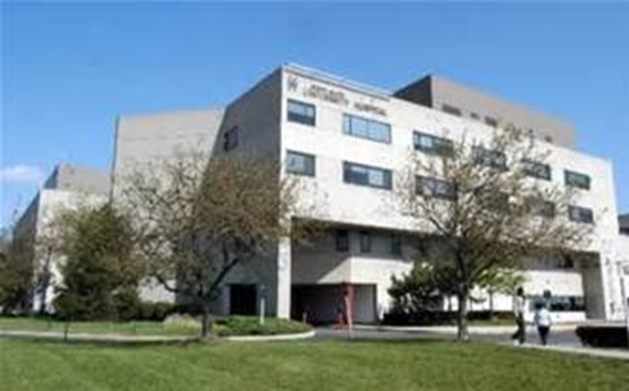
Staten Island University Hospital Northwell Health
Northwell Health
315 residents and fellows
16 programs

Slide 5
10-Year Accreditation Site Visits
All Sponsoring Institutions and programs undergo a full accreditation site visit every 10 years. This is preceded by a comprehensive Self-Study process that includes a description of how the Sponsoring Institution or program creates an effective learning and working environment, and how this leads to desired educational outcomes.

Slide 6
10-Year Accreditation Site Visits
For the Self-Study, programs are also asked to review their aims and conduct an analysis of strengths, areas for improvement, external opportunities, and threats, and to formulate and document plans for improvement.

Slide 7
10-Year Accreditation Site Visits
The 10-Year Accreditation Site Visit is scheduled at least 24 months after the program has completed its Self-Study and submitted its Self-Study Summary.
The minimum notice for all announced site visits is approximately 30 days. Notice may be less than 30 days if a site visit is required to meet a Review or Recognition Committee meeting deadline
The 10-Year Accreditation Site Visits for subspecialty programs will be coordinated with the visit of their respective core program.

Slide 9
Reminder!
In preparation for the site visit, Self-study already completed.

Slide 10
Eight Steps to Prepare for the 10-Year Accreditation Site Visit
Reassemble the Annual Program Evaluation/Self-Study Group to “Harvest” the data in areas for improvement identified in the Self-Study.
Discuss improvements made as a result of the self-study with stakeholders.
Reassess program aims and other elements of the program's strategic assessment (strengths, opportunities and threats).

Slide 11
Eight Steps to Prepare for the 10-Year Accreditation Site Visit
4. Discuss program aims, improvements achieved,
and other elements of the programs strategic
assessment with program stakeholders.
5. Complete and submit summary of achievements.
6. Update data in Accreditation Data System (ADS).
7. Ensure timely data submission prior to the site
visit.
8. Set and confirm logistics of the site visit.

Slide 12
1. Reassemble the Annual Program Evaluation/Self-Study Group
Time in between is deliberate
Remind them of what was done
Inform them of the site visit
Re-analyze the data
Should be done throughout the year
On faculty agenda’s

Slide 13
2. Discuss improvements made as a result of the self-study with stakeholders
Review improvements made
Perhaps incorporate a PDCA cycle if not done so already
Stakeholders, is this really happening?
If done correctly this wont be a surprise

Slide 14
3. Reassess program aims and other elements of the program's strategic assessment (strengths, opportunities and threats).
Changes?
Still a strength, opportunity or threat?
Perhaps went from threat to opportunity

Slide 15
Aims
Hospital-based or community-based practices for the future
Type of residents
Research aims
Quality improvement aims
Alignment with hospital wide aims

Slide 16
Aims Cont.
Short and to the point
Not explaining how to in the aim
Examples:
Provide a comprehensive 3 year curriculum to enable residents to learn tertiary, secondary, and primary care skills in all settings
Educate residents to be excellent practitioners of medically directed anesthesiology in an Anesthesia care team model
Produce excellent, independent practitioners who will be local and national leaders, and for academic careers.

Slide 17
4. Discuss program aims, improvements achieved, and other elements of the programs strategic assessment with program stakeholders
Deja Vu
Another opportunity to have an improvement-focused conversation about the program
Spread beyond just those stakeholders
Most important people to ask???

Slide 18
I would like to add!!
Rumors!
Documents are still alive
Print
Easy to find
Label
Binders

Slide 19
Review of documents

Slide 20
5. Complete and submit summary of achievements
The Summary of Achievements must be completed and uploaded through the Accreditation Data System (ADS) a minimum of 12 days prior to the 10-year accreditation site visit date
Make sure discussed and finalized
Time is up!
Don’t wait until step 5, utilize in step 1

Slide 21
Summary of Achievements Review

Slide 22
6. Update data in Accreditation Data System (ADS)
Only three sections of ADS program data can be updated
current responses to any citations
the open text section entitled “Changes and Other Updates”
a current block diagram that accurately reflects the program.
Punctuation
Grammar
Accuracy
Full sentences

Slide 23
6. Update data in Accreditation Data System (ADS)
If asked for a certain word count don’t exceed but base answer around it
Your lifeline
Major changes…always answer or get a citation
Any updates or changes made after that date will not be reflected in the documents available to the site visitor or the Review Committee reviewers

Slide 24
7. Ensure timely data submission prior to the site visit
The Summary of Achievements, and for any updates, the Self-Study Summary Update, must be submitted via ADS a minimum of 12 days before the 10-year accreditation site visit
Another tip?

Slide 25
8. Set and confirm logistics of the site visit
Interview 12 to 18 peer-selected residents or fellows during the site visit
The 10-year accreditation site visit for a core program will take a half to a full day, depending on the size of the program, while the visit for a subspecialty program generally will require less time

Slide 26
Review of agenda

Slide 27
Day of Preparations
Meet at main entrance
Security restrictions
Avoid getting lost
Inform ahead of time about any parking restrictions etc.
Ask about dietary restrictions
Ask about accommodations and give suggestions
Have cab number available for departure
Don’t provide what they don’t ask for – keep on side

Slide 28
What Happened?
Department of Academic Affairs driven
Wellness
Faculty development
Want program driven

Slide 29
Suggestions for Preparations
Faculty meetings
Provide education/information
Create/bring templates
Complete forms – don’t wait
Get started early!
Use your lifeline
TELL EVERYONE!!

Slide 30
Upcoming Live Webinars
Meet the Experts – Fall Freebie Thursday, November 21, 2019 12:00pm – 1:00pm EST
Jump Start Your GME Thursday, December 5, 2019 12:00pm – 1:00pm EST
Creating a Diverse Workforce Tuesday, December 17, 2019 12:00pm – 1:00pm EST
On-Demand Webinars
Special Reviews – Helpful not Hurtful
2019 CPR Part 3 of 4: Section IV & Section V
GME Is Not Just GME
SI 2025 Part 4 of 4: Strategic Planning
Understanding Practice Data
CPR 2019 Part 4 of 4: Putting It All Together
Crafting “Top Notch” Goals, Objectives and Evaluations
Feedback – From the Top Down
Evolving Resident Well-Being
We All Need Scholar Activity, Including Coordinators
NEW Faculty Development Series
15 Minutes to Effective Feedback
Toolbox for Teaching Millennials
Taking Supervision to the Next Level
Contact us today to learn how our Educational
Passports can save you time & money!
724-864-7320
www.PartnersInMedEd.com
30

Slide 31
Partners in Medical Education, Inc. provides comprehensive consulting services to the GME community.
Partners in Medical Education
724-864-7320 | info@PartnersInMedEd.com
Amy Lefkovic, MHA GME Consultant
Amy@PartnersInMedEd.com
www.PartnersInMedEd.com

