Slide 1
Partners Webinar Alert
Reminder…Because of the amount of individual logins for this webinar. Please DO NOT Unmute your Microphone after you enter this webinar.

Slide 2
Recognizing & Addressing Precursors of Burnout: The Value of Shame Resiliency Training to Support Resident Well-Being
Amie Langbein, DO, PCC, CDWF
The Story Doc

Slide 3
Introducing Your Presenter…
Amie Langbein, DO, PCC
Board-certified Family Physician
Executive and Leadership Professional Coach
Transformational Wellness Coach for Healthcare Professionals
Certified Brené Brown DW Facilitator
Certified Conscious Business Coach
Visiting Lecturer Thomas Jefferson University Hospital
Faculty Holy Family University School of Nursing and Allied Health Professions

Slide 4
Learning Objectives
Define shame and identify how it shows up and impacts medical trainees
Recognize the challenges of medical education that contribute to feelings of shame and burnout
Distinguish shame resiliency and resiliency
Understand why early intervention is critical
Introduce resilience exercises/tools to encourage resident well-being

Slide 6
A Whole New Doctor
Our aim is to support and empower medical students
The focus is on well-being
Provide skills to including resiliency building and leadership training
https://www.statnews.com/2019/03/25/coaching-leadership-training-avoid-burnout-medical-students/

Slide 7
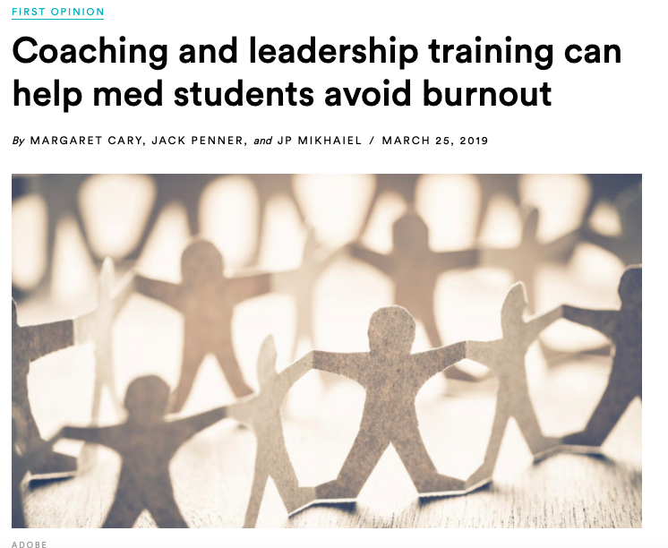

Slide 8
A New Kind Of Doctor
Create a culture of confidential, safe disclosure for challenges
Identify solutions to improve learning environments for residents
Support time for personal growth and connection
Make wellness a part of residency culture and vocabulary
Develop recurring, longitudinal wellness curriculums; building skills, such as resilience, mindfulness, and empathy

Slide 9
Intern Wellness Initiative Pilot
Peer to peer experiential groups quarterly focusing on challenges unique to the intern experience
Combined Conferences presentations focusing on personal growth and increasing emotional durability
Remote Professional Development Coaching

Slide 11
Physician Well-Being
“Psychological, emotional and physical well-being are critical in the development of competent, caring, and resilient physicians and require proactive attention to life inside and outside of medicine.”
FamMed. 2019;52(8):670-6.)doi:10.22454/FamMed.2019.899425

Slide 12
Physician Well-Being
“Emphasizing physician well-being in residency is especially important as work habits and patterns surrounding self-care begin to solidify around this time.”
There are concrete ways to teach and enhance resiliency
FamMed. 2019;52(8):670-6.)doi:10.22454/FamMed.2019.899425

Slide 13
Alarming Statistics
30% Medical Students are Depressed
11.1% Medical Students with Suicidal Ideation
42%-53% Physicians are Burned Out
45.2 % RESIDENTS EXPERIENCE BURNOUT BY THEIR 2ND YEAR

Slide 14
Resident Burnout
Nearly 1/3 first year residents PRIOR to starting their internships experience burnout
They exhibit lower levels of mindfulness and
COPING SKILLS
Higher levels of depressive symptoms, fatigue, worry and stress
AcadPsych.2017Apr;41(2):189-194.doi:10.1007/s40596-016-0628-6.

Slide 15
Consequences of Burnout
Decreased productivity
Unprofessionalism
Decreased Empathy
Lower medical knowledge
Higher attrition
Suicidal ideation
Alcohol or drug dependence
Relationship stress
FamMed. 2019;52(8):670-6.)doi:10.22454/FamMed.2019.899425

Slide 16
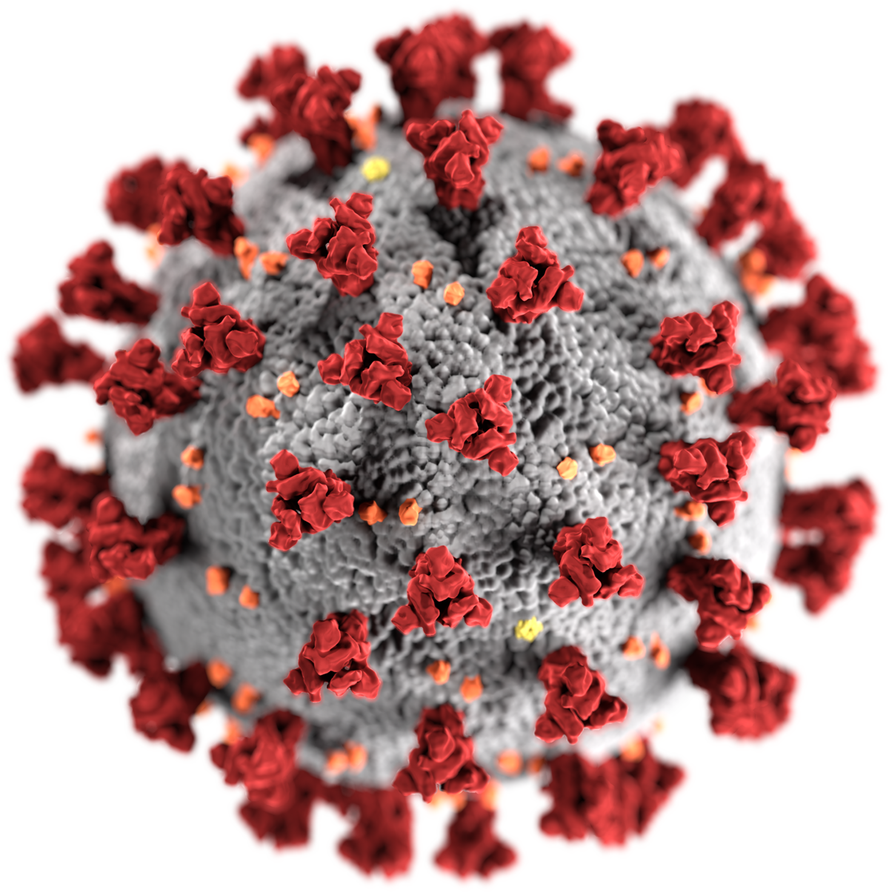
COVID-19
Anger
Fear
Anxiety
Life, death and suffering
Lack of PPE
Changing responsibilities
Distance from loved ones
Guilt

Slide 17
Addressing Burnout by Fostering Well-Being
NO easy one size fits all fix
Problem is multifactorial - systemic, organizational, cultural and individual
Today we will we talking mostly about individual ways to cultivate wellness through awareness of the feelings, challenges and struggles trainees encounter

Slide 18
“What you do makes a difference and you have to decide what kind of difference you want to make.”

Slide 19
“Shame is the intensely painful feeling or experience of believing that we are flawed and therefore unworthy of love, belonging and connection” Brené Brown
This Photo by Unknown Author is licensed under CC BY

Slide 20
Shame in Residency
“I’m not good enough”
“Do I even belong here?”
“I can’t do what looks so easy for my fellow residents”
”I’m the stupidest one here”
“I think they made a mistake accepting me”
“I’m afraid I’m going to kill someone”
“ Is this even the right career for me?”

Slide 21
Shame + Resilience
Shame: shows up as feelings of inadequacy- “NOT GOOD ENOUGH, SMART ENOUGH, DEDICATED ENOUGH, STRONG ENOUGH”
The first step to challenging this mindset is awareness that shame exists
Resilience: how well we adapt to challenging circumstances and get back up after setbacks
Resilience can be learned and creates a sense of control

Slide 22
Why Shame Resilience Matters
Awareness of shame in residents gives them a new lens to view adversity and challenges
In doing so, they can evaluate and cultivate coping mechanisms to thrive as resilient individuals
Foster connection with peers in the medical community
Help them find fulfillment in their work
Enable them to develop self-care practices and coping strategies to engage with uncertainty
ReprodHealth.2018Mar27;15(1):53.doi:10.1186/s12978-018-0489-4

Slide 23
Resilience Toolbox
Resilience as a “toolbox”
Using “tools” to cope

Slide 24
Mental Models of Shame + Resilience
“When something bad happens it means I’m not good enough”
“I see my missteps as failures and failure is unacceptable.”
“Challenges hold opportunities to grow and learn”
“I bounce back from difficult situations by leaning on my support group or recharging myself by doing things that I love.”

Slide 25
Idealized vs. Unwanted Identities
Notes:
.

Slide 26
Manifestations of Shame in Residency
Feelings of incompetence
Not feeling qualified
Personalizing negative feedback
Not knowing answers
Covering up mistakes
Lack of balance
Failing exams

Slide 27
Feelings of Shame Can Be Correlated With:
Burnout
Anxiety
Depression
Eating Disorders
Suicide
Violence
Bullying
Addiction

Slide 28
Self-Talk Matters
Shame
Guilt

Slide 29
Shame is:
I am bad -
The focus is on the self

Slide 30
Guilt is:
I did something bad -
The focus is on the behavior

Slide 31
Why Recognizing Shame and Guilt in Medicine Matters
Shame is associated with feelings of inadequacy, altered ability to be empathic, increased anxiety and diminished capacity to forgive ourselves
Guilt is associated with the ability to see other perspectives, enhanced self-compassion and empathy, and overall wellbeing

Slide 32
“My dear young colleague, you are not a fraud. You are a flawed and unique human being with excellent training and an admirable sense of purpose. Your training and sense of purpose will serve you well. Your humanity will serve your patients even better.”
-Susan Koven MD,
Harvard Medical School

Slide 33
Imposter Syndrome
Pervasive feeling of self doubt, insecurity, or fraudulence despite overwhelming evidence to the contrary
It strikes smart, successful individuals
It often manifests after an especially notable accomplishment (e.g., getting into a residency, winning an award, earning a promotion)

Slide 34
It’s estimated that 70 % of people will experience at least one episode of Imposter Syndrome in their lives.
Sakulku, J. Alexander, James. International Journal of Behavioral Science 2011. Vol. 6 No. 1, 75-97

Slide 35
We cannot pour from an empty cup

Slide 36
Talk to a Friend Exercise
How would I talk to a friend who has made a mistake?
How do I talk to myself when I make a mistake?

Slide 37
Self Compassion
Self Kindness: when I mess up, do I talk to myself like I talk to someone I love
Common Humanity: Our struggles are everyone’s struggles. We are not alone
Mindfulness: awareness that things change and what is present right now might not be here in a few minutes, a few days, or forever
www.selfcompassion.org

Slide 38
Opportunities to Create Meaning from Experiences
“During my most trying months of medical school, I met every Sunday evening with three friends. Phones off, lights dim, wine glasses full. We shared the most challenging and most rewarding moments of our weeks. These conversations helped each of us glean — or perhaps create — meaning in challenging, sometimes traumatic, experiences: the death of a child we’d cared for; abusive language from a superior; the guilt of committing a medical error.”
Dhruv Khullar, MD
https://www.nytimes.com/2018/01/01/upshot/finding-purpose-for-a-good-life-but-also-a-healthy-one.html

Slide 39
Empathy Experience Example
Each person write down one concern or stressor they have about their work
Collect the cards, shuffle and redistribute the cards. Everyone should get someone else’s card
Have everyone read the card they now have out loud

Slide 41
Resilience Resume Example
Write down a list of goals or accomplishments that you’ve reached in spite of challenges or obstacles you’ve encountered
Keep this list accessible, to remind and energize yourself as you confront new challenges

Slide 42
“The human mind is automatically attracted to the worst possible case, often very inaccurately.”
Dr. Martin Seligman

Slide 43
Fear vs. Trust Based Thinking
“The ICU is a challenge for me, but I am really good in the office with patients.”
“I’m very good in real life situations but have trouble with standardized tests.”
“I’m the only resident who can’t seem to cut it in the ICU.”
“I feel stupid because I failed the COMLEX 3 exam.”

Slide 44
Put it in Perspective Example
Ask yourself, what is the worst possible situation?
Force yourself to consider the best possible outcome
Now, consider what’s most likely to happen
Develop a plan for the most realistic situation
Based on the work of Dr. Martin Seligman

Slide 45
3-Minute Mental Makeover
Write down 3 things you are grateful for
Write down the story of your life in 6 words
Write down 3 wishes
Write down 3 commitments you want to make to yourself today
ThoeleDG,PermJ2020;24:19.056 DOI:https://doi.org/10.7812/TPP?19.056

Slide 46
Wellness Education
Create communities of connection
Practice empathy
Build agency/control through resiliency training
Talk about “purpose”
Let residents know THEY MATTER

Slide 47
Wellness Education
Essential curriculum should begin early
Be longitudinal
Identify a champion
Provide support for self disclosure of struggles
FamMed. 2019;52(8):670-6.)doi:10.22454/FamMed.2019.899425

Slide 48
Antidote to Shame is Empathy
Shame leads to isolation, separation, feelings of being stuck and powerlessness
Empathy leads to courage, connection and compassion

Slide 49
“Empathy has no script. There is no right or wrong way to do it. It’s simply listening, holding space, withholding judgment, emotionally connecting and communicating that incredibly healing message of: You’re not alone.”
Brené Brown

Slide 50
Resources
https://www.medscape.com/slideshow/2020-lifestyle-burnout-6012460#2
JAMA.2016;316(21):2214-2236.doi:10.1001/jama.2016.17324
JAMA. 2018;320(11):1114-1130. doi:10.1001/jama.2018.12615
FamMed. 2019;52(8):670-6.)doi:10.22454/FamMed.2019.899425
AcadPsych.2017Apr;41(2):189-194.doi:10.1007/s40596-016-0628-6
Koven,S. Letter to a Young Female Physician. N Engl J Med 2017: 376:1907-1909. doi:1.1056/NEJMp1702010
Brené Brown. June 2010. The Power of Vulnerability. Retrieved from http://www.ted.com
Santos, Laurie. (2020, April 16. The Happiness Lab Podcast: Bonus: Helping the Helpers.
Seligman, M. (2011). Flourish: A Visionary New Understanding of Happiness and Well Being. Free Press.
https://www.nytimes.com/2018/01/01/upshot/finding-purpose-for-a-good-life-but-also-a-healthy-one.html
ThoeleDG, Healthcare Practitioners and Families Writing Together: The Three Minute Mental Makeover. Perm J 2020;2419.056. DOI:https://doi.org/10.7812/TPP/10.056

Slide 51
Questions??
51

Slide 52
Upcoming Live Webinars
Working with your IRB Thursday, June 4, 2020 12:00pm – 1:00pm EST
Digging for Data 102 Tuesday, June 11, 2020 12:00pm – 1:00pm EST
Demystifying Diversity Tuesday, July 7, 2020 12:00pm – 1:00pm EST
Faculty Development Planning: Sponsoring Institution Role Thursday, July 16, 2020 12:00pm – 1:00pm EST
Latest On-Demand Webinars
Creating a Diverse Workforce
APE Reconstructed
Digging for Data 101
PEC: Best Practices Research and Scholarly Process in a Nutshell: Getting Started Ask Partners – Spring Freebie Lessons Learned: Accepting Displaced Orphan Residents
Is your Coordinator Well Enough: Coordinators as Role Models of Wellness
Research Proposal Development: Tips for Success Working with your Governing Board
NEW Faculty Development Series
15 Minutes to Effective Feedback
Toolbox for Teaching Millennials
Taking Supervision to the Next Level
Contact us today to learn how our Educational
Passports can save you time & money!
724-864-7320
www.PartnersInMedEd.com
52

Slide 53
Partners in Medical Education, Inc. provides comprehensive consulting services to the GME community.
Partners in Medical Education
724-864-7320 | info@PartnersInMedEd.com
Amie Langbein, DO, PCC, CDWF
The Story Doc
thestorydoc.com
amiestorydoc@gmail.com
www.PartnersInMedEd.com

