Slide 1
Recruitment Strategies

Slide 2
Introducing Your Presenter
Amy Lefkovic, MHA
Received her Bachelors Degree in Health Information Management from Kean University
Began her career in Graduate Medical Education (GME) at Hospital for Special Surgery as the Radiology Fellowship Program Coordinator
Received her Masters degree in Healthcare Administration from Seton Hall University
Continued her career in GME at Lutheran Medical Center as the OB/GYN Residency Coordinator
Is currently the Manager of GME and Academic Affairs at Staten Island University Hospital

Slide 3
Goals and Objectives
To explore ways in which to determine what types of residents your program is looking for.
To determine how you will recruit these types of residents both before and during interviews.
To review the requirements of recruitment and interviews.

Slide 4
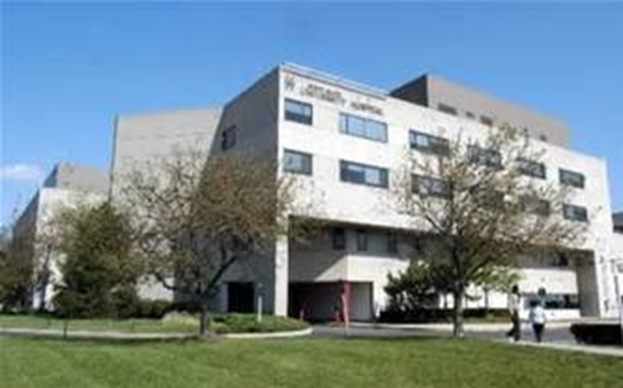
Staten Island University Hospital Northwell Health
Northwell Health
300 residents and fellows
16 programs

Slide 5
Common Interest
Best for hospital
Best for program
Best for trainees
Accrediting bodies
ACGME
Fellowship Council
CODA

Slide 6
Institutional Requirements
Take direction from accrediting bodies.
I.A.6. A written statement must document the Sponsoring Institution’s commitment to GME by providing the necessary financial support for administrative, educational, and clinical resources, including personnel, and which must be reviewed, dated, and signed at least once every five years by the DIO, a representative of the Sponsoring Institution’s senior administration, and a representative of the Governing Body.
Institutional Requirements
GME mission and vision.

Slide 7
Institutional Requirements
IV.A. Eligibility and Selection of Residents/Fellows: The Sponsoring Institution must have written policies and procedures for resident/fellow recruitment and appointment, and must monitor each of its ACGME-accredited programs for compliance.
IV.A.2. An applicant must meet one of the following qualifications to be eligible for appointment to an ACGME-accredited program:
I.V.A.2.a) graduation from a medical school in the United States or
Canada, accredited by the Liaison Committee on Medical
Education (LCME).
IV.A.2.b) graduation from a college of osteopathic medicine in the
United States accredited by the American Osteopathic Association
(AOA)

Slide 8
Institutional Requirements
IV.A.2.c) graduation from a medical school outside of the United States or Canada, and meeting one of the following additional qualifications:
IV.A.2.c).(1) holds a currently-valid certification from the
Educational Commission for Foreign Medical Graduates prior to
appointment (including a valid visa)
IV.A.2.c.(2) holds a full and unrestricted license to practice
medicine in a United States licensing jurisdiction in his or her
current ACGME specialty/subspecialty program

Slide 9
Self-Study
Think about the future not just the next academic year.
Provide a brief description if the residency/fellowship program, as you would to an applicant or a prospective faculty member. Discuss any notable information about the program.

Slide 10
Baseline
Learn from past
Analyze data

Slide 11
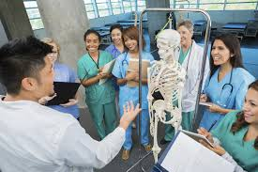
Program Aims
Types of residents you want to produce
Diverse group
U.S. graduates
Affiliated schools

Slide 12
Program Aims
Board pass rate
Local

Slide 13
Recruiting Aims
Diversity
Host a diversity night at the hospital
U.S. Graduates
Consider interviewing only U.S. graduates
Check filters
Affiliated Schools
Medical student night

Slide 14
Recruiting Aims
Affiliated schools
Medical student night
Interview all rotators
Local Residents
Tri State area night

Slide 15
Recruiting Aims
Board scores
USMLE/COMLEX filter cutoffs
Good test takers
Miss out on great candidates
Emergency Medicine videos
Combine more than one

Slide 16
Medical Student Night
GME and/or Program Specific
Invitations
Tours
Program Directors - brief and unique information about program

Slide 17
Medical Student Night
CURRENT RESIDENTS
Webinar for long distance
Summer
Medical school table

Slide 18
Who Are We??
Number of current residents
Fellowships
Global Health
Call schedule

Slide 19
Who Are We??
Website
UP TO DATE
User friendly
List of specialties
List of leadership
Resident pictures
Resident quotes

Slide 20
Brochure
Give them a chance to ask
Contact information
Program Directors
Current residents
Wellness initiatives
Size of hospital and health system

Slide 21
Program Homework
Document
Rank order list for memory
Post survey
PDCA

Slide 22
ERAS Is Your Friend
Filters
Emergency Medicine videos
Invite applicants
Personal statement
Specialty letters of recommendation

Slide 23
Interviews
IV.A.3. An applicant invited to interview for a resident/fellow position must be informed, in writing or by electronic means, of the terms, conditions, and benefits of appointment to the ACGME-accredited program, either in effect at the time of the interview or that will be in effect at the time of the interview or that will be in effect at the time of his or her eventual appointment.
IV.A.3.a) Information that is provided must include: financial support; vacations, parental, sick and other leaves of absence; and professional liability, hospitalization, health, disability and other insurance accessible to residents/fellows and their eligible dependents.

Slide 24
Policies and Procedures
Is that all??!!
Academic Affairs policies and procedures
Be transparent

Slide 25
Policies and Procedures
Contract - watermark
Salary
Housing
Visa’s
Other policies and procedures - aims

Slide 26
Additional Documents
Hospital/Health System information
Contact information
Resident quotes
Local attractions
Information for later

Slide 27
You Are Cordially Invited
Remember your aim!

Slide 28
Interview Day
Name badge
Agenda
Tours
Current residents

Slide 29
Interview Structure
Number of applicants per day
Number of days
Avoid burnout
Day of the week
Weekends - Pros and Cons
One on one interviews

Slide 30
Interview Structure
Four interviews - two at a time
Program Director/Chairman
RESIDENTS

Slide 31
Tell Me About Yourself
Stand out from rest
Research
Future goals
Questions??

Slide 32
Tell Me About Yourself
Core competencies
Unique questions
Based on aims
Based on other competencies
Example: Disagree with policies and procedures?

Slide 33
Don’t Tell Me About Yourself
Religion
Pregnancy
Politics
Race/Ethnicity

Slide 34
Don’t Tell Me About Yourself
Marital status
Debt
Smoke or drink
ERAS
REMINDER! Still an interview

Slide 35
Program Homework
Score sheet - aim based
Interview day rank list
RESIDENTS
COORDINATORS

Slide 36
Interviewees
Thank you note
Second look
Dress code

Slide 37
Additional Interview Dates
PDCA
Treat as day one
Put yourself in their shoes
Combine rank order list
The work is almost done!

Slide 38
Rank Time!
Look at previous years greatest number
Rank enough
Only rank who you want
Don’t manipulate the list - it’s not worth trying

Slide 39
Match Day!
Welcome!!
Analyze data
Where did they go?

Slide 40
Match Day!
Aims met??
PDCA

Slide 41
It’s Not Over Yet...
Orientation
Share aims and expectations
Workshops based on aims
Don’t overwhelm them

Slide 42
The Honeymoon Is Over
PGY 1.5
Fulfilled aims?
New aims?
Update process
It’s the most wonderful time of the year...AGAIN

Slide 43
Advantages
Program direction
Help complete self-study
Transparency
Baseline data
Ongoing data

Slide 44
Disadvantages
Too focused on aims
Other candidates
PGY 1 - first year

Slide 45
Timeline
Baseline data - now!
Determine aims - following baseline data analysis
Medical student night/webinar - Summer

Slide 46
Summary
Remember your requirements
Baseline data
PDCA
Be transparent
Program aims

Slide 47
References
https://www.acgme.org/What-We-Do/Accreditation/Self-Study
https://www.acgme.org/Portals/0/PFAssets/InstitutionalRequirements/000InstitutionalRequirements2018.pdf?ver=2018-02-19-132236-600
https://www.huffingtonpost.com/margaret-jacoby/10-questions-never-to-ask_b_8742940.html

Slide 48
Upcoming Live Webinars CLER Thursday, May 3, 2018 12:00pm – 1:00pm EST
Journey from Initial Accreditation to Continued Accreditation Tuesday, May 22, 2018 12:00pm – 1:00pm EST Resident Remediation Thursday, June 7, 2018 12:00pm – 1:00pm EST DIO Competencies Tuesday, June 26, 2018 12:00pm – 1:00pm EST
www.PartnersInMedEd.com
On-Demand Webinars Self-Study…Have You Analyzed Your Data Yet? Creating a Robust Resident Evaluation System
Institutional Site Visit Prep Process
From APE to Self-Study… and Everything in Between
Healthcare Disparities in GME Institutions
AOA to ACGME Accreditation: Best Practices and Challenges
Transitioning from Residency to Practice
Contact us today to learn
how our Educational Passports can save you time & money!
724-864-7320
Presented by Partners in Medical Education, Inc. 2018

Slide 49
Partners in Medical Education, Inc. provides comprehensive consulting services to the GME community.
Partners in Medical Education
724-864-7320 | info@PartnersInMedEd.com
Amy Lefkovic, MHA GME Consultant
Amy@PartnersInMedEd.com
www.PartnersInMedEd.com
Presented by Partners in Medical Education, Inc. 2018

