Slide 1
Please Note…
Please make sure your Start Video is OFF when logging into the WebEx platform.
Here is what it should look like
ALSO
It is NORMAL to not hear any sound until the webinar starts at 12:00 noon EST.
Your phone line is muted, but you can always chat to the host, BJ Schwartz, if you have any questions or concerns during this time.

Slide 2
Resident Wellness in the Virtual Word
Amy Durante, MHA

Slide 3
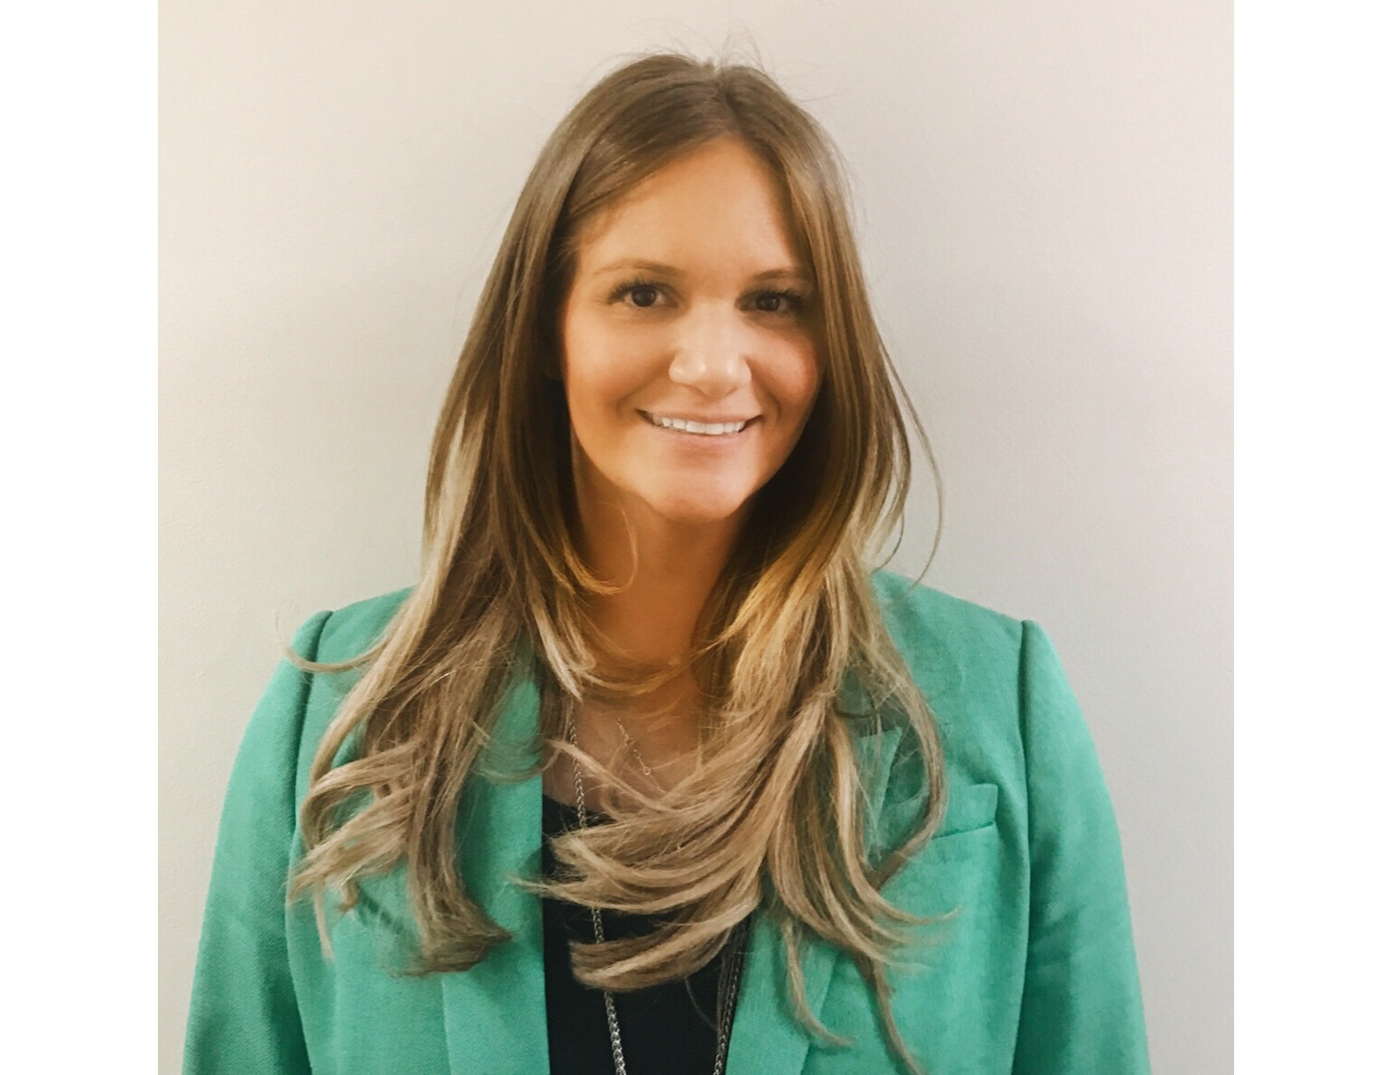
Introducing Your Presenter…
Amy Durante, MHA
Received her Bachelors Degree in Health Information Management from Kean University
Began her career in Graduate Medical Education (GME) at Hospital for Special Surgery as the Radiology Fellowship Program Coordinator
Received her Masters degree in Healthcare Administration from Seton Hall University
Continued her career in GME at Lutheran Medical Center as the OB/GYN Residency Coordinator
Is currently the Director of Medical Education at Staten Island University Hospital

Slide 4
Learning Objectives
To review the ACGME resident well-being requirements
To discuss strategies for enhancing resident/fellow well-being
To provide tips and tools for fulfilling the ACGME’s requirements in the virtual world

Slide 5
ACGME Requirements
Disclaimer - scared
Get back to the foundation
Listed 34 times

Slide 6
Introduction
Graduate medical education occurs in clinical settings that establish the foundation for practice-based and lifelong learning. The professional development of the physician, begun in medical school, continues through faculty modeling of the effacement of self-interest in a humanistic environment that emphasizes joy in curiosity, problem-solving, academic rigor, and discovery. This transformation is often physically, emotionally, and intellectually demanding and occurs in a variety of clinical learning environments committed to graduate medical education and the well-being of patients, residents, fellows, faculty members, students, and all members of the health care team.

Slide 7
Common Program Requirements
I.D.2. The program, in partnership with its Sponsoring Institution, must ensure healthy and safe learning and working environments that promote resident well-being and provide for:
I.D.2.a) Access to food while on duty;
Safe, quiet, clean, and private sleep/rest facilities
Clean and private facilities for lactation
Residents family

Slide 8
Common Program Requirements
Faculty members create an effective learning environment by acting in a professional manner and attending to the well-being of the residents and themselves.
Faculty well-being
#1 complaint

Slide 9
Common Program Requirements
The Program Evaluation Committee should consider the following elements in its assessment of the program:
Well-being

Slide 10
The Learning and Working Environment
Residency education must occur in the context of a learning and working environment that emphasizes the following principles:
Commitment to the well-being of the students, residents, faculty members, and all members of the health care team

Slide 11
VI.C. Well-Being
Residents and faculty members are at risk for burnout and depression. Programs, in partnership with their Sponsoring Institutions, have the same responsibility to address well-being as other aspects of resident competence. Physicians and all members of the health care team share responsibility for the well-being of each other. For example, a culture which encourages covering for colleagues after an illness without the expectation of reciprocity reflects the ideal of professionalism.

Slide 12
Well-Being
The responsibility of the program, in partnership with the Sponsoring Institution, to address well-being must include:
efforts to enhance the meaning that each resident finds in the experience of being a physician
Tell them why you did – everyone know that more than they know their favorite pizza place!

Slide 13
SCHEDULE!!
Attention to scheduling, work intensity, and work compression that impacts resident well-being

Slide 14
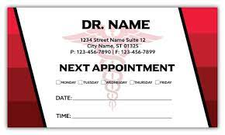
Well-Being
Evaluating workplace safety
Policies and programs in place that encourage optimal resident and faculty member well-being
For a later discussion
Attend medical, mental health, and dental care appointments

Slide 15
Well-Being
Attention to resident and faculty member burnout, depression, and substance use disorders. The program, in partnership with its Sponsoring Institution, must educate faculty members and residents in identification of the symptoms of burnout, depression, and substance use disorders, including means to assist those who experience these conditions.

Slide 16
Well-Being
Provide access to appropriate tools for self-screening
Mental health protocol
Records hidden
Only seen by attending
Provide access to confidential, affordable mental health assessment, counseling, and treatment, including access to urgent and emergent care 24 hours a day, seven days a week

Slide 17
Mandatory Time Free of Clinical Work and Education
The program must design an effective program structure that is configured to provide residents with educational opportunities, as well as reasonable opportunities for rest and personal well-being.

Slide 18
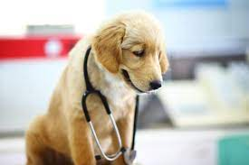
Where does it say the part about yoga and pet therapy??

Slide 19
It Doesn’t……
Attention to scheduling, work intensity, and work compression that impacts resident well-being

Slide 20
Background and Intent
Policies and programs in place that encourage optimal resident and faculty member well-being
Background and Intent: Well-being includes having time away from work to engage with family and friends, as well as to attend to personal needs and to one’s own health, including adequate rest, healthy diet, and regular exercise.
“If you build it they will come”

Slide 21
After Schedule is Done…
Be mindful not to be “too virtual” with schedules
Set a foundation
GME wellness committee
Faculty chair and Attendees
Program specific wellness committee
Participation from all PGY levels
Hospital-Wide wellness committee

Slide 22
Others that Started
Chief Resident committee
Especially in June/July
Duty hours requirement survey – HUGE for resident well-being
GME Town Halls
Program Town Halls

Slide 23
“John, You Are Muted”
Fear of the virtual meetings is (mostly) gone
No different from in person because discussion or screen sharing
Freedom to join from home
Be careful!!

Slide 24
Attention in Meetings
Engaging
Multitasking
Zoom fatigue
Put on cameras
Use polling feature
Use blackboard feature
Create a flipped classroom

Slide 25
What Did You Do BC..Before COVID
Pet therapy
Get to know others more personally
What were their interests?
Basically everything can be done virtually

Slide 26
Our Experience
Chief resident meetings
GME Town Hall
Fight Against Racism
Yoga
Comedian
Band
Announcements
Cooking classes

Slide 27
Pre-Scheduled
Yoga
Comedian
Band
Cooking classes
Scheduled time best for residents
Made sure set up but didn’t stay

Slide 28
You Are Invited to a Zoom Meeting
Doesn’t all have to be a scheduled “meeting”
Announcements
While in a meeting – invited to join but posted after
GME Professionals Day
Resident and Fellow Appreciation Day (Week)

Slide 29
Resident Appreciation Week
Poster in the education center and screen saver
Executive Director “shout out” on Instagram
Live stream of band
Program Director and hospital leadership appreciation video

Slide 30
SOCIAL MEDIA
HUGE
A “like” can go a long way
Create for program or hospital
Get creative
Running challenge
Scavenger hunt

Slide 31
EMAIL/What’s App
Birthday celebrations
Prizes for checking email
GEM points
“Residents are NEVER a bother, I am happy to help!”
“Thank you for reaching out”
Chief what’s app
Can only receive information cannot respond

Slide 32
Resident Appreciation Day Not Virtual
T-Shirts that were permitted to be worn
Individually wrapped goodie bags
Candy
Voucher for a free pizza
Voucher for a free coffee
QR code for House Staff Association Chair
Individually wrapped for quick pick up
Learned the VERY hard way

Slide 33
Resources
Be sure to provide residents and faculty with an assessment tool
Even if you cant be with them, call them
Thank you for checking in?!?
Post in questions, anyone else experiencing this?
As much as you can safely
Would you want to do it?
ASK THEM!!!

Slide 34
Faculty
Faculty well-being survey worse than resident survey
A different approach with faculty
Teacher of the month
Mentor – residents and faculty
Resources
If they don’t, the residents never will
When I was your age…

Slide 35
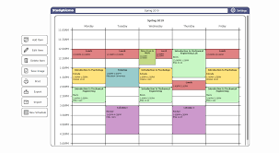
Virtual World
Here to stay!
Train faculty
Residents frustrated don’t know by now – taking away from their education
Don’t overload
SCHEDULE

Slide 36
Questions

Slide 37
Upcoming Live Webinar
The Role of Coaching
Thursday, September 30, 2021
12:00pm – 1:00pm EST
GME Financing: The Basics, the Strategies, and the Upcoming Changes
Thursday, October 7, 2021
12:00pm – 1:00pm EST
Planning and Tracking Scholarly Activity
Thursday, October 21, 2021
12:00 – 1:00 EST
Latest On-Demand Webinars
Site Visits – What to Expect in 2021
ADS Update 2021
GME Grants and Funding Sources
Survey Research
Impactful AIR & APE – Bridging Data & Action
GMEC Checkups – QIPS Edition
ACGME Surveys – What Now?
Other Approaches to CCC & Evaluation
Lessons Learned from the Pandemic: Planning for the Next Disaster
Ask Partners – Spring Freebie
Digging for Data Part 3
How to Maximize Virtual Learning Part 2
Scholarly Work in Pandemic Times
Faculty Development Series
15 Minutes to Effective Feedback
Toolbox for Teaching Millennials
Taking Supervision to the Next Level
Contact us today to learn how our Educational
Passports can save you time & money!
724-864-7320
www.PartnersInMedEd.com
Presented by Partners in Medical Education, Inc. 2021
37

Slide 38
Partners in Medical Education, Inc. provides comprehensive consulting services
to the GME community.
Partners in Medical Education
724-864-7320 | info@PartnersInMedEd.com
Amy Durante, MHA
Amy@PartnersInMedEd.com
www.PartnersInMedEd.com

