Slide 1
Responsiveness to Diverse Patient Populations

Slide 2
Introducing Your Presenter
Amy Lefkovic, MHA
Received her Bachelors Degree in Health Information Management from Kean University
Began her career in Graduate Medical Education (GME) at Hospital for Special Surgery as the Radiology Fellowship Program Coordinator
Received her Masters degree in Healthcare Administration from Seton Hall University
Continued her career in GME at Lutheran Medical Center as the OB/GYN Residency Coordinator
Is currently the Manager of GME and Academic Affairs at Staten Island University Hospital

Slide 3
Goals and Objectives
To review the responsibilities and requirements of residents with respect to diversity
To determine what can be done to fulfill these requirements
To explore ways in which recruitment can help aid in the diversity of your program

Slide 4
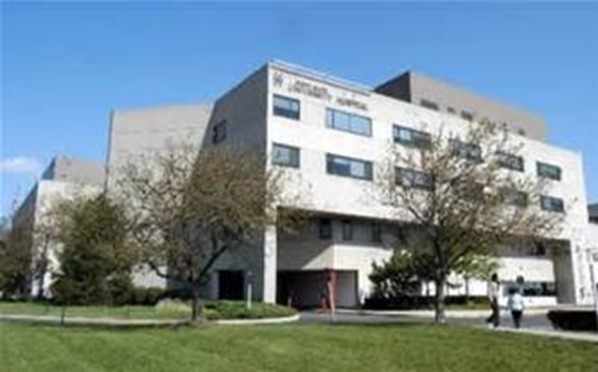
Staten Island University Hospital Northwell Health
Northwell Health
300 residents and fellows
16 programs

Slide 5
Requirements
Residents are expected to demonstrate:
IV.A.5.e).(1) compassion, integrity, and respect for others;
IV.A.5.e).(2) responsiveness to patient needs that supersedes self interest;
IV.A.5.e).(3) respect for patient privacy and autonomy;

Slide 6
Requirements
IV.A.5.e).(4) accountability to patients, society and the profession; and,
IV.A.5.e).(5) sensitivity and responsiveness to a diverse patient population, including but not limited to diversity in gender, age, culture, race, religion, disabilities, and sexual orientation.

Slide 7
Requirements
VI.A.1.b).(1).(a) Residents must receive training and experience in quality improvement processes, including an understanding of health care disparities.

Slide 8
Requirements
VI.A.1.b).(3).(a) Residents must have the opportunity to participate in interprofessional quality improvement activities.
VI.A.1.b).(3).(a).(i) This should include activities aimed at reducing health care disparities.

Slide 11
Compassion, Integrity, and Respect for Others
Mission
The mission of the _____ is to enhance the quality of life by working in partnership with the community to enforce the law, preserve peace, reduce fear, and maintain order.

Slide 12
Compassion, Integrity, and Respect for Others
The Department is committed to accomplishing its mission of protecting the lives and property of all citizens by treating every citizen with compassion, courtesy, professionalism, and respect, while efficiently rendering services and enforcing the laws impartially, by fighting crime both through deterrence and the relentless pursuit of criminals.

Slide 14
Values
In partnership with the community, we pledge to:
Protect the lives and property of our fellow citizens and impartially enforce the law.
Fight crime both by preventing it and by aggressively pursuing violators of the law.

Slide 15
Values
Maintain a higher standard of integrity than is generally expected of others because so much is expected of us.
Value human life, respect the dignity of each individual, and render our services with courtesy and civility.

Slide 16
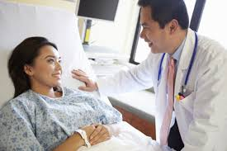
Responsiveness to Patient Needs that Supersedes Self Interest
Self referral
Personal views
Self rewarding/gaining
Get to know their self interests

Slide 17
Accountability to Patients, Society and the Profession
Maintain a higher standard of integrity than is generally expected of others because so much is expected of us.
Value human life, respect the dignity of each individual, and render our services with courtesy and civility.

Slide 18
Sensitivity and Responsiveness to a Diverse Patient Population
Including but not limited to:
diversity in gender
age
disabilities

Slide 20
Diversity in gender
Transgender
Confused
Pain threshold
Mastered the art of complaining

Slide 21
Age
Guardian
Expressing concerns
Confidentiality
Shy

Slide 22
Age
Forgetfulness
Full disclosure
Dementia

Slide 23
Disabilities
Apparent/Not apparent
Full concept
Medical advise
Embarrassed
Difficulty examining

Slide 25
Sensitivity and Responsiveness to a Diverse Patient Population
Culture
Race
Religion
Sexual orientation

Slide 26
Health Care Disparities
Health disparities refer to differences in the health status of different groups of people. Some groups of people have higher rates of certain diseases, and more deaths and suffering from them, compared to others.

Slide 28
Reminder
They are doctors/scientists!
Need to know more detail than just a few concepts
Healthcare beliefs and interactions
Common healthcare ailments

Slide 29
Inform them
Break it down
Explain
Show them
Very busy

Slide 30
Bring to Light
May not have thought about
Age
Gender
Disabilities
Bias testing
Fear of the unknown
Personal opinions

Slide 31
Ask Them
Let is sink in
What do you think?
What is their new mission

Slide 32
Educate
Monthly diversity meetings/workshops
Personal experiences
Patient experiences
Calendar of holidays along with summary
Up to date information
LGBTQ community

Slide 33
Educate
Subcommittees
Create diversity committee – let them teach us
Program
Hospital wide

Slide 34
Educate
Create subcommittees/groups/clubs
Religion
Race
Culture
Use existing subcommittee
Resident Quality Care Collaborative Council
Wellness

Slide 35
Educate
Fact sheet
Remind them to ask questions
Patient educate the trainees

Slide 36
Collaborative Work
Nurses
Language and Health Literacy Coordinator
Interpreter phones
7 million dollars

Slide 37
Collaborative Work
Workshop experience
One thing want to know
One thing never want to happen
One thing never want to be referred to as
Patient experience team
Patient panel

Slide 38
Encourage
Ask questions
Be respectful
Treat others the way you would want to be treated
Share experiences with co-residents

Slide 40
Residents 2019
I.C. The program, in partnership with its Sponsoring Institution, must engage in practices that focus on mission-driven, ongoing, systematic recruitment and retention of a diverse and inclusive workforce of residents, fellows (if present), faculty members, senior administrative staff members, and other relevant members of its academic community.

Slide 41
Background and Intent
It is expected that the Sponsoring Institution has, and programs implement, policies and procedures related to recruitment and retention of minorities underrepresented in medicine and medical leadership in accordance with the Sponsoring Institution’s mission and aims. The program’s annual evaluation must include an assessment of the program’s efforts to recruit and retain a diverse workforce

Slide 42
Interview Season
Diverse resident population
Look at previous data
Strategies for recruitment

Slide 43
Trainees Become Educators
Diversity night
ECFMG requirement
Teach U.S. culture and see where we differ

Slide 44
Summary
Bring to light
EDUCATE
Always remind
Recruit our new educators

Slide 45
References
https://www.huffingtonpost.com/matthew-lynch-edd/promoting-respect-for-cul_b_1187683.html
https://www.acgme.org/Portals/0/PFAssets/InstitutionalRequirements/000InstitutionalRequirements2018.pdf?ver=2018-02-19-132236-600
https://www.acgme.org/Portals/0/PFAssets/ProgramRequirements/CPRs_2017-07-01.pdf

Slide 46
On-Demand Webinars
Ask Partners - Spring Freebie
Building a Scholarly Activity Infrastructure at a Community Based Institution
ACGME Check-Up for Programs and Institutions
Recruitment Strategies
CLER
Journey from Initial Accreditation to Continued Accreditation
Resident Remediation
DIO Competencies
Upcoming Live Webinars
Demystifying the Resident and Faculty ACGME Survey Thursday, August 16, 2018 12:00pm – 1:00pm EST
Oversight of the Clinical Learning and Working Environment Tuesday, August 28, 2018 12:00pm – 1:00pm EST
Policies, PLA’s and Policing Thursday, September 13, 2018 12:00pm – 1:00pm EST
www.PartnersInMedEd.com
Contact us today to learn
how our Educational Passports can save you time & money!
724-864-7320

Slide 47
Partners in Medical Education, Inc. provides comprehensive consulting services to the GME community.
Partners in Medical Education
724-864-7320 | info@PartnersInMedEd.com
Amy Lefkovic, MHA GME Consultant
Amy@PartnersInMedEd.com
www.PartnersInMedEd.com
Presented by Partners in Medical Education, Inc. 2018

