Slide 1
Self-Study Visits
Presented by:
Catherine Henderson, DrPH, LFACHE
Consultant
Partners in Medical Education, Inc.

Slide 2
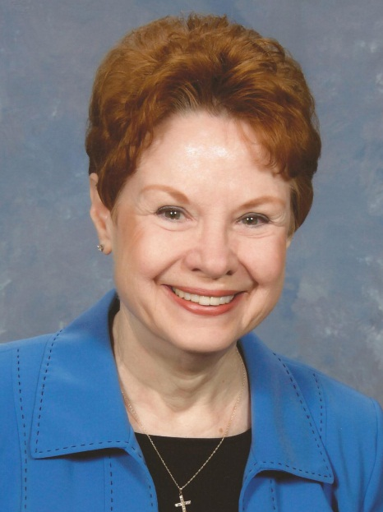
Introducing Your Presenter…
Catherine Henderson, DrPH, LFACHE
GME Consultant
25+ years experience in GME, nursing leadership, hospital administration, and medical staff development
Assisted over 45 institutions, and 150 programs in 40 specialties, improve GME quality and accreditation outcomes.
Her clients’ achievements include 81 programs & institutions achieving maximum accreditation cycle; 8 initial program and 4 initial institution accreditations; and 14 programs/institutions taken from probation to full accreditation.

Slide 3

Goals and Objectives
Identify role of self-study visits in the Next Accreditation System’s (NAS) continuous oversight process
Compare and contrast the program Self-Study Visit (SSV) and Annual Program Evaluation (APE) processes
Identify practical steps to take now

Slide 4

ACGME Self-Study Visits
Where should I focus my effort?

Slide 5

Overview
In NAS, there are no accreditation cycles
ACGME Review Committees conduct an annual assessment to approve continued accreditation, using multiple data sources
Focused, or full, site visits are scheduled,
if/as needed
Every ten years, each residency will perform an extensive self-study and ACGME will conduct an extensive site visit

Slide 6

The focus of the self-study is continuous improvement in the program

Slide 7
Self-Study Visit: Definition
“The 10 Year Self Study site visit is based on a comprehensive self-study, which includes a description of how the program or sponsoring institution creates an effective learning and working environment, and how this leads to desired educational outcomes, and an analysis of strengths, weaknesses, and plans for improvement.”
ACGME Policies and Procedures, July 2013; 17:30(5)(a)

Slide 8

Program Self-Study
Every 10 years; you have date of first self-study
NOT a totally independent assessment. Built on the results of preceding Annual Program Evaluations
Two part process
  Full year of self-study
  Onsite ACGME team site visit
Review Committee issues accreditation status,
based on self-study document and site
visit report of compliance

Slide 9
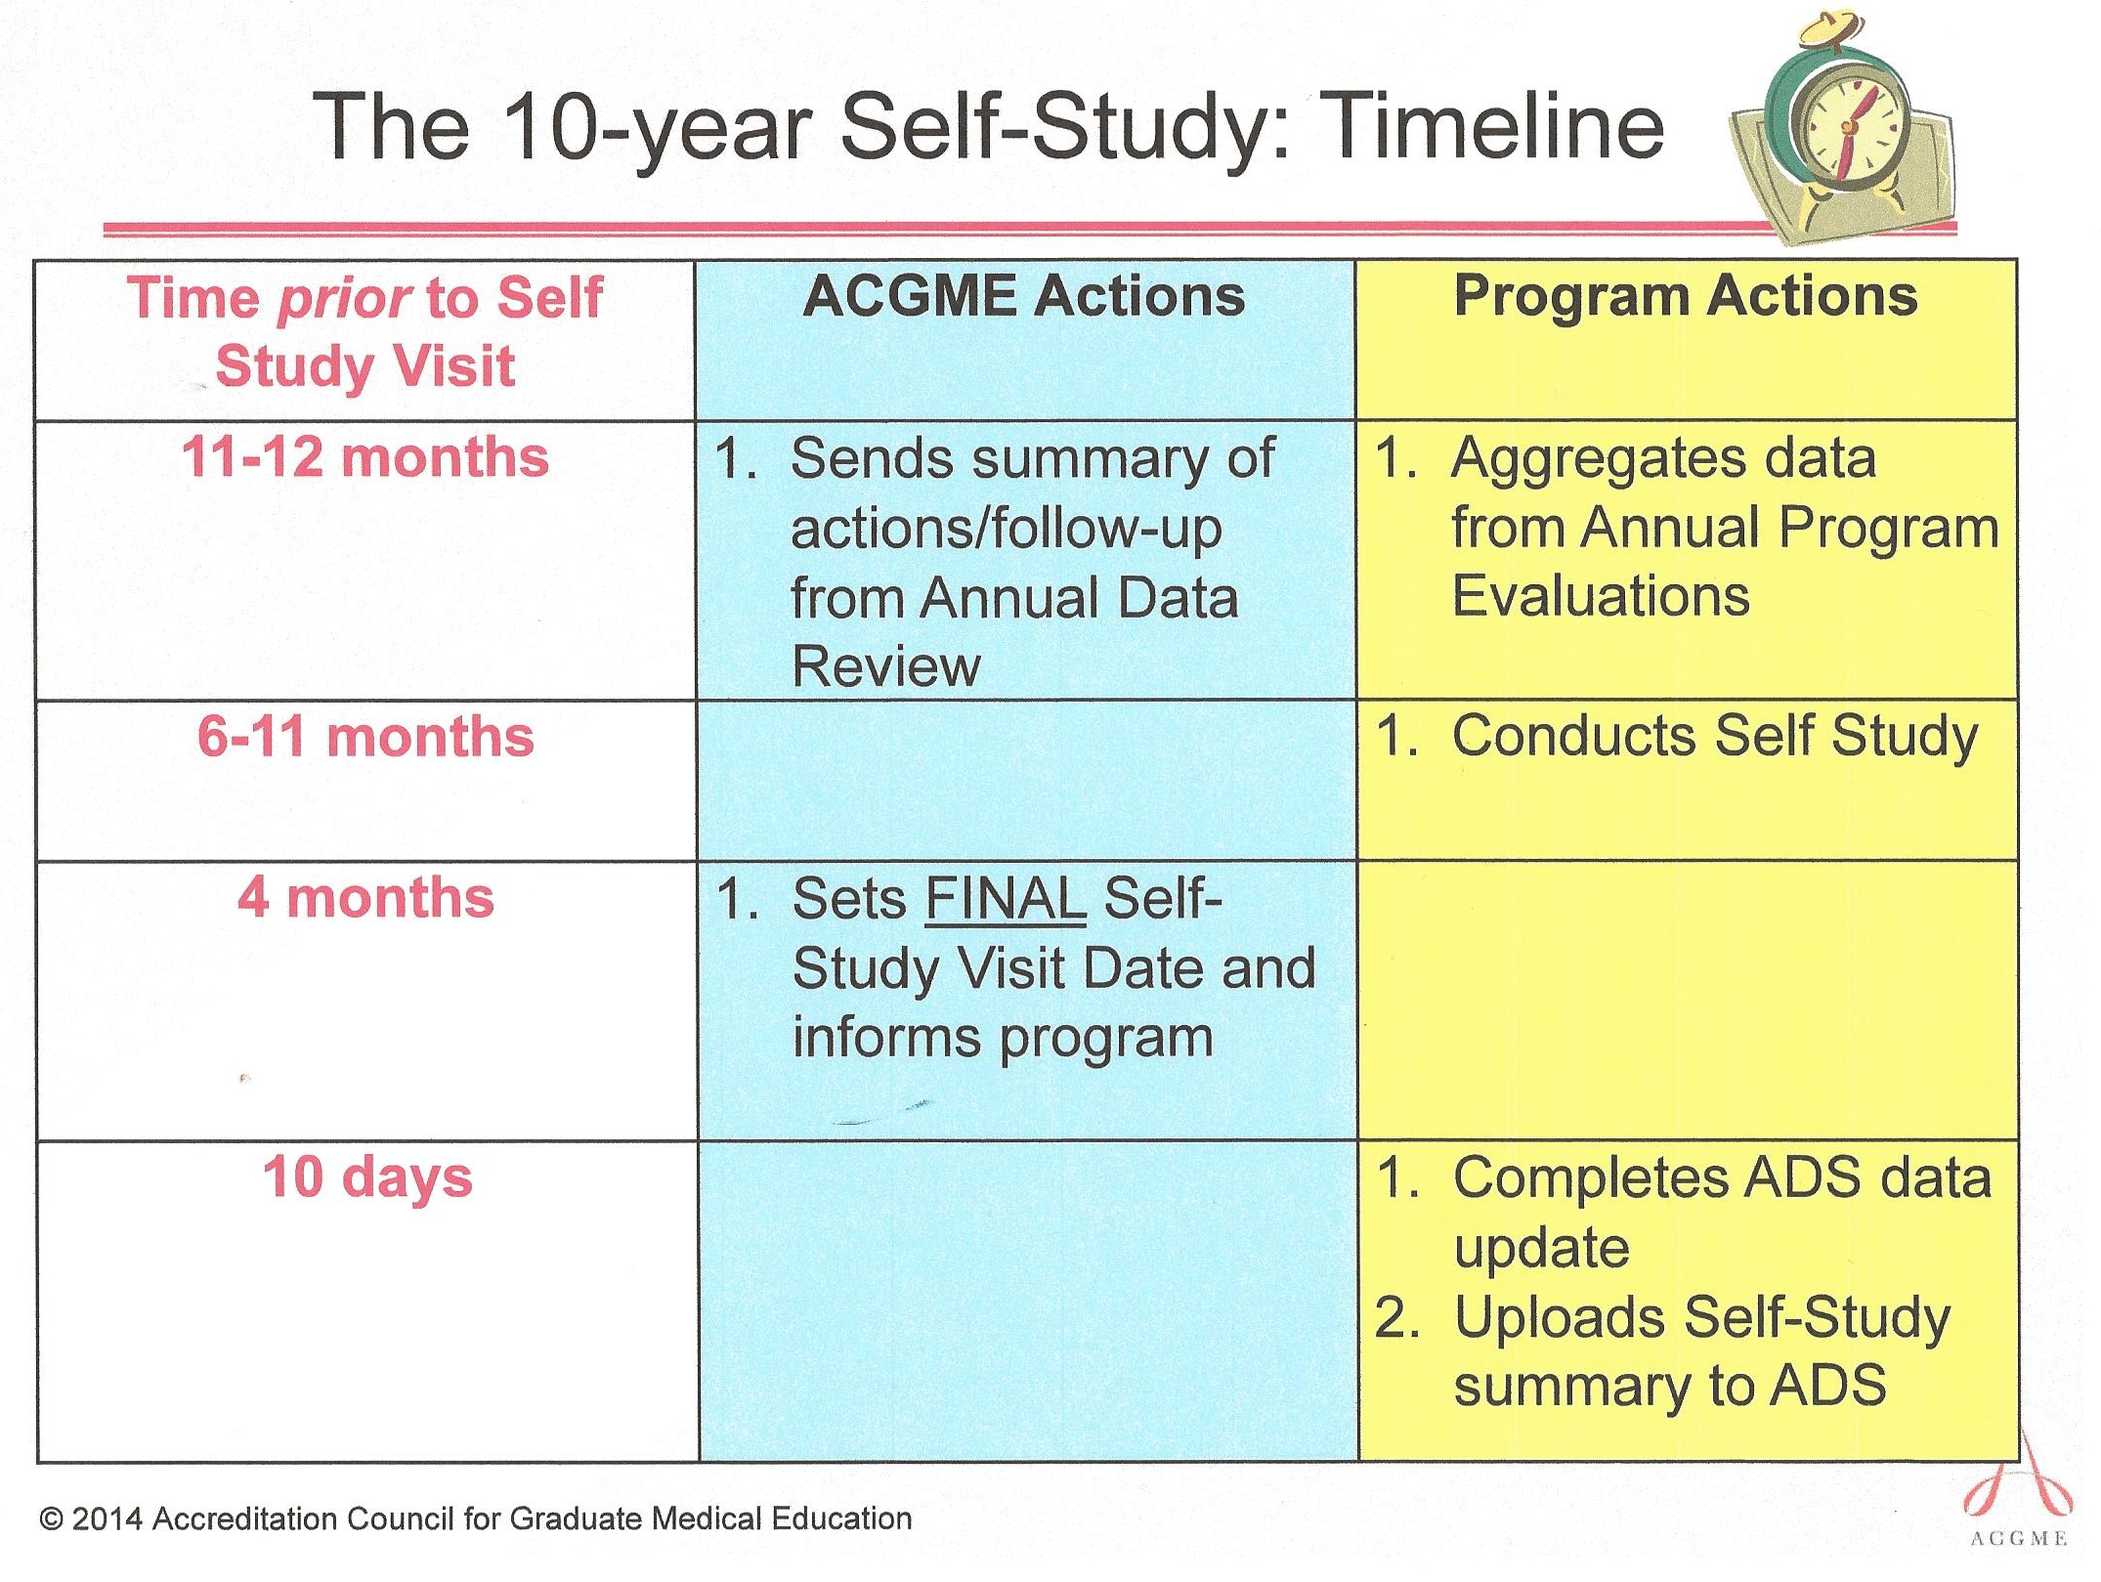

Slide 10
ACGME’s Stated Self-Study Objectives
Assess the program’s ongoing compliance with applicable accreditation requirements
  “Continued Accreditation”: Core and Outcome Requirements
  Other accreditation status: Core, Detail, Outcome Requirements
Focus on program strengths and areas for improvement
Track ongoing improvements and their success
Consider new areas of ACGME interest
  Program aims
  External environment (opportunities & threats)

Slide 11
Program Self-Study: Who?
Year-long self-study conducted by group(s) of faculty members and program leadership with resident input
  Not a solo activity
  Include program leadership, faculty, residents, and coordinator
  Consider recent graduates; other hospital representatives
  (e.g., performance improvement staff)
Should the Program Evaluation Committee conduct the self-study?

Slide 12

First, Master the Annual Program Evaluation
APE is performed by the Program Evaluation Committee
Required to review
  Resident performance
  Faculty development
  Graduate performance
  Program quality
Results in written action plan AND at least one program performance improvement initiative related to one of the four areas of focus

Slide 13

Self-Study Starts with APE
Each year, your Annual
Program Evaluation builds on
the findings and actions from
the prior year

Slide 14

Data to Consider in APE
Citations, actions taken, results
“Areas of Improvement” noted by ACGME
Annual changes (rotations, didactics, sites)
Rotation schedule/block diagram
ADS data, especially:
  Faculty qualifications, FTEs, turnover
  Faculty and resident scholarly activity
Resident and faculty surveys (ACGME and internal)
Resident files (quality of documentation)

Slide 15

Additional Data to Add for
Self-Study
Summary from ACGME’s annual reviews, sent at the beginning of the self-study year
Program aims – overall goal or mission statement
SWOT analysis
Program’s performance improvement initiatives

Slide 16
What is Your Overall Goal??
Your self-study is tied to your self-identified aims and actions taken to achieve them
Are you preparing residents for fellowships? Rural practice? Academia?
What other roles does your program serve?
How does your patient population influence how you practice? (reducing healthcare disparities)

Slide 17

SWOT Analysis
STRENGTHS
  Acknowledge what you do well
  What are your internal assets?
  What makes your program special?
WEAKNESSES (Areas for Improvement)
  Requirements that you do not meet
  Factors within your control that prevent you from attaining excellence

Slide 18

SWOT Analysis
OPPORTUNITIES
  External to the program; not under your direct control
  Factors that you might take advantage of to
  improve your program
  Example: Can your residents join a successful
  PI project underway in the nursing department?

Slide 19

SWOT Analysis
THREATS
  External to the program; not under your direct control
  Factors in the environment that could reduce
  your effectiveness
  Example: Will the new ambulatory surgery center
  across town reduce patient volume available
  to your residents?

Slide 20

Program’s Performance Improvement
In the self-study, assess the effectiveness of your performance improvement process
Can you provide documentation of
ongoing tracking of your PI initiatives?
Do you know/understand/use the PDSA cycle?
How do you select and prioritize PI initiatives?

Slide 21
Self-Study Process
ACGME does not specify the process to use
However, you are expected collect, confirm, and clarify data. This is not an isolated research project!
Display longitudinal data on a spreadsheet?
A core residency and its dependent subspecialty (fellowship) programs are one unit in NAS. They conduct the self-study together and are surveyed together by ACGME.

Slide 22

Program Self-Study Visit
Every 10 years; 90 – 120 days notice
of specific date
Team of two or more field staff
site visitors
Single day for core program;
multiple days for core residency with fellowships

Slide 23
Program Self-Study Visit
ACGME visitors might review
  Curriculum goals and objectives
  Resident involvement in patient safety and
  performance improvement
  Documentation of APE process
  Duty hours, policies, accreditation compliance
  Faculty development

Slide 24

Self-Study Document
Not to exceed 2500 words
(about 7 pages, single spaced)
Uploaded into ADS 10 days before the Self-Study Visit
Will include a summary of how the Self-Study was conducted, and who participated in the process in the “Introduction.” Keep a record of the process

Slide 25

Self-Study Document Elements*
Introduction
Program Overview
Program Aims
Aggregated lists of Strengths and Areas for
Improvement for the period since the last
scheduled accreditation review
Opportunities and Threats
Action Plans for maintaining Strengths, addressing Areas for improvement, capitalizing on Opportunities, and mitigating Threats
*Source: Philibert I, Lieh-Lai M. A Practical Guide to the ACGME Self-Study. J Grad Med Educ. 2014;6(3):612-614.

Slide 26
Self-Study Document
Focus on SWOT
Show evidence of ongoing improvement through sequential annual program evaluation action plans and program improvement initiatives
Prepare a sample to show how your program tracks the progress in those performance improvement initiatives, and then ties the findings into the next APE

Slide 27
ACGME Self-Study Visit
In addition to reviewing the self-study report, the team can be expected to examine:
Compliance with accreditation requirements
Issues identified in resident/faculty surveys
Verification of self-reported data (e.g., responses to previous citations in ADS; resident participation in PI; scholarly activity)
Faculty development
Appropriateness of SWOT analysis

Slide 28

What Should You Do NOW?
Know when you are scheduled for your first self-study
Review the September 2014 JGME article
Define your program’s aims
Devote necessary time and effort to produce
an effective Annual Program Evaluation every year
Educate your faculty and residents to
prepare them for their role in the self-study process
Set up a system now to track everything!

Slide 29
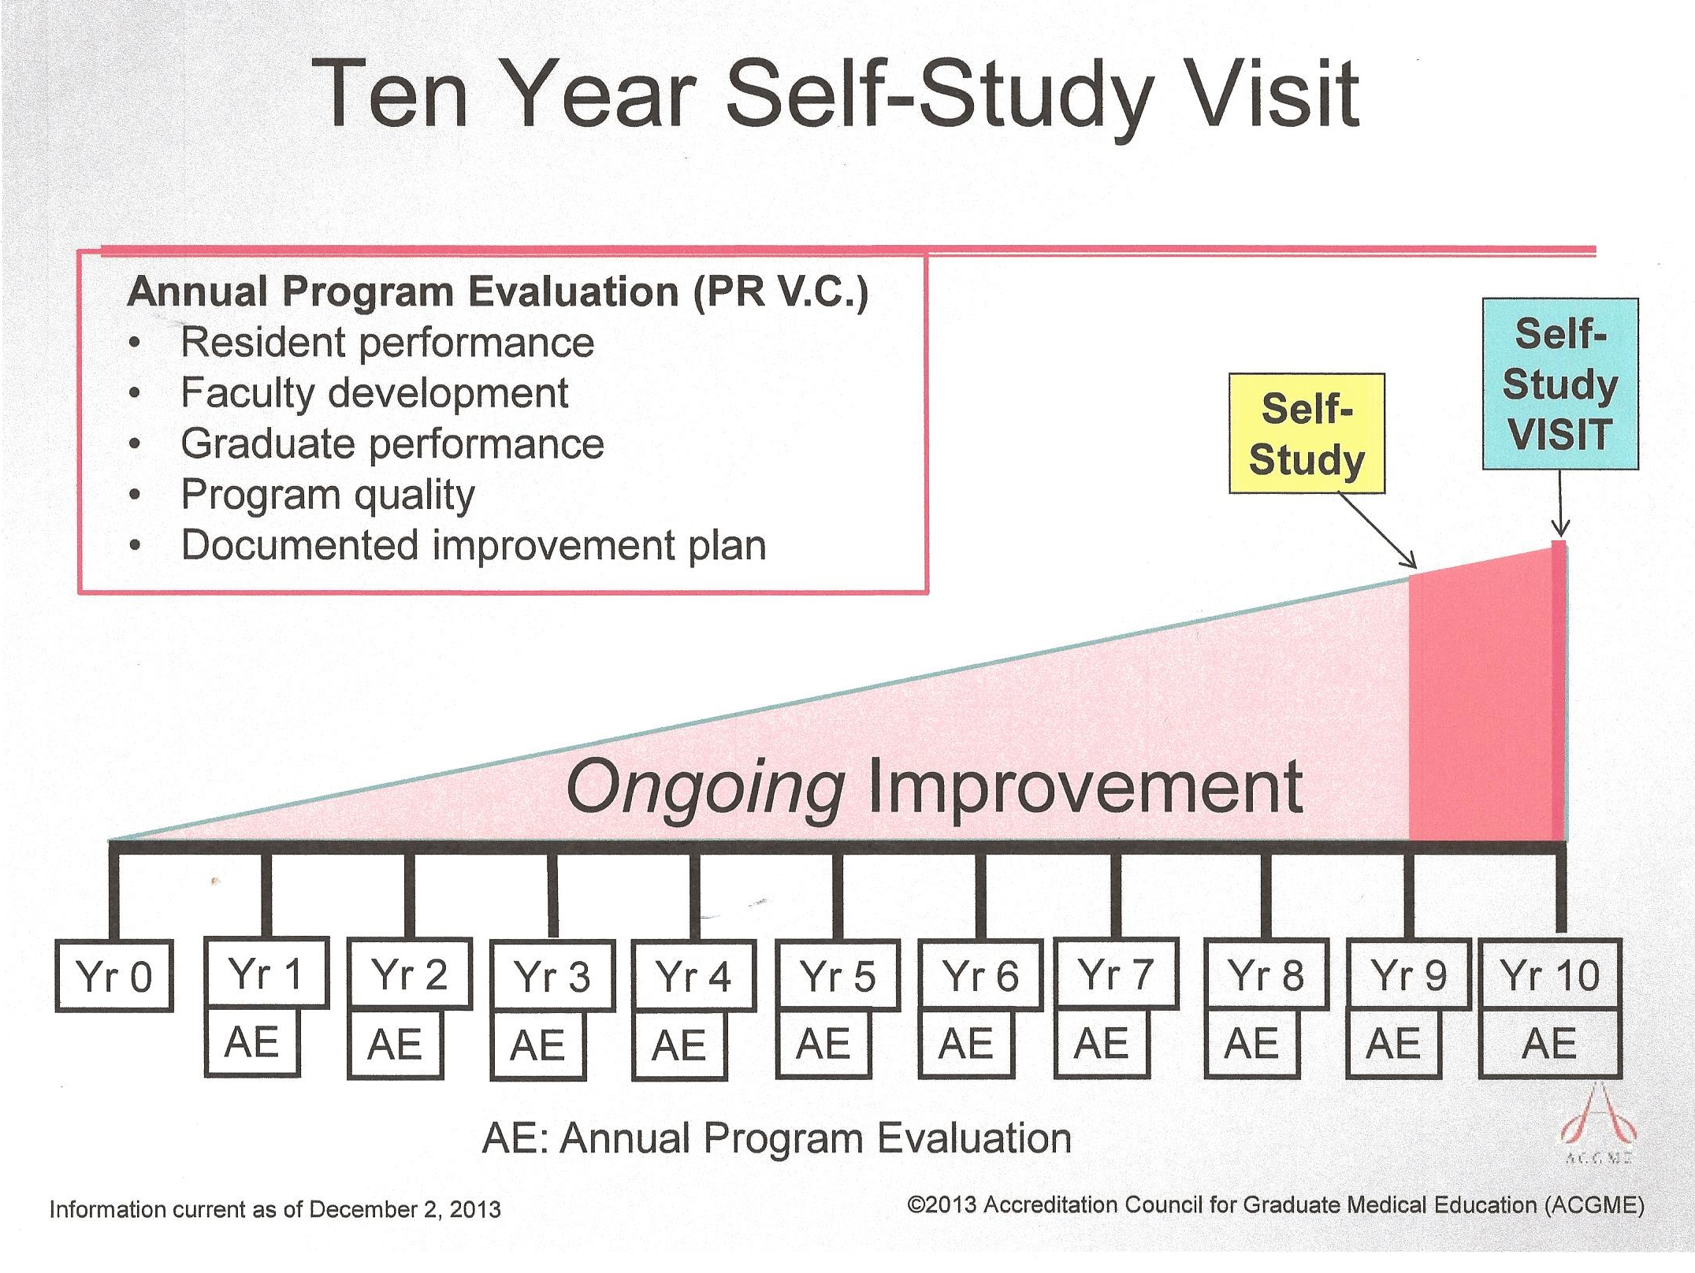

Slide 30

Want more information about conducting
your self-study visit?
Ask us about a customized consulting engagement to jump start your process

Slide 31



Partners’ Online Education
Upcoming Live Webinars
Program Accreditation Under NAS
Wednesday, December 10, 2014
12:00pm – 1:30pm EST
Institutional Readiness for the
Single Accreditation System
Tuesday, January 6, 2015
12:00pm – 1:30pm EST
Annual Program Evaluation
Thursday, January 15, 2015
12:00pm – 1:30pm EST
Critical Components of
Your Institutional Application
Thursday, February 5. 2015
12:00pm – 1:30pm EST
Visit our website to see our NEW
Spring 2015 Schedule!
www.PartnersInMedEd.com
On-Demand Webinars
Self-Study Visits
Introduction to GME for
New Program Coordinators
Milestones & CCCs
GME Financing – The Basics
Single Accreditation System
The IOM Report
Institutional Requirements: What’s New?
Contact us today to learn
how our Educational Passports can save you time & money!
724-864-7320

Slide 32


Partners in Medical Education, Inc. provides comprehensive consulting services to the GME community. For more information, contact us at:
724-864-7320
Info@PartnersInMedEd.com
www.PartnersInMedEd.com
Presented by Partners in Medical Education 2014

