Slide 1



Please Note…
Please make sure your Start Video is OFF when logging into the WebEx platform.
Here is what it should look like
ALSO
It is NORMAL to not hear any sound until the webinar starts at 12:00 noon EST.
Your phone line is muted, but you can always chat to the host, BJ Schwartz, if you have any questions or concerns during this time.

Slide 2
SI2025
2022 Check-up
Tori Hanlon, MS, CHCP
Heather Peters, M.Ed., Ph.D

Slide 3

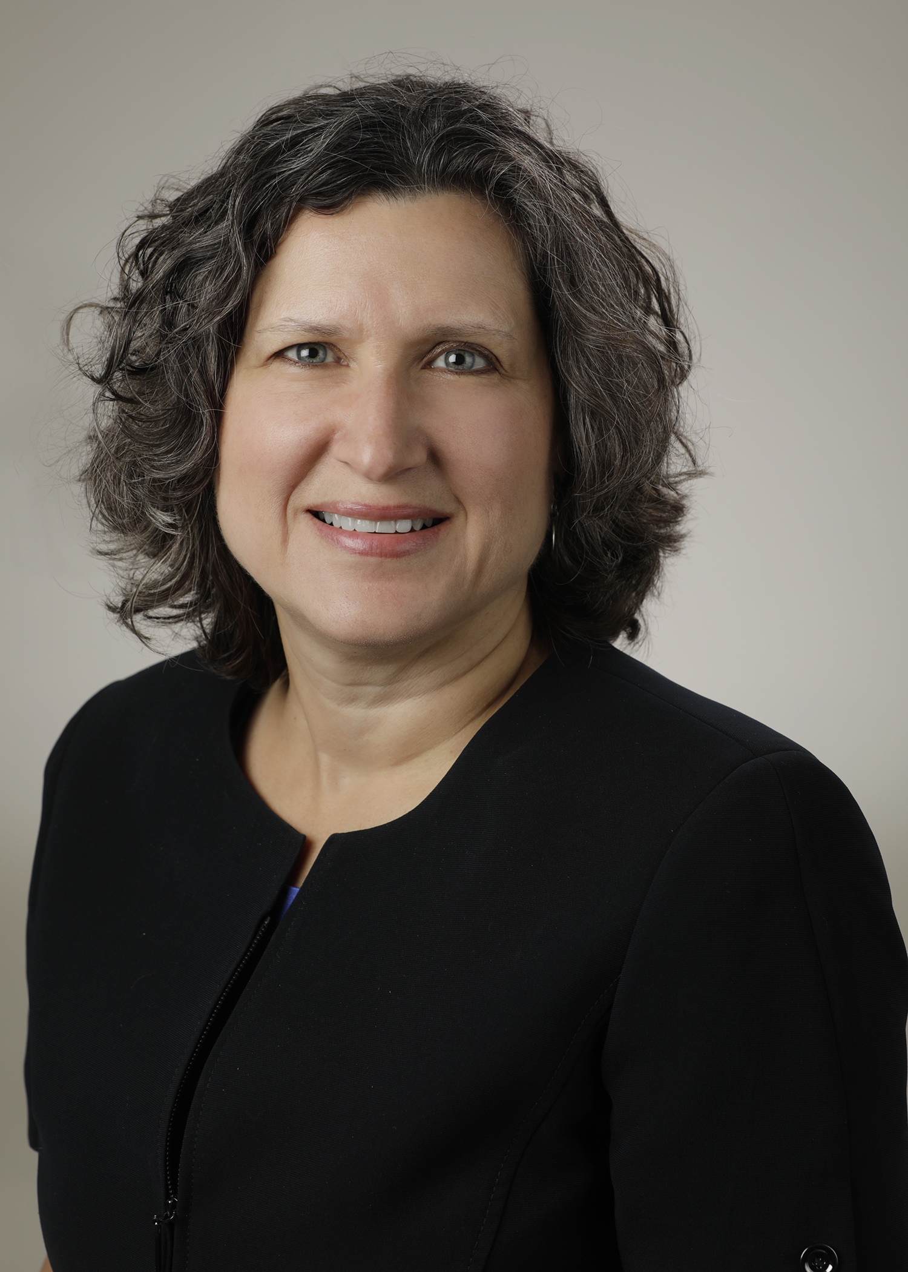
Introducing Your Presenters…
Tori Hanlon, MS, CHCP
GME Consultant
Heather Peters, M.Ed., Ph.D.
GME Consultant
Currently the Director of GME Strategy and Integration for a health system in NJ
DIO at multiple institutions over the past 12 years
Expertise in GME accreditation for sponsoring institutions and programs
Developed GME strategic plans for multiple GME institutions of various sizes

Slide 4


Objectives
Provide an overview of the SI2025 initiative
Discuss the Three Pillars and Domains for National Learning Community of Sponsoring Institutions Program Development
Provide guidance for GME environments as they prepare for these changes.
Provide an opportunity to evaluate progress of current sponsoring institution on the SI2025 Change Trajectory
History of the Sponsoring Institution (JGME)
SI2025 - GME Development - Curriculum and Mindset Shifts – Partners®

Slide 5


History of Sponsoring Institutions, 1982-2017
P. Surdyk, Ph.D – JGME 2017
Sponsoring Institutions are currently in a state of accelerated evolution in response to major changes under-way in the health care system and beyond.
The next stage in the maturation of SIs will necessarily benefit from reflecting on where these changes will lead.
It will require the collaboration of the entire GME community to understand how SIs can meet the needs of patients by creating physicians who are prepared to practice in 2025.
As in the past, it is through these relationships that future SIs will realize our future vision for GME.

Slide 6
History of Sponsoring Institutions, 1982-2017
1982 – ACGME is formed
Initially, the Review Committees for each specialty were delegated the authority for compliance with general and specialty-specific requirements.
1992 – Separate section of General Requirements identified as “Institutional Requirements”
1993 – GMECs were required
1995 – the Institutional Review Committee (IRC) formed but only gave “favorable” or “unfavorable” decisions
1997 – Each SI appointed a DIO
2005 – Full accreditation for SIs to the IRC
2011 – Responsibility given to SIs for educational outcomes
2014 – Single Accreditation System (AOA)
2012 – Clinical Learning Environment Review (CLER)
2015 – SI 2025

Slide 7
Understanding the Report
SI2025 Task Force
What is SI2025?
Facilitated ”listening sessions” across the U.S. at existing SIs
Listening sessions gathered information and allowed for conversations
  Identified up to 4 aspects of health care delivery in the U.S. in the year 2025 that are most likely to impact GME
  How will these aspects of future health care delivery affect the GME needs of residents and fellows?
  How will these aspects of future care delivery affect the organization of residency and fellowship training?
Project initiated by ACGME in 2015
Purpose: Develop a future vision for institutions sponsoring graduate medical education programs
SI2025 Task Force appointed by ACGME Board of Directors

Slide 8
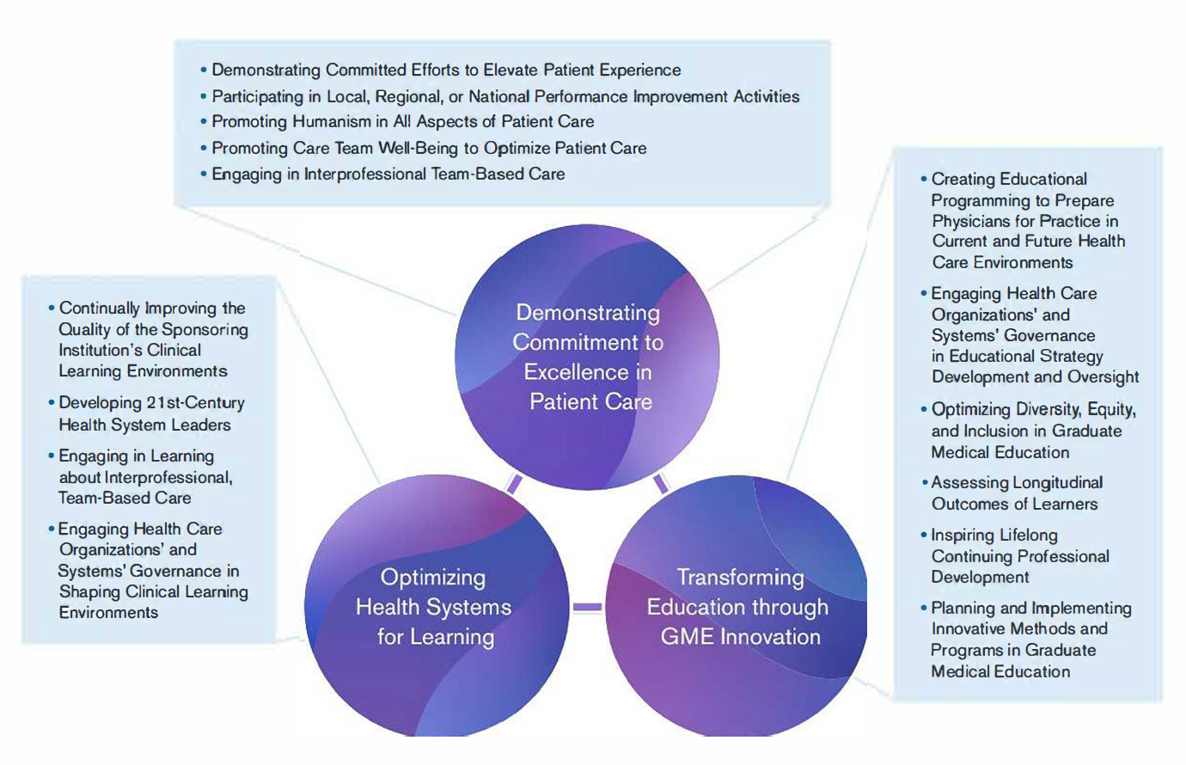
Pillars and Domains for National Learning Community of Sponsoring Institutions Program Development

Slide 9
Perspective from a Current DIO
Continually Improving 1he Quality of the Sponsoring Institution's Clinical Learning Environments
Developing 21st-Century Health System Leaders
Engaging in Learning about interprofessional, Team-Based Care
Engaging Health Care Organizations' and Systems' Governance in Shaping Clinical Learning Environments

Slide 10
Perspective from a former DIO
Demonstrating Committed Efforts to Elevate Patient Experience
Participating in Local, Regional, or National Performance Improvement Activities
Promoting Humanism in All Aspects of Patient Care
Promoting Care Team Well-Being to Optimize Patient Care
Engaging in lnterprofessional Team-Based Care

Slide 11
Evolution in Role of Physician
Cost-efficient health care
Work-life balance
Physician Employment
Artificial intelligence
Specialization
Accountability for faculty with clinical and educational responsibilities
Compensation for faculty with clinical and educational responsibilities
Medical literature

Slide 12
Health System Mergers
Large Health Care Organizations (HCOs)
Workforce planning
Critical pipeline for new physicians
Cost of GME will be questioned
Efficiency & Productivity
Presented by Partners in Medical Education, Inc. 2022

Slide 13
How the GME Trainee’s Role has Changed
 | Current View | Future
Health care professionals as healers | Physicians’ central role as healers is an essential component of patient care | Physicians’ role as healers is increasingly shared with other members of the health care team
Face-to-face clinical encounters | Patients’ face-to-face encounters with physicians are viewed as an essential component of patient care | Quality & quantity of physicians’ face-to-face encounters with patients in lieu of remote contact & patient care provided by other health care professionals
Bedside interactions | Bedside interactions & education are viewed as an essential component of inpatient care & GME | Quantity & quality of bedside interactions due to reduced need for physical exam & the increasing number of other health care professionals

Slide 14
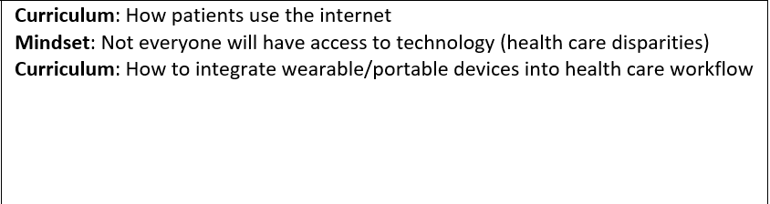
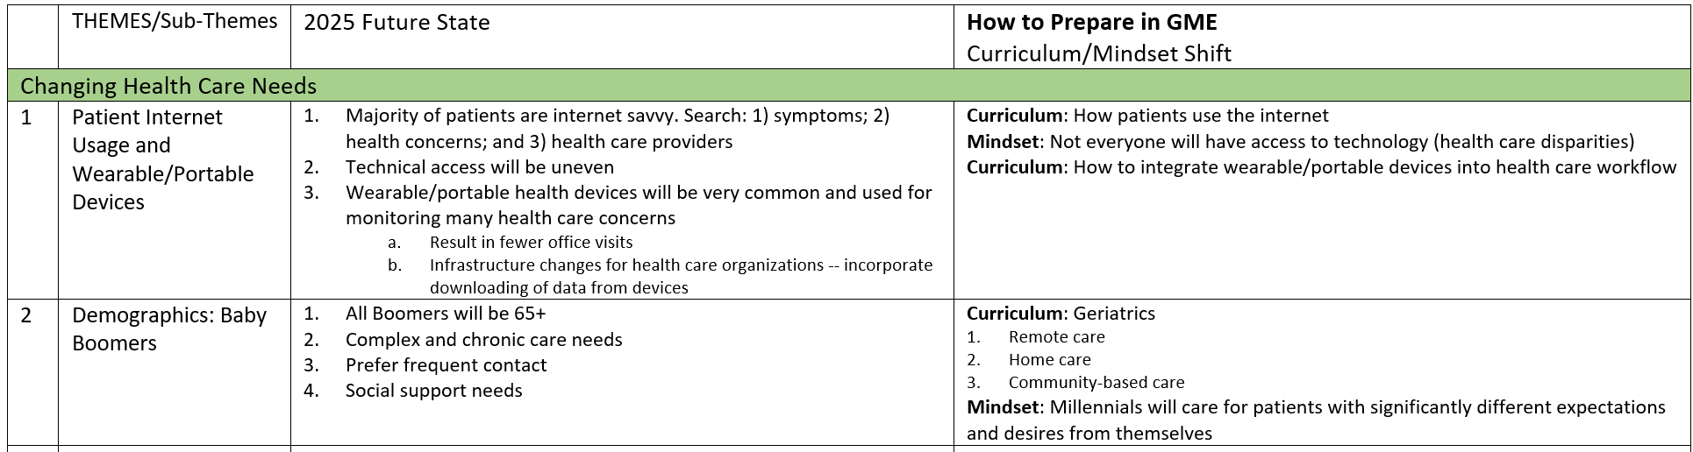
GME Table from Partners®

Slide 15
Where is your Sponsoring Institution on the SI2025 Trajectory
PHASE I: Administrative oversight & educational support
PHASE II:
Introduction of system-oriented educational support & clinical integration of GME
PHASE III:
Full implementation system-oriented educational support & clinical integration of GME
Presented by Partners in Medical Education, Inc. 2022

Slide 16
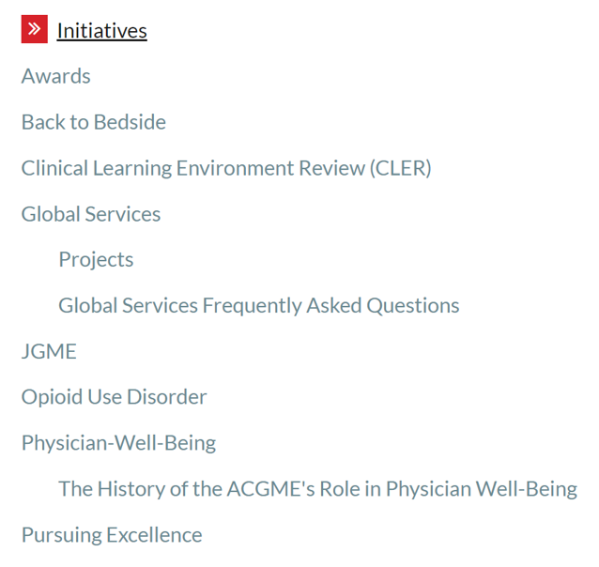
SI2025 Recommendations
The ACGME should introduce and develop standards for SIs that are consistent with the future state envisioned in the SI2025 findings.
  Revisions to IRs in 2017, 2020, & 2024
  Actual Revisions to IRs in 2019, 2021, and 2022
The ACGME should develop a new initiative to recognize SIs that are complying with requirements while also leading in the areas of enhanced, systems-based educational support & integration of GME within clinical learning environments.
  Pursuing Excellence Initiative
The ACGME should promote the development and implementation of educational programs that develop the skills of GME and health care leaders, faculty, residents/fellows.
The ACGME should develop a mechanism to continually evaluate the health care environment to ensure alignment of ACGME expectations for SIs with the rapidly changing health care system and societal health care needs.
ACGME Initiatives

Slide 17
Resources
John F. Duval, Lawrence M. Opas, Thomas J. Nasca, Paul Foster Johnson, and Kevin B. Weiss (2017) Report of the SI2025 Task Force. Journal of Graduate Medical Education: December 2017, Vol. 9, No. 6s, pp. 11-57.
Debra F. Weinstein and John Patrick T. Co (2017) Predictions and Prescriptions for Institutions Sponsoring Graduate Medical Education. Journal of Graduate Medical Education: December 2017, Vol. 9, No. 6, pp. 680-682.
Patricia M. Surdyk. (2017) The History of Sponsoring Institutions, 1982-2017. Journal of Graduate Medical Education: December 2017.

Slide 18
Upcoming Live Webinar
Site Visit Are Coming!
Thursday, October 20, 2022
GME Educational Program Design II
Thursday, November 3, 2022
Lights, Camera…Zoom!
Thursday, November 17, 2022
Meet the Experts – Fall Freebie
Tuesday, November 29, 2022
Motivating Faculty to Mentor & Do Research
Thursday, December 8, 2022
Sponsoring Institution Self-Study 101
Thursday, December 15, 2022
Latest On-Demand Webinars
Wellness is a Team Sport
Looking Behind the Curtain at CMS Reporting
ADS 2022: Part II
Scholarly Activity – Starting the Year Off Right
JEDI Warriors in GME: Guardians of Justice, Equity, Diversity, and Inclusion
ACGME Complaint Letter: Now What?
Here We Grow Again – And With Our Community
The ABCs of GMEC: Part II
ADS 2022: Part I
Ask Partners – Spring Freebie
Getting to the Next Stage – Program Improvement II
Faculty Development Series
15 Minutes to Effective Feedback
Toolbox for Teaching Millennials
Taking Supervision to the Next Level
Contact us today to learn how our Educational
Passports can save you time & money!
724-864-7320
www.PartnersInMedEd.com
Presented by Partners in Medical Education, Inc. 2022
18

Slide 19

Partners in Medical Education, Inc. provides comprehensive consulting services to the GME community.
Partners in Medical Education
724-864-7320 | info@PartnersInMedEd.com
Tori Hanlon, MS< CHCP
Tori@partnersinmeded.com
Heather Peters, M.Ed., Ph.D
Heather@partnersinmeded.com
www.PartnersInMedEd.com

