Slide 1
SI2025 Part 2 of 4 : Changes on the Horizon
Heather Peters, M.Ed, Ph.d
GME Consultant

Slide 2
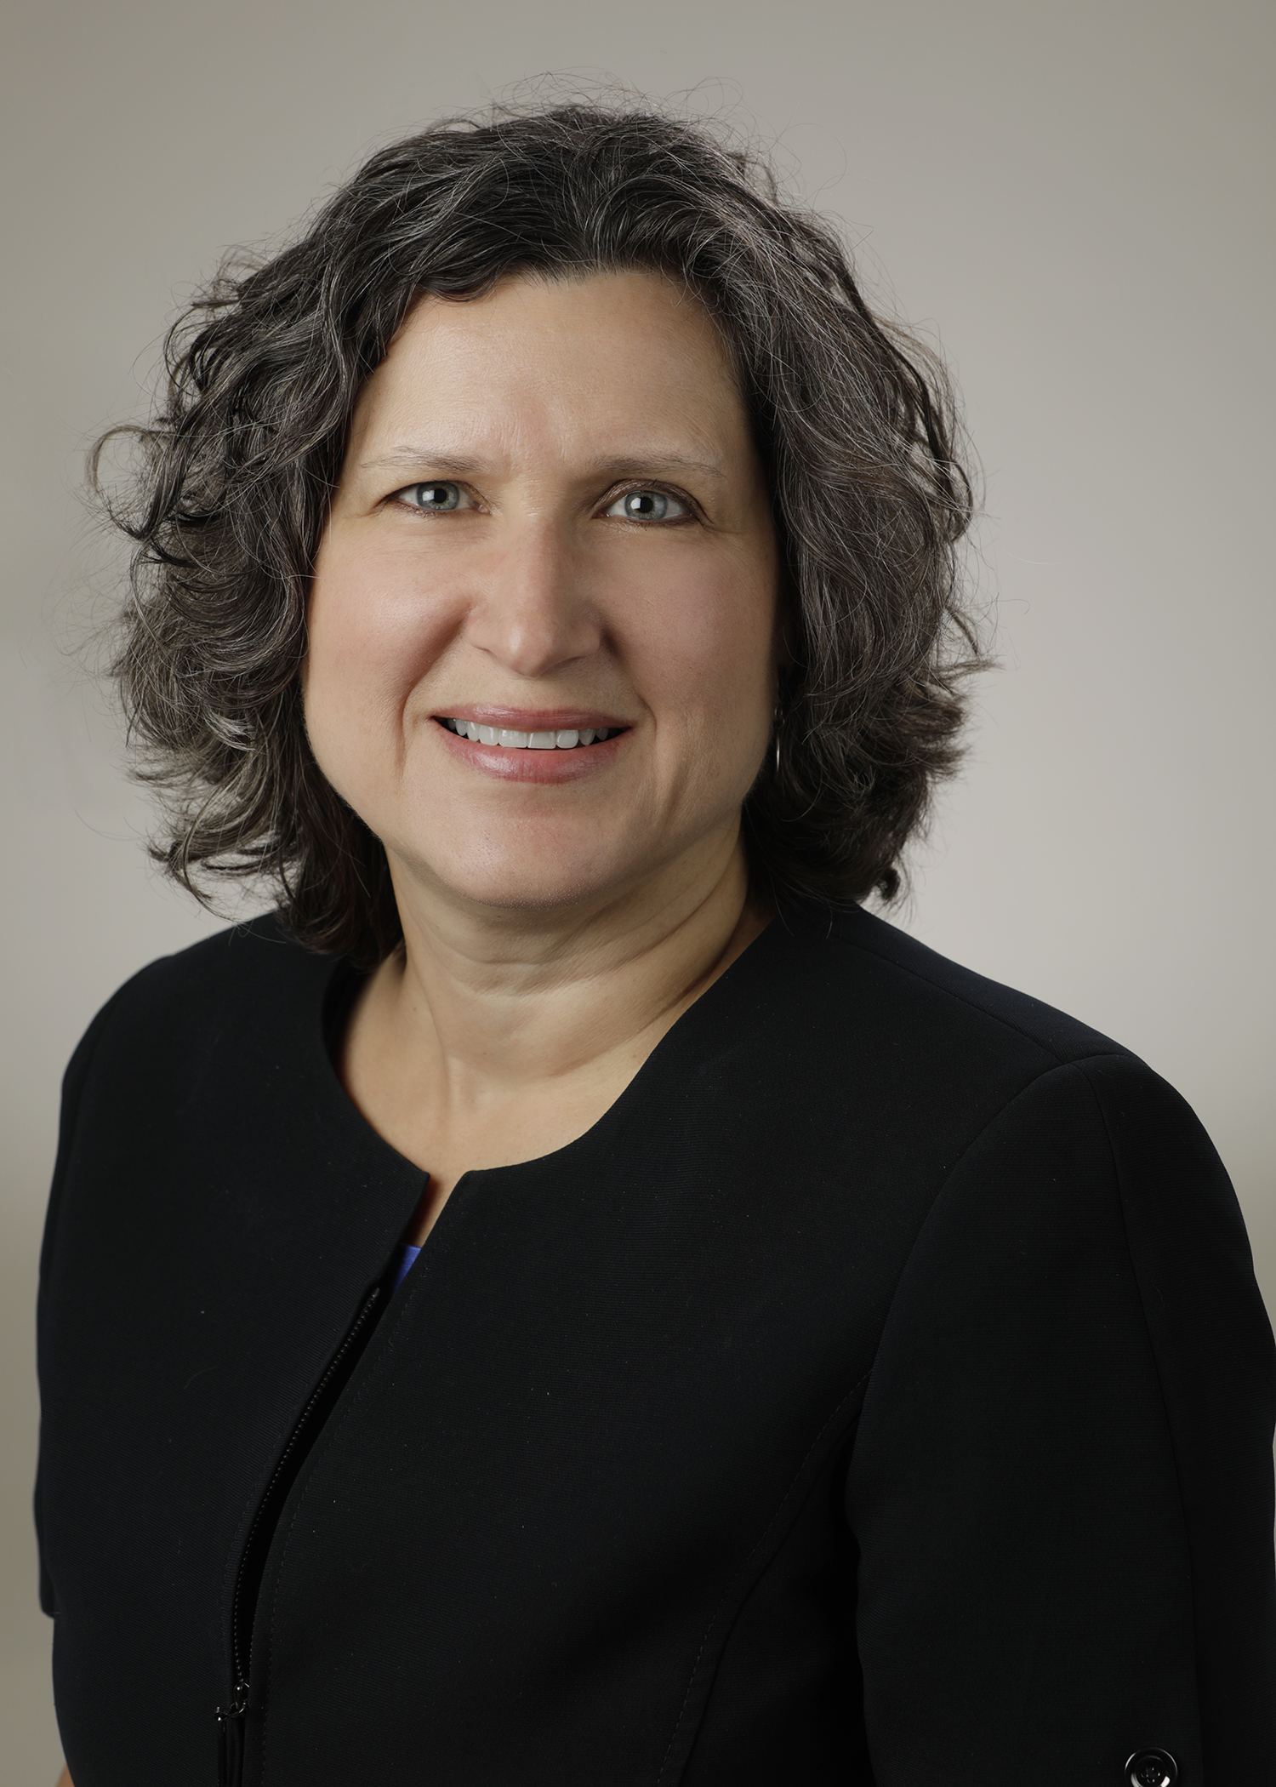
Introducing Your Presenter…
Heather Peters, M.Ed, Ph.D
GME Consultant
GME Director & DIO
Seasoned speaker at ACGME & subspecialty national meetings
Institutional and Program accreditation expertise
3 decades in education; Masters of Education in curriculum & evaluations, PhD concentration in secondary education & adult learning theories

Slide 3
Objectives
Discuss Key Concepts of Change in the following strands of the SI2025 Report:
Changing health care needs
Changes in health care delivery
Evolution in health care systems
Evolution in the role of the physician
Provide guidance for the GME (Sponsoring Institutions and Programs) as they prepare for these changes.

Slide 4
What is SI2025?
Project initiated by ACGME in 2015
Purpose to develop a future vision for institutions sponsoring graduate medical education programs
SI2025 Task Force appointed by ACGME Board of Directors

Slide 5
SI2025 Task Force
Facilitated “listening sessions” across the U.S. at existing SIs, which included stakeholders from every part of the community-based institutions and academic medical centers:
Identify up to 4 aspects of health care delivery in the U.S. in the year 2025 that are most likely to impact GME
How will these aspects of future health care delivery affect the GME needs of residents and fellows?
How will these aspects of future care delivery affect the organization of residency and fellowship training?
Qualitative Analysis
1000+ participants
Findings reflect “viewpoints expressed by multiple individuals”
Take Home: If the concept is discussed in the report, it means that this was mentioned by a number of participants

Slide 6
Task Force Findings
Theme | Webinar
Changing health care needs | SI2025 Part 2
Changes in health care delivery
Evolution in health care systems
Evolution in the role of the physician
Evolution in the role of other health care professionals | SI2025 Part 3
Evolution in GME
Uncertainties in models for GME funding
Role of GME in continuum of medical education

Slide 7
Definitions
Digital Native
Sponsoring Institution (SI)
Health Care Organization (HCO)
Community-Based Institution (CBI)

Slide 8
Changing Health Care Needs
Patient internet usage & wearable/portable devices
Demographics: Baby boomers, Generation X, and Millennials
Racial/Ethnic Diversity
Patient contact with health care professionals
Public health care quality information
Big data
Patient access to their own health care data

Slide 9
Demographics: Baby boomers, Generation X, and Millennials
Baby Boomers:
1. All will be 65+ by 2025
2. Complex and/or chronic health care needs
3. Prefer frequent contact and face-to-face health care
4. Social support needs
Generation X:
1. Prioritize convenience and cost over relationship with health care provider
2. “consumer-oriented” mindset
Millennials:
1. Very diverse
2. Technically proficient
3. Prioritize convenience in health care over costs
4. Health Systems will adapt to Millennials (target market)

Slide 10
Contact with Health Care Providers
Less frequent F2F
Team-based care
Virtual Visits
Uneven Changes

Slide 11
Access to Patient Care Data
Some have access
Most have access
Patients will have their test results in real-time
More complete data than provided now
Patients will “carry” their own data from provider to provider

Slide 12
Changes in Health Care Delivery
Physicians and health care teams
Retail health care
Hierarchy of health care teams
Medical knowledge and standardization of clinical care

Slide 13
Retail Health Care
2016 Retail Health Care
Pharmacies
2025 Retail Health Care
Pharmacies
Big Box Stores
Urgent Care Centers
Big Box Stores
Urgent Care Centers
Flu Shots
Beginning to enter into urgent health care
Providing maintenance for chronic health care issues:
Asthma
Hypertension
CHR

Slide 14
Medical Knowledge and Standardization of Clinical Care
Mindset: How can physicians learn to trust AI for diagnosis and patient management?
Clinical care pathways
Structured, standardized care plans
AI as part of health care team
Curriculum:
How to develop/evaluate clinical care pathways
How to integrate AI into health care management

Slide 15
Evolution in Health Care Systems
Health care financing and disparities
Acute care
Health system mergers
Health care payment and delivery models
Health systems and population health
Health care professionals and population health
Bundling and commoditization of health care services
Strategic planning

Slide 16
Health System Mergers
Workforce planning
Critical pipeline for new physicians
Cost of GME will be questioned
Efficiency & Productivity
Large Health Care Organizations (HCOs)

Slide 17
Health Care Payment and Delivery Models
Specialty-based Departments
Service Lines
$
Bundled payments
Capitated payments
Pay for Performance
Curriculum
Deployment of data/analytical tools
Individual, team, and organizational performance goals

Slide 18
Strategic Planning
Long-term
>5 years
Workforce goals
Physician training/recruiting
Curriculum:
Organizational missions and goals

Slide 19
Evolution in Role of Physician
Cost-efficient health care
Work-life balance
Physician Employment
Artificial intelligence
Specialization
Accountability for faculty with clinical and educational responsibilities
Compensation for faculty with clinical and educational responsibilities
Medical literature

Slide 20
Work-Life Balance
Most physicians will be employed by large HCOs
Life-style balance will be prioritized

Slide 21
Medical Literature
More medical journals:
Smaller self-published, online, and open access journals will appear
Millennials will use blogs, podcasts, and other media
Curriculum:
Conflicts and dualities in interest; critical thinking skills to evaluate literature
Mindset:
Electronic, self-directed and individual approaches to accessing and incorporating medical literature

Slide 22
Accountability & Compensation for faculty with clinical and educational responsibilities
Sponsoring Institution: Coordinate faculty development that “defines and upholds common standards of professionalism”
HCOs will have strong business interest in compensation for faculty
+
More consistent compensation
-
Accountability will increase (quality & performance metrics)

Slide 23
Recommendations
The ACGME should introduce and develop standards for SIs that are consistent with the future state envisioned in the SI2025 findings.
Revisions to IRs in 2017, 2020, & 2024
The ACGME should develop a new initiative to recognize SIs that are complying with requirements while also leading in the areas of enhanced, systems-based educational support & integration of GME within clinical learning environments.
The ACGME should promote the development and implementation of educational programs that develop the skills of GME and health care leaders, faculty, residents/fellows.
The ACGME should develop a mechanism to continually evaluate the health care environment to ensure alignment of ACGME expectations for SIs with the rapidly changing health care system and societal health care needs.

Slide 24
Resources
John F. Duval, Lawrence M. Opas, Thomas J. Nasca, Paul Foster Johnson, and Kevin B. Weiss (2017) Report of the SI2025 Task Force. Journal of Graduate Medical Education: December 2017, Vol. 9, No. 6s, pp. 11-57.
Debra F. Weinstein and John Patrick T. Co (2017) Predictions and Prescriptions for Institutions Sponsoring Graduate Medical Education. Journal of Graduate Medical Education: December 2017, Vol. 9, No. 6, pp. 680-682.

Slide 25
Upcoming Live Webinars
Ask Partners – Spring Freebie Thursday, March 21, 2019 12:00pm – 1:00pm EST
Understanding the CLE Tuesday, March 26, 2019 12:00pm – 1:00pm EST
Onboarding the New Program Director Tuesday, April 2, 2019 12:00pm – 1:00pm EST
CPR 2019 Part 2 of 4: Section I & Section II Thursday, April 18, 2019 12:00pm – 1:00pm EST
On-Demand Webinars
New Institution – The Value of GME
Meet the Experts – Fall Freebie
Milestones – Beyond the CCC
Mentoring the GME Coordinator: The First 3 Years
2019 CPR Part 1 of 4: Overview
SI 2025 Part 1 of 4: Introduction & Overview
Onboarding the New Coordinator
2019 CPR Part 1 of 4: Overview
NEW Faculty Development Series
Contact us today to learn how our Educational
Passports can save you time & money!
724-864-7320
www.PartnersInMedEd.com
15 Minutes to Effective Feedback
25

Slide 26
Partners in Medical Education, Inc. provides comprehensive consulting services to the GME community.
Partners in Medical Education
724-864-7320 | info@PartnersInMedEd.com
Tori Hanlon, MS, CHCP
tori@partnersinmeded.com
Heather Peters, M.Ed, Ph.D
heather@partnersinmeded.com
www.PartnersInMedEd.com

