Slide 1
SI2025 Part 4: The Call for Strategic Planning in GME
Heather Peters, M.Ed, Ph.D
GME Consultant

Slide 2
Introducing Your Presenter…
Heather Peters, M.Ed, Ph.D
GME Consultant
GME Director & DIO
Seasoned speaker at ACGME & subspecialty national meetings
Institutional and Program accreditation expertise
3 decades in education; Masters of Education in curriculum & evaluations, PhD concentration in secondary education & adult learning theories

Slide 3
Objectives
Review "Key Concepts of Change" in the SI2025 Report
Define: Strategic Planning
Discuss: 1) alignment with institutional initiatives; 2) finance; 3) value of GME; and 4) potential strategic goals for GME

Slide 4
What is SI2025?
Project initiated by ACGME in 2015
Purpose to develop a future vision for institutions sponsoring graduate medical education programs
SI2025 Task Force appointed by ACGME Board of Directors

Slide 5
SI2025 Task Force Findings
Theme | Webinar
Changing health care needs | SI2025 Part 2
Changes in health care delivery
Evolution in health care systems
Evolution in the role of the physician
Evolution in the role of other health care professionals | SI2025 Part 3
Evolution in GME
Uncertainties in models for GME funding
Role of GME in continuum of medical education

Slide 6
An Unknown Future…
2060
2050
Will be training until past 2050
2040
2030
2025
2019
Trainees starting in 2019

Slide 7
Changes on the Horizon
Evolving Roles
Physicians
GME
Changing
Health care delivery systems
Payment models
Health Care Team composition

Slide 8
Strategic Planning for GME organizations
A strategic plan deals with issues that cannot and will not be dealt with by operating the program or department in a business-as-usual manner.
Strategic plans require leadership and inventive thinking and assume higher risks, leading to higher rewards.

Slide 9
Strategic Planning
Long-term
>5 years
Workforce goals
Physician training/recruiting

Slide 10
Strategic Planning
Quality
Service
Finance
People
Growth

Slide 11
Rationale
CLER Findings 2018
Most GME Sponsoring Institutions do not participate or are not part of the CLE’s strategic planning
Accreditation
It’s easy to get bogged down in all the many accreditation tasks in today’s GME environment. Without a strategic approach, you risk burn-out of administration and wasted time
Spending time developing a strategic 5-10 year plan will help guide decisions about
the institution,
your programs,
the curriculum,
recruitment and more
within a framework that can adapt as the future becomes reality
Presented by Partners in Medical Education, Inc. 2019

Slide 12
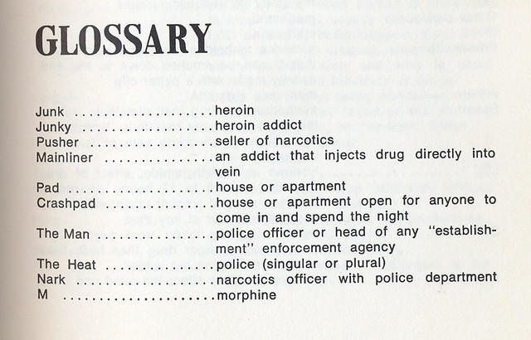
Strategic Planning Glossary
Strategic Innovation: Insight-based resource allocation that will create value for target customer segments
Strategic Insight: A new idea combining two or more pieces of information that will positively affect business success and provide competitive advantage
Strategic Planning: Channeling insights into an action plan to achieve goals and objectives
Strategic Thinking: The generation of insights to achieve advantage
Source: The Strategic Mindset: Applying strategic thinking skills for organizational success. Strategic Thinking Institute. Accessed 7/5/19 at https://www.strategyskills.com/pdf/The-Strategic-Mindset.pdf
This Photo by Unknown Author is licensed under CC BY
Presented by Partners in Medical Education, Inc. 2019

Slide 13
Key Concept: Tactics vs Strategy
Basis for Comparison | Tactics | Strategy
Meaning | A carefully planned action made to achieve a specific objective is Tactics | A long-range blueprint of an organization’s expected image is Strategy
Concept | Determining how the strategy will be executed | An organized set of activities that can lead the company to differentiation
Nature | Preventive | Competitive
What is it? | Action | Action Plan
Focus on | Task | Purpose
Formulated at | Middle Level | Top Level
Risk involved | Low | High
Approach | Reactive | Proactive
Flexibility | High | Comparatively less
Orientation | Towards the present condition | Future oriented
Source: Difference between tactics and strategy. Accessed on 7/6/19 at https://keydifferences.com/difference-between-tactics-and-strategy.html
Presented by Partners in Medical Education, Inc. 2019

Slide 14
Aligning Tactics & Strategy with GME Language and Concepts
Basis for Comparison | Tactics | Strategy | Alignment with GME Concepts
Meaning | A carefully planned action made to achieve a specific objective is Tactics | A long-range blueprint of an organization’s expected image is Strategy | Tactics: Action items for each APE Strategy: AIM statements
Concept | Determining how the strategy will be executed | An organized set of activities that can lead the company to differentiation | Tactics: Measurable steps for each action item Strategy: Building program’s reputation and differentiation from other like programs
Nature | Preventive | Competitive | Tactics: Keep program in “continued accreditation” Strategy: Recruiting the “best fit” candidates
Focus on | Task | Purpose | Tactics: Day to day/year to year Strategy: What will it take to get to the next level in 5/10 years; how will we replace our current workforce
Presented by Partners in Medical Education, Inc. 2019

Slide 15
Health System Mergers
Workforce planning
Critical pipeline for new physicians
Cost of GME will be questioned
Efficiency & Productivity
Large Health Care Organizations (HCOs)

Slide 16
We never dreamed this was possible…
Hahnemann University Hospital closure upends career paths for 570 doctors-in-training

Slide 17
Connecting the Dots to GME
Strategic Planning - Institution
Sponsoring Institution 2025
GME Service Line

Slide 18
Health Care Payment and Delivery Models
Specialty-based Departments
Service Lines
$
Bundled payments
Capitated payments
Pay for Performance
Curriculum
Deployment of data/analytical tools
Individual, team, and organizational performance goals

Slide 19
What is a service line?
A strategy to improve financial benefits while retaining the ability to serve the community
Focuses on building capabilities in a few clinical areas – key centers of excellence
High quality care to well-defined populations

Slide 20
GME Scorecard as a Service Line
Indicator | July | Aug | Sept
# Patients Seen in the ED by Residents | 633 | 768 | 812
# of Left before being seen – ED Resident shifts | 4.45 | 4.4 | 4.13
Hours logged Night Float | 372 | 372 | 360
Money Saved – Night Float Coverage PA’s | $25K | $25K | $25K
Money Saved – Physician Coverage | $37k | $37k | 37K
# Safety Events Logged | 12 | 18 | 19
LOS – Teaching Service | 4.45 | 4.4 | 4.13
% Discharges before Noon Teaching Service | 47% | 51% | 55%
No show rate - Continuity Clinic | 33% | 39% | 28%
Continuity Clinic Visits | 320 | 401 | 427
Hand Washing – Teaching Team/ED/Surg | 88% | 81% | 92%

Slide 21
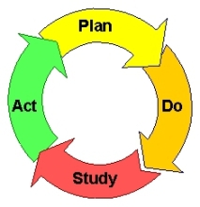
Workforce Planning in GME
Process:
Current state analysis
Future state analysis
Gap analysis
Execute & Adjust
Workforce Members:
Physicians
Interprofessional members of the health care team
GME support (coordinators, GME team)
GME leadership

Slide 22
Artificial Intelligence: Medical Knowledge and Standardization of Clinical Care
Mindset: How can physicians learn to trust AI for diagnosis and patient management?
Clinical care pathways
Structured, standardized care plans
AI as part of health care team
Curriculum:
How to develop/evaluate clinical care pathways
How to integrate AI into health care management

Slide 23
GME within a Business Culture
Remember…the members of the C-Suite often have an MBA...so…
they think differently
they use a different language

Slide 24
“C” Suite Focus: Improve Results
Increasing sales (revenue)
Increasing market share
Improving customer loyalty
Reducing costs
Reducing errors
Customer service
Employee turnover
Employee engagement
C-Suite Pillars
Quality
Service
Financial
People
Growth

Slide 25
Under-Valued Areas of GME
Hospital coverage
Access to care – leverage of ambulatory visits
Implementation quality improvement projects
Core Measures
HCAHPS
Scholarly activity
Care for under and uninsured

Slide 26
Take Home Points
“Get to the table”
Scaffold program leadership
Pay attention to local/national trends
Look forward
Review the implementation table
2060
2050
2040
2030
2025
2019

Slide 27
“Get to the table”
Be part of the discussions about where your institution is going
Be sure that your resource needs are felt at the top levels of your institution
Be clear with your growth plans for GME
Be ready justify the value of your GME programs in your institution

Slide 28
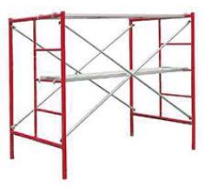
Scaffold Program Leadership
How to quantify trainee and faculty activities to prove value to the organization
Strategic planning principles
Looking to the future

Slide 29
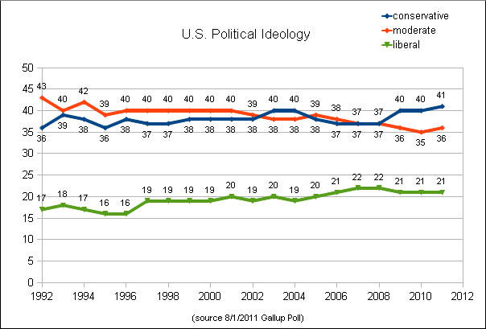
Local/National Trends
National politics will affect
future GME development
Local trends need to be
considered when planning
Look Forward…
It’s tempting to look backward…it’s essential to keep looking forward
Change is scary… but it’s not going away… it’s up to us be the champions of looking forward and embracing change

Slide 30
Review the Implementation Table Provided by Partners®
 | THEMES/Sub-Themes | 2025 Future State | How to Prepare in GME
Changing Health Care Needs
1 | Patient Internet Usage and Wearable/Portable Devices | Majority of patients are internet savvy. Search: 1) symptoms; 2) health concerns; and 3) health care providers Technical access will be uneven Wearable/portable health devices will be very common and used for monitoring many health care concerns Result in fewer office visits Infrastructure changes for health care organizations -- incorporate downloading of data from devices | Curriculum: How patients use the internet Mindset: Not everyone will have access to technology (health care disparities) Curriculum: How to integrate wearable/portable devices into health care workflow
2 | Demographics: Baby Boomers | All Boomers will be 65+ Complex and chronic care needs Prefer frequent contact Social support needs | Curriculum: Geriatrics Remote care Home care Community-based care Mindset: Millennials will care for patients with significantly different expectations and desires from themselves
3 | Demographics: Generation X | Prioritize convenience and cost over relationship “consumer-oriented” | Curriculum: “Consumer-oriented” health care Urgent Care & Retail Care Team for health care will be across organizations
4 | Demographics: Millennials | Diverse Technically proficient Prioritize convenience in health care over cost Health systems will adapt (target market) | Curriculum: How to practice medicine with the confines of a health system Curriculum: Technical proficiency (internet usage; virtual visits)
5 | Racial/Ethnic Diversity | US population will be more diverse than even | Curriculum: Providing care for different cultures and how to practice inclusion

Slide 31
Upcoming Live Webinars
Understanding Practice Data Tuesday, August 15, 2019 12:00pm – 1:00pm EST
CPR 2019 Part 4 of 4: Putting It All Together Tuesday, August 27, 2019 12:00pm – 1:00pm EST
Crafting “Top-Notch” Goals, Objectives and Evaluations Thursday, September 12, 2019 12:00pm – 1:00pm EST
Feedback – From The Top Down Tuesday, September 17, 2019 12:00pm – 1:00pm EST
On-Demand Webinars
2019 CPR Part 1 of 4: Overview
Aims and Action Plans
SI 2025 Part 2 of 4: Changes on the Horizon
Ask Partners – Spring Freebie
Understanding the CLE
CPR 2019 Part 2 of 4: Section I & Section II
SI 2025 Part 3 of 4: GME Evolution, Funding & Future
Building Your Sponsoring Institution – The First 2 Years
Special Reviews – Helpful not Hurtful
2019 CPR Part 3 of 4: Section IV & Section V
NEW Faculty Development Series
15 Minutes to Effective Feedback
Toolbox for Teaching Millennials
Contact us today to learn how our Educational
Passports can save you time & money!
724-864-7320
www.PartnersInMedEd.com
31

Slide 32
Partners in Medical Education, Inc. provides comprehensive consulting services to the GME community.
Partners in Medical Education
724-864-7320 | info@PartnersInMedEd.com
Heather Peters, M.Ed, Ph.D
heather@partnersinmeded.com
www.PartnersInMedEd.com

