Slide 1
Please Note…
Please make sure your Start Video is OFF when logging into the WebEx platform.
Here is what it should look like
ALSO
It is NORMAL to not hear any sound until the webinar starts at 12:00 noon EST.
Your phone line is muted, but you can always chat to the host, BJ Schwartz, if you have any questions or concerns during this time.

Slide 2
Sponsoring Institution Self-Study 101
Heather Peters, M.Ed, Ph.D
Christine Redovan, MBA, MLIS

Slide 3
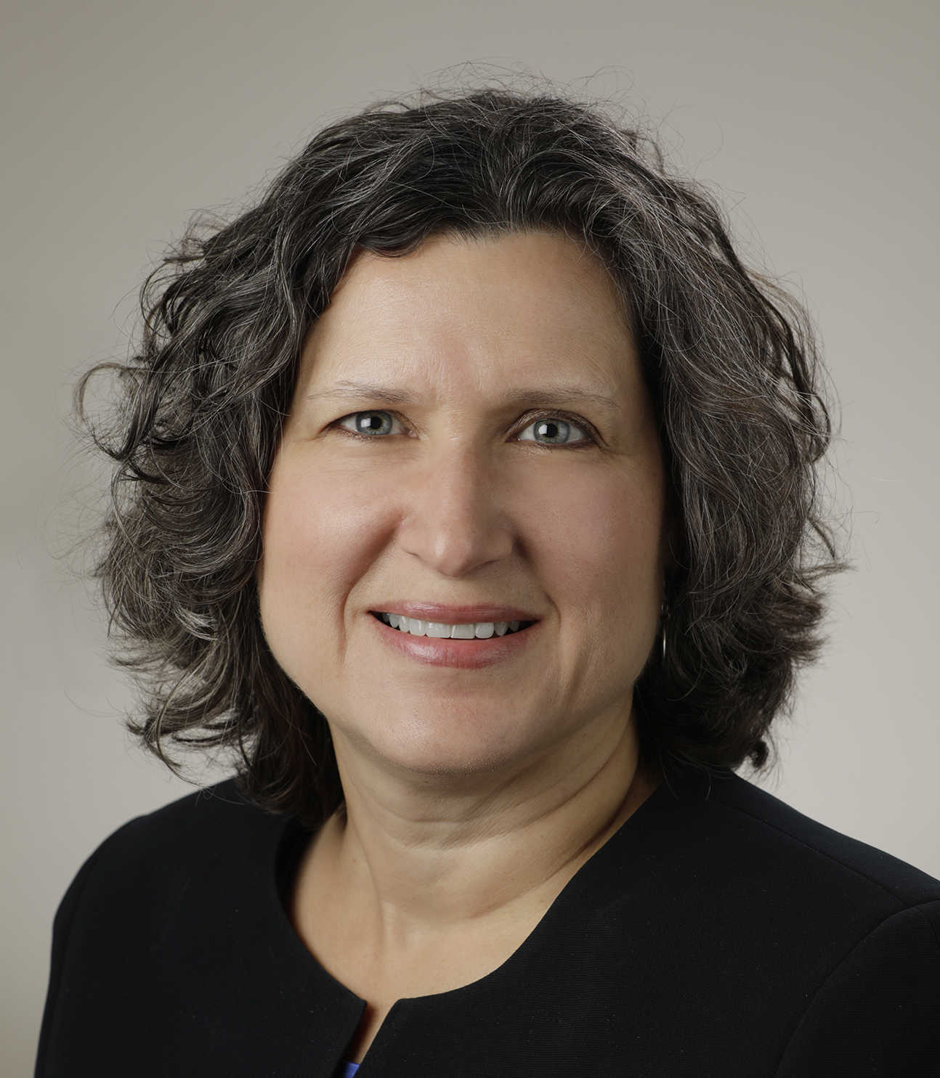
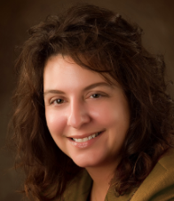
Introducing Your Presenters…
Heather Peters, MEd, PhD
Christine Redovan, MBA, MLIS
Seasoned facilitator for SI evaluation
Focused on metrics for documenting improvement and outcomes
Co-led sponsoring institutional self-studies
Experienced strategic planner for multiple GME organizations
Presented by Partners in Medical Education, Inc. 2022

Slide 4
Learning Objectives
Develop a framework for successful self-study completion
Discuss a suggested timeline for activities in the SI self-study and preparation for the 10-year site visit
Provide insight and outcomes from actual SI self-studies
Outline best practices for SI self-study processes, including the self-study committee and all stakeholders

Slide 5
Institutional Self-Study Framework
WHY: Provides a framework for SI improvement for the next 3-5 years
WHO: A self-study committee composed of major stakeholders of the institution
HOW: The self-study committee analyzes GME performance and identifies actions that can be taken to achieve defined institutional aims
Presented by Partners in Medical Education, Inc. 2022

Slide 6
WHEN: ACGME Timeline
Start before you receive your letter. Six months is not enough time.
Review your Aims at least once (can be included in AIR) and provide updates
Review requirements for sponsoring institution in relation to your GMEC minutes

Slide 7
How do we start?
Best Practice: Based on the due date for your self-study (see your ACGME ADS for exact date) - plan to start 6 months out
Assemble Self-Study committee (more on next slide)
Develop timeline for Self-Study Committee Meetings
plan on at least 4 meetings
Mission & SWOT
Aims & Determining Survey Data Needed
Post Survey Analysis
Finalizing Aims/Action Plans
Presented by Partners in Medical Education, Inc. 2022

Slide 8
Self-Study Committee
Think broadly – who is impacted by your trainees?
Required:
DIO (primary responsibility)
One or more peer-selected residents/fellows
A representative of the senior leadership
Institutional coordinator, if the institution has one
Possible members:
Program Directors
Graduates (those that stayed and those that didn't)
Service Chiefs
Patients
Community representatives
Corporate leadership
Additional Senior Leadership
Program Coordinators
Other GME staff
This is a crucial step – the more work and thought you put into your committee, the more robust your self-study will be (ACGME self-study question)
Presented by Partners in Medical Education, Inc. 2022

Slide 9
What do we do?
Determine areas of Risk
Existing oversight mechanisms of the SI/GMEC:
SWOT Analysis
APE reports to the GMEC
ACGME Surveys
Trainee feedback (Forums & other Venues)
Strengths
Weaknesses
Opportunities
Threats
Review Documents
AIR Reports
Local strategic planning efforts
CLER Reports
Summaries of program Self-studies

Slide 10
How to Develop Aims & Action Plans
3-5 Aims relevant to GME mission
Refer to Three Pillars of Institutional Achievement (more to come)
Language on website:
The team should identify the resources, processes, and policies that will support achievement of the aims, and should describe actions the Sponsoring Institution will take to facilitate achievement over the next three to five years.
Language in FAQs:
Aims should be SMART (specific, measurable, achievable, realistic, and time-bound)
KEY Point: These aims are for 3-5 years, so don't feel they need to be fully achieved by the 10-year site visit

Slide 11
Aims
Related to GME institutional mission
Related to institutional performance analysis
SWOT Analysis
Identify resources, processes and policies that will support meeting the aims
This Photo by Unknown author is licensed under CC BY-ND.
Makes action plan easy!
Presented by Partners in Medical Education, Inc. 2022

Slide 12
Aim Example
Aim | Resources | Processes | Policies
(S) Improve access to primary care for patients in 90210 zip code. (M) Increase 90210 primary care visits by 25%. (A) Existing facilities and personnel in place. (R) Required rotations, QI techniques, scholarship (T) Begin July 2022; assessment every six months; final results January 2024. | FM and IM residents and faculty FMP located 2 miles from 90210. IM residents rotate at the free clinic within 90210. Preliminary data from community needs assessment Community funding grant Local and national agencies | Surveys Clinic hours Public transportation hours/routes Unassigned patients & discharge instruction | 90210 is part of the service area of the SI Health disparity project a requirement for graduation Social worker part of all discharges

Slide 13
Action Plan
Item | Link to SI Aims | Expectations | Responsible Party | Status Update
FMP remain open until 9 pm at least one day a week | Improve primary care access for patients from 90210 Reduction of barriers to care Joint hospital & GME project | Conduct survey of patients for potential hour expansion, including preferred day and time Cost/benefit analysis of extended hours Impact of extended hours on residency | Dr. Smith, FM PD Dr. Jones, PGY 1 Dr. Dre, PGY 3 Ms. Pacman, FMP admin Mr. Rogers, COO | 12/22 - survey identified Monday and Wednesday as preferred days.
Unassigned patient referral from ER to FMP | Improve primary care access for patients from 90210 Improve primary care access for all patients Joint hospital & GME project | Unassigned patients given FMP brochure. Barriers discussed during discharge. Appointment made during discharge. | Dr. Pepper, FM APD Dr. Johnson, ER director Ms. Jackson, ER Case Manager PGY 2 class FM

Slide 14
Role of the GMEC, C-Suite & Academic Leadership
C-Suite
Guide
Support
Confirm
Question
Common Goals
GMEC
Develop
Question
Prepare
Participate
Support
Oversee
DIO
Lead
Develop
Share
Listen
Support
Presented by Partners in Medical Education, Inc. 2022

Slide 15
Institutional Self-Study Summary Form
Self-Study Team
SI Mission
Opportunities
Threats
Aims
Advancing Aims
SI Actions
Understanding the ACGME Framework: National Learning Community for Sponsoring Institutions – 3 Pillars
Presented by Partners in Medical Education, Inc. 2022

Slide 16
Sponsoring Institution Strategies from the National Learning Community Initiative
Presented by Partners in Medical Education, Inc. 2022

Slide 17
Once the self-study is submitted
Begin preparing for your 10-year site visit
Review compliance for all elements of the sponsoring institution
WARNING: Lots of changes have been made to the Institutional Requirements in the past 5 years
Common Citations for SIs
Lack of oversight of programs by the GMEC
Lack of oversight of CEE (work hour) logging/compliance
Lack of participation of GMEC members
Lack of tracking of required responsibilities of the GMEC
Lack of peer-selected trainees in attendance at the GMEC
Lack of mechanism for trainees to report lapses in professionalism, or supervision (NEW in 2023 – harassment)
Continue to monitor your aims (will be asked on the achievement summary)
AIR
GMEC updates
GME community updates
Best Practice: Create a visual of your aims for posting
Presented by Partners in Medical Education, Inc. 2022

Slide 18
6 Months prior to 24-Month Mark (scheduled SV date)
Revive the Self-Study Committee
Review the AIMS and action plans
Should be reviewing regularly
What have you accomplished?
What have you learned?
What data/outcomes do you have to share?
Months
Don’t forget – You should be working on preparing for the ACGME site visit!

Slide 19
Institution Self-Study Achievements Summary Form
Describe improvements in critical areas identified during the Self-Study that have already been achieved.
Discuss how these improvements relate to the Sponsoring Institution's graduate medical education mission.
Summarize what was used to track progress and to assess the improved outcomes.
Discuss how the Sponsoring Institution's leadership coordinated aims and improvement priorities for the Sponsoring Institution.
Discuss whether and how the Self-Study and preparing for the 10-year Accreditation Site Visit added value, and summarize any learning that occurred during this process.
Presented by Partners in Medical Education, Inc. 2022

Slide 20
Self-study findings in action
Promote and enhance professional development throughout the graduate medical education community. | Professional development throughout the GME community will be encouraged by developing and implementing an in-house examination for program administrators intended to familiarize them with ACGME institutional, common program requirements, and policies. Completion of the in-house exam and/or obtaining TAGME certification will result in a monetary reward. Development of a similar in-house course for new program directors is being planned. | Program Administrators meet regularly One of our administrators and our Director of GME re-certified TAGME Recognized with a luncheon for GME Professionals Day-with questions and discussion by DIO Bonuses awarded for TAGME recertification | The in-house examination is being composed (pre-TAGME)
 | Faculty development courses and research publication data will be monitored by developing a tracking mechanism. ACGME Annual Conference attendance will be promoted for GME leaders and administrators. | Currently using New Innovations and GME office New CME division started under DIO, which will also be used for Faculty Development Tracking GME office has acquired fulltime IT staff person | Development of IT tracking mechanism
Presented by Partners in Medical Education, Inc. 2022

Slide 21
A Few More Instructions..
Year of SI Self-Study, you can submit your SS in lieu of the AIR
Nice suggestion, but consider that the Senior Leadership is not as likely to understand the self-study as well as the AIR
Single-Program Sponsoring Institution (SPSI)
May use its AIR process to complete its Institutional Self-Study.
However, it would modify its AIR so that performance indicators are based on three to five years of data, and action plans are developed for a 3–5-year period.
May submit an executive summary of its Institutional Self-Study in lieu of the SS
Include all required elements of AIR executive summaries, as indicated in Institutional Requirements I.B.5.b) and I.B.5.b).(1)-(2).
Presented by Partners in Medical Education, Inc. 2022

Slide 22
Resources
Institutional Self-Study (acgme.org)
Under "What we do"
ACGME Guidance for Institutional Self-Studies – Webinar Handout

Slide 23
Upcoming Live Webinar
Digging for Data V
Thursday, January 5, 2023
Developing Residency Budgets
Thursday, January 19, 2023
Onboarding Residents
Thursday, February 2, 2023
How Semi-Annual Evaluations Document, Educate, and Improve
Thursday, February 9, 2023
Ask Partners – Spring Freebie
Tuesday, March 21, 2023
Latest On-Demand Webinars
Meet the Experts – Fall Freebie
Lights, Camera…Zoom!
GME Educational Program Design II
Site Visits Are Coming!
SI 2025: 2022 Check Up
Back To Basics: Intermediate Topics for New Program Coordinators
GME Educational Program Design I
Wellness is a Team Sport
Looking Behind the Current of CMS Reporting
ADS 2022: Part II
Scholarly Activity – Starting the Year Off Right
NEW Program Director Coaching Series
Jan – March Session – FULL
Next Session Starts April – June
6 one-hour group sessions over 12wks
2 one-on-one 30 min indiv. Sessions
Limited Enrollment for interactivity
Course Materials/GME Community Network
Email BJ@PartnersInMedEd.com for pricing and availability
Contact us today to learn how our Educational
Passports can save you time & money!
724-864-7320
www.PartnersInMedEd.com
Presented by Partners in Medical Education, Inc. 2022
23

Slide 24
Partners in Medical Education, Inc. provides comprehensive
consulting services to the GME community.
Need help setting up the framework and developing an action plan for
your Self Study?
We can help! Contact us today.
Partners in Medical Education
724-864-7320 | info@PartnersInMedEd.com | www.PartnersInMedEd.com
Heather Peters, M.Ed, Ph.D
Heather@PartnersInMedEd.com
Christine Redovan, MBA, MLIS
Christine@PartnersInMedEd.com

