Slide 1
Please Note…
Please make sure your Start Video is OFF when logging into the WebEx platform.
Here is what it should look like
ALSO
It is NORMAL to not hear any sound until the webinar starts at 12:00 noon EST.
Your phone line is muted, but you can always chat to the host, BJ Schwartz, if you have any questions or concerns during this time.

Slide 2
Site Visits Are Coming! (…maybe?)
Presented by: Christine Redovan, MBA, MLIS

Slide 3
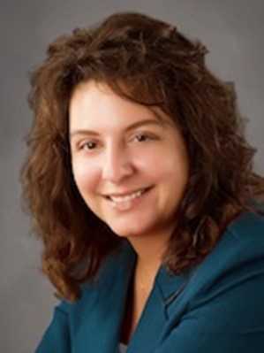
Introducing Your Presenter…
Christine Redovan, MBA, MLIS
GME Consultant
Successful reaccreditation of over 100 residency programs and institutions
Continuous accreditation expert
Focused on best practices, collaboration and data driven outcomes

Slide 4
Learning Objectives
Understand the site visit process in 2022
Utilize tools to perform an audit of your residency program
Incorporate lessons learned into program improvement

Slide 5
Program Site Visits 101
Site Visit Type | Purpose | Preparation
Application | Initial Accreditation | Program, PD, Faculty
Accreditation | Continued Accreditation | Program, PD, Faculty, Residents
10-year Accreditation* | Continued Accreditation | Program, PD, Faculty, Residents
At RC Request | Annual data review Survey results Complaint | Program, PD, Faculty, Residents
*postponed through June 2022 Source: ACGME Policies & Procedures (6/2022)

Slide 6
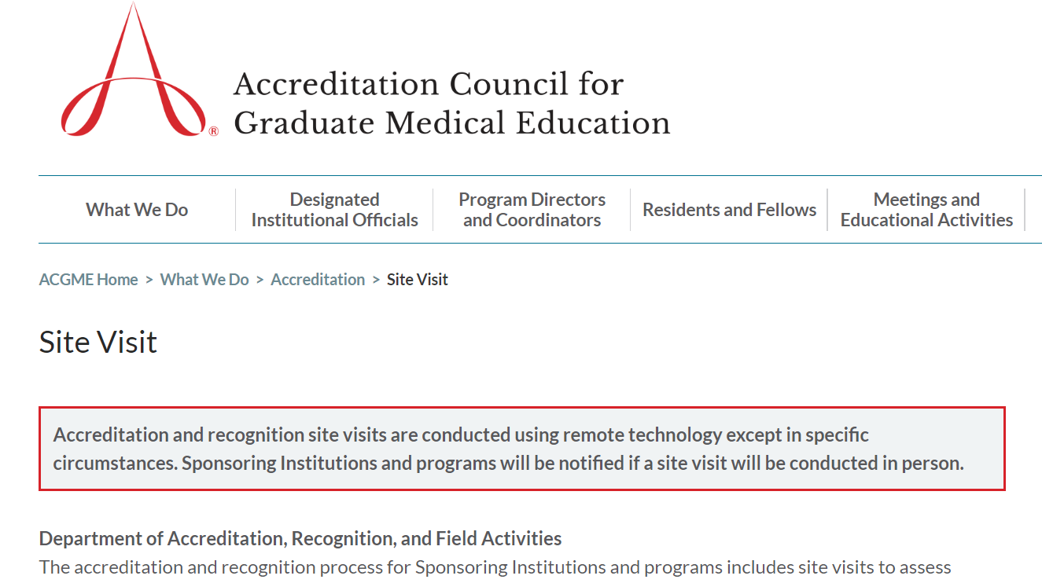
Where do we start?

Slide 7
Overview of Process
Black out date request
Receive notification of site visit date – from ACGME field staff
Accept or postpone
Assigned site visitor
Updating ADS
Site visit upload list
Document due dates
Receive site visit letter – from site visitor
Schedule for the day
Additional document request (if applicable)

Slide 8
ADS Update
Straightforward - what we complete on an annual basis.
Pay attention to time frames!
last academic year
current academic year
last three years
today
This Photo by Unknown Author is licensed under CC BY-NC

Slide 9
ADS Attachments
Specialty-specific application
The word document on RC website
Asks specific questions related to the requirements
May require site data
It is not clear if this will be required for 10-year site visits
Block Diagram
Part of annual data update; double check you are using the required template

Slide 10
ADS Attachments
Program Letters of Agreement (PLA)
Duration of the educational experience(s)
Content of the educational experience(s) (e.g., rotation names, educational objectives)
Site director name and title
Faculty members who will assume educational and supervisory responsibility for residents during each rotation at the site (faculty members can be identified by individual name or as a group)
Specific responsibilities of the supervising faculty members for teaching, supervision, and formal evaluation of residents
Policies and procedures that will govern resident education during the assignment
Source: CPR I.B.2.a; ACGME Program Director’s Guide to the Common Program Requirements, V 2.0, Oct 2021.

Slide 11
ADS Attachments
Program Letters of Agreement (PLA)
Considerations for travel time and distance to the participating site, and when the program should consider providing the residents with accommodations proximal to the participating site
Description of expectations regarding resident participation in didactic activities during rotations at the participating site
Signed by the DIO
Reviewed and updated every 10 years
Source: ACGME Program Director’s Guide to the Common Program Requirements

Slide 12
ADS Attachments
Program Letters of Agreement (PLA)
Update when:
PD changes
Site director changes
Resident assignment changes
Revisions to CPR 1.B.1.a through d.
Source: ACGME Common Program Requirements FAQ (8/25/2022)

Slide 13
ADS Attachments
Goals and Objectives
Competency Based
PGY level specific (if applicable)
Show progression
Measurable
Use Bloom’s Taxonomy Action Verbs
Does your PEC review rotation goals and objectives?
Source: ACGME Program Director’s Guide to the Common Program Requirements, V 2.0, Oct. 2021.

Slide 14
ADS Attachments
Blank Evaluation Forms
Easy! Print off blank forms from RMS
Resident evaluation of faculty*
Resident evaluation of program*
Faculty evaluation of program*
Faculty evaluation of resident
Multi-source evaluations of resident*
Semi-annual evaluation
Final evaluation
This Photo by Unknown Author is licensed under CC BY
*Anonymous

Slide 15
ADS Attachments
Program Specific Policies
Clinical and Educational Work Hours
Supervision of Residents
Resident & Faculty Well-Being
Are your policies updated?
Do they contain specialty specific information?
Are all your policies updated?

Slide 16
Virtual Visits
Site visitor will review specific program information that we upload into ADS under a separate “upload” tab
Usual documents that are reviewed during in-person site visits
Secure environment; no need to remove names or other identifying information
Follow the specific instructions for each upload

Slide 17
Site Visit Uploads – Resident Files
Resident Files
Two current files from each year of training
COMPLETED!
Faculty eval of resident
Multi-source eval of resident
Semi-annual eval of resident
This Photo by Unknown Author is licensed under CC BY-SA-NC

Slide 18
Site Visit Uploads - Resident Files
Run aggregate report from residency management system (RMS)
Do you have the multi-source evals?
- peer
- self
- patient
- nurse
- direct observation
- tech/clerical
What do your requirements say?

Slide 19
Site Visit Uploads - Resident Files
Does your semi-annual evaluation have:
Required elements per specialty?
Reference or inclusion of individualized learning plan?
If doubles as annual evaluation, reference readiness to progress to the next year of the program?
Signature of PD and resident?

Slide 20
Site Visit Uploads – Resident Files
Resident Files
Final evaluations of graduates from the last three years
Does your final evaluation have:
Reference to CCC and Milestones?
Signature of PD and resident?
The “magic” sentence?
[resident] has demonstrated the knowledge, skills, and behaviors necessary to enter autonomous practice.

Slide 21
Site Visit Uploads – Resident Files
Files of residents who have left the program in the last three years
Transfer documentation for residents who have transferred into the program in the past three years
At a minimum:
- summative competency-based performance evaluation
- Milestones
What do your requirements say?
What does your policy say?

Slide 22
Site Visit Uploads - Didactics
Current academic year
Lectures
Conferences
Interdepartmental conf
Courses
Labs
Asynchronous learning
Simulation
Drills
Case discussion
M & M
Grand rounds
Journal club
1. Title of Activity
2. Activity Type
3. Faculty or resident leading/presenting
4. Any specialty specific requirement

Slide 23
Site Visit Uploads – Faculty Files
Completed annual, confidential evaluation of a faculty member by the resident
Easy! Pick one faculty and run an aggregate report
Do faculty have evaluations?
Does the PD review the evaluations with the faculty annually?

Slide 24
Site Visit Uploads – Program Policies
Guidelines for circumstances and events that require residents to communicate with appropriate supervising faculty
Policies and procedures to ensure coverage and continuity of patient care in circumstances in which residents are unable to attend work, including but not limited to fatigue, illness, family emergencies and parental leave.
1. Is the call-in process written?
2. Does it cover all scenarios?

Slide 25
Site Visit Uploads
Work Hour Report Data
Resident Participation in Quality Improvement
Minimum of 6 months of data
Same format that GMEC uses
Written list of up to 10 activities and opportunities
Faculty & resident names
Title of project/activity
Short description of project/activity
This Photo by Unknown Author is licensed under CC BY-NC

Slide 26
Continuous Accreditation Readiness
Take one piece at a time
Identify areas that could use updating
Use your PEC
Program audits would make a great coordinator committee activity and/or training
Program audits would make a great GMEC sub-committee and/or oversight activity
When was the last time you really read your requirements?

Slide 27
Successful Programs
PD Guide to Common Program Requirements
Specialty Requirements
Contains common requirements as well as the specific specialty requirements. Includes detailed educational and clinical items.
Detailed explanation on what is expected for each element of the common program requirements.
Specialty FAQs
ACGME Policy & Procedure Manual
Additional explanation for areas of the requirements that are confusing or need additional information.
Describes the accreditation and recognition process and expectations for programs and sponsoring institutions.
Specialty Documents & Resources
CPR FAQs
Contains block diagram template, case log information, complement increases, RC updates.
Additional explanation for areas of the common program requirements that are confusing or need additional information.
Designed by PresentationGO.com
Notes:
© Copyright PresentationGO.com – The free PowerPoint and Google Slides template library

Slide 28
Final Thoughts….
Looking at your program from a site visit perspective reduces emotion/bias
Encourages deeper self-evaluation during the annual program evaluation (APE)
Identified gaps make for great APE action plans
Sharing may spark ideas and continue improvement in efficiency and effectiveness
This Photo by Unknown Author is licensed under CC BY-SA-NC

Slide 29
Q & A

Slide 30
Upcoming Live Webinar
GME Educational Program Design II
Thursday, November 3, 2022
Lights, Camera…Zoom!
Thursday, November 17, 2022
Meet the Experts – Fall Freebie
Tuesday, November 29, 2022
Motivating Faculty to Mentor & Do Research
Thursday, December 8, 2022
Sponsoring Institution Self-Study 101
Thursday, December 15, 2022
Latest On-Demand Webinars
GME Educational Program Design I
Wellness is a Team Sport
Looking Behind the Curtain at CMS Reporting
ADS 2022: Part II
Scholarly Activity – Starting the Year Off Right
JEDI Warriors in GME: Guardians of Justice, Equity, Diversity, and Inclusion
ACGME Complaint Letter: Now What?
Here We Grow Again – And With Our Community
The ABCs of GMEC: Part II
ADS 2022: Part I
Ask Partners – Spring Freebie
Faculty Development Series
15 Minutes to Effective Feedback
Toolbox for Teaching Millennials
Taking Supervision to the Next Level
Contact us today to learn how our Educational
Passports can save you time & money!
724-864-7320
www.PartnersInMedEd.com
Presented by Partners in Medical Education, Inc. 2022
30

Slide 31
Partners in Medical Education, Inc. provides comprehensive consulting services to the GME community.
Partners in Medical Education
724-864-7320 | info@PartnersInMedEd.com
Christine Redovan, MBA, MLIS
Christine@partnersinmeded.com
www.PartnersInMedEd.com

