Slide 1
Please Note…
Please make sure your Start Video is OFF when logging into the WebEx platform.
Here is what it should look like
ALSO
It is NORMAL to not hear any sound until the webinar starts at 12:00 noon EST.
Your phone line is muted, but you can always chat to the host, BJ Couch, if you have any questions or concerns during this time.

Slide 2
Site Visits – What to Expect in 2021
Heather Peters, M.Ed, Ph.D
Christine Redovan, MBA, MLIS
Tori Hanlon, MS, CHCP

Slide 3
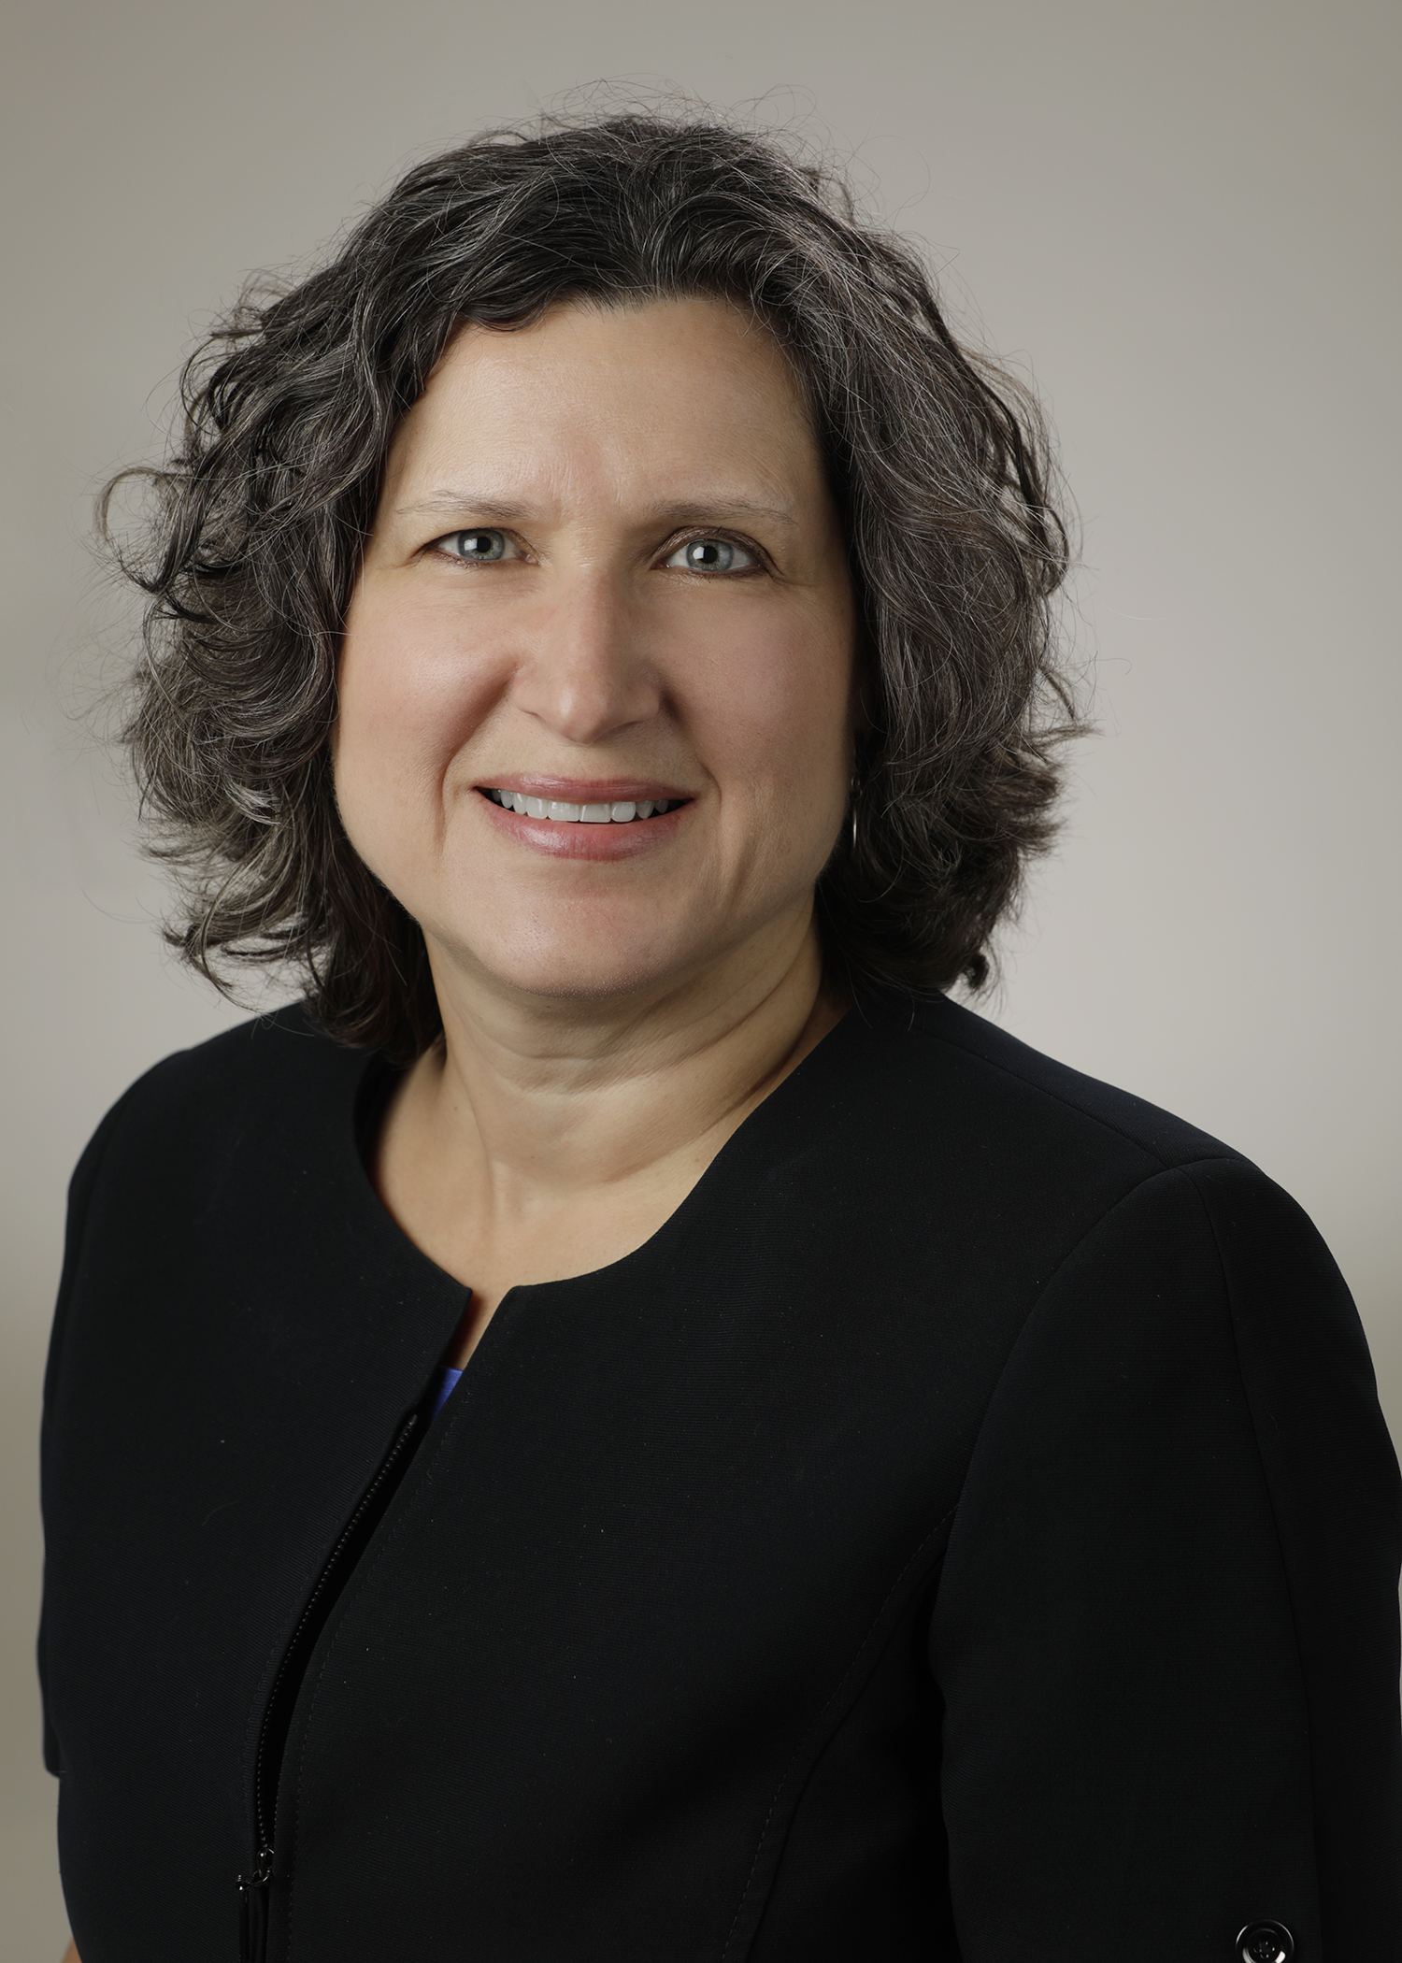
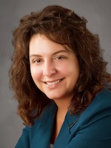
Introducing Your Presenters…
Heather Peters, M.Ed, Ph.D
GME Consultant
Christine Redovan, MBA, MLIS
GME Consultant
Tori Hanlon, MS, CHCP
GME Consultant
Combined 40+ years of site visit preparation
Unique perspectives from multiple specialties

Slide 4
LEARNING OBJECTIVES
OUTLINE the different types of ACGME site visits
DESCRIBE best practices for site visit preparation
DISCUSS trends in site visits identified during the past 12 months
ACGME Expectations for Content of Resident and Fellow Files
ACGME Site Visit Document List by Accreditation Status for Accreditation and Recognition Site Visits
ACGME Updating ADS by Accreditation or Recognition Status
CEE Work Hours Reporting Template
Didactics/Conference Schedule Template

Slide 5
Types of Site Visits

Slide 6
IMPORTANT
New ACGME Institutional & Program Requirements effective July 1, 2021

Slide 7
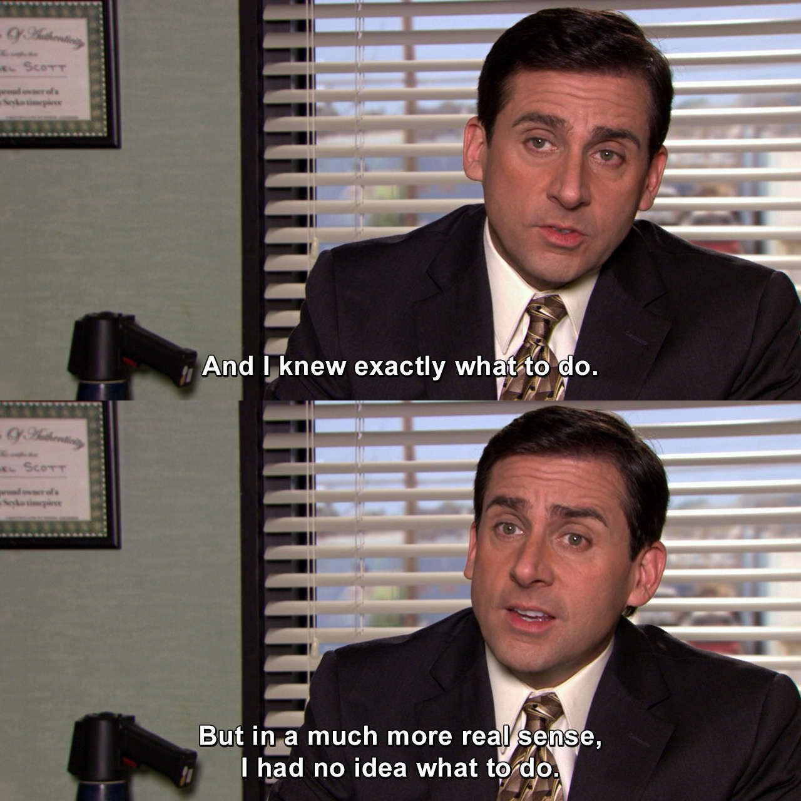

Slide 8
Types of Site Visits
Sponsoring Institution
New Program
Initial to Continued Accreditation
10-Year
For Cause
Osteopathic Recognition

Slide 9
Sponsoring Institution (SI)
New SIs don't require a site visit
First site visit approx. 2 years after receiving Initial Accreditation
10-year site visit approx. 24 months after institutional self-study
All about the GMEC and oversight of programs

Slide 10
Program Site Visits
New Program
Occur approx. 6-8 weeks after submission of the application*
Secure resources before submitting application
Initial to Continued Accreditation
Occur approx. 2 years after receiving Initial Accreditation*
What and how is program achieving substantial compliance with requirements
10-Year
Feasibility and strategic planning
Submission of updated application
Scheduling of 10-year site visits suspended at this time
Correlation between program self-study and 10-year site visit removed
Accreditation focused on ACGME's annual review of programs (ADS annual update & ACGME surveys)
*Timeline pre-COVID

Slide 11
Site Visits For Cause
Data prompted*
Requested by RCs who set own threshold for compliance
Resident survey is main trigger (84%)
Complaints
RC may request site visit following consideration of complaint allegations and SI/program response
Anyone with knowledge of a SI or program may report a training-related issue or allegations of non-compliance w/ ACGME requirements
Probation
SIs or programs w/ probationary accreditation status will need to have a site visit prior to achieving Continued Accreditation (CA) or CA w/ Warning
Usually a team of field representatives conducting site visit
GMEC oversight of programs important
Other reasons include case logs, board pass rates, faculty survey, scholarly activity, resident/faculty attrition
Special Reviews play a role here
Focused site visit
Subject to review under core, detail and outcome requirements
*Caniano, D, Martinez, S, & Nace, C. (2021). Reasons for data-prompted site visits: Field staff findings and review committee decisions. [Oral presentation]. ACGME Annual Educational Conference. [Virtual Experience.]

Slide 12
Osteopathic Recognition
No site visit required for Initial Recognition
First site visit approx. 2 years after receiving Initial Accreditation
Resubmission of osteopathic recognition application
What and how is program achieving substantial compliance with osteopathic recognition requirements
Additional players = Director of Osteopathic Education

Slide 13
Virtual vs. In-Person
Timeline for resuming in-person site visits uncertain at this time
ACGME's department of field activities currently evaluating future of site visits – working on determination of criteria for remote vs. in-person site visits
What's different?
*Smaller groups *Virtual tours of FMPs *Body language and facial expressions more important

Slide 14
Components of Preparation

Slide 15
Site Visit Work-Flow
Note – time frames may be shortened significantly if scheduled earlier in the black out period, if a new program, site visit for cause or other factors with scheduling by field staff or programs.

Slide 16
ACGME Letters
Black-out dates
Letter of SV Notification
From ACGME field staff
Due dates
List of requirements
Letter of Instruction
From site visitor
Due dates
Proposed schedule
One drive instructions
This Photo by Unknown author is licensed under CC BY-NC.

Slide 17
Documents to ACGME
ADS update
Attachments
2 yr, 10 yr, prompted full site visits
Specialty Specific Application
Policies
Evaluations
PLA
Block Diagram
This Photo by Unknown author is licensed under CC BY-SA.

Slide 18
ADS Updates
Narratives
Faculty Roster
PD CV
Faculty board, license updates
Sites
Read
instructions!

Slide 19
ADS Updates
Specialty Specific Application
It most likely changed
PLA's
Current? Same people?
Policies
Updated? Program specific?
Evaluations
Are they what you use?

Slide 20
Documents to Site Visitor
New Program
2 yr, 10 yr, full
Supervision Policy
Conference Schedule
Resident files
Supervision policy
Conference schedule
QI/PT safety list
Resident S/W list (optional)
Faculty S/W list (optional)
Site Visitor can request other documents!

Slide 21
Documents to Site Visitor
Resident Files
Use aggregate reports, if possible, to aid in compilation
Only send what is being requested
Conference Schedule
All years of training
Date, type/topic, presenter, faculty/resident/both
QI & Patient Safety projects
Supervision policy (yes....you submit twice)

Slide 22
Documents to Site Visitor
SV Schedule
Check email addresses
Block out everyone's calendar 15 min before and 15 min after scheduled time
Any questions, call the site visitor
This Photo by Unknown author is licensed under CC BY-SA-NC.

Slide 23
Mock Site Visit
Internal, external, combination
Excellent preparation for programs and persons
Provides opportunities to practice
Identifies areas of concern

Slide 24
Post Site Visit
Sending requested documents
Debrief with team & DIO
Prepare for any potential citations
Place on PEC agenda for further exploration
This Photo by Unknown author is licensed under CC BY.

Slide 25
Site Visit Trends in 2021
Presented by Partners in Medical Education, Inc. 2021

Slide 26
Virtual Site Visits
More flexibility with the order and start times
Increase in communication prior to site visit
Checking Zoom connections
Providing guidance as to additional documents/concerns prior to site visit
Grouping site visits – much harder to predict
Same SI, but different site visitors in same week
Same SI, same site visitor for several different programs spread out over 6-8 weeks
time zones are important
Virtual Site Visits
Presented by Partners in Medical Education, Inc. 2021

Slide 27
The pendulum has swung…
PROGRAMS RESPONSIBLE FOR PROGRAM ISSUES
SPONSORING INSTITUTION REPONSIBLE
FOR PROGRAM’S ISSUES & LEARNING/WORKING ENVIRONMENT
Presented by Partners in Medical Education, Inc. 2021
27

Slide 28
Participating Sites
SI is responsible for oversight of clinical learning and working environment….
Program Level:
Not an acceptable “excuse” for low scores on ACGME survey
Emphasis on interaction between faculty at different sites, particularly remote sites
Faculty at participating sites are responsible for evaluation of your learners – if this isn’t happening – follow up
Sponsoring Institution Level:
GMEC – representation of participating sites
Patient Safety Alert training, professional lapses, critical issues affecting your trainees
Presented by Partners in Medical Education, Inc. 2021

Slide 29
Citations 2021
Broader in scope – not always tied to a requirement
Same issue – multiple citations
Tracking of work hours
Resident Learning and Working environment
Sponsoring institution oversight
Environment of retaliation and fear
Presented by Partners in Medical Education, Inc. 2021

Slide 30
Accreditation Withheld
Lack of teaching experience for faculty
Insufficient procedures
STOP
Insufficient faculty
Remote site issues
Presented by Partners in Medical Education, Inc. 2021

Slide 31
Resources
ACGME Expectations for Content of Resident and Fellow Files
ACGME Site Visit Document by Accreditation Status for Accreditation and Recognition Site Visits
ACGME Updating ADS by Accreditation or Recognition Status
CEE Work Hours Reporting Template
Didactics/Conference Schedule Template
Presented by Partners in Medical Education, Inc. 2021

Slide 32
Upcoming Live Webinar
Holistic Review Thursday, August 26, 2021 12:00pm – 1:00pm EST
A Day in the Life of a DIO
Thursday, September 9, 2021
12:00pm – 1:00pm EST
Resident Wellness in the Virtual World
Tuesday, September 21, 2021
The Role of Coaching
Thursday, September 30, 2021
12:00pm – 1:00pm EST
Latest On-Demand Webinars
ADS Update 2021
GME Grants and Funding Sources
Survey Research
Impactful AIR & APE – Bridging Data & Action
GMEC Checkups – QIPS Edition
ACGME Surveys – What Now?
Other Approaches to CCC & Evaluation
Lessons Learned from the Pandemic: Planning for the Next Disaster
Ask Partners – Spring Freebie
Digging for Data Part 3
How to Maximize Virtual Learning Part 2
Scholarly Work in Pandemic Times
How to Maximize Virtual Learning Par 1
Faculty Development Series
15 Minutes to Effective Feedback
Toolbox for Teaching Millennials
Taking Supervision to the Next Level
Contact us today to learn how our Educational
Passports can save you time & money!
724-864-7320
www.PartnersInMedEd.com
Presented by Partners in Medical Education, Inc. 2021
32

Slide 33
Partners in Medical Education, Inc. provides comprehensive consulting services
to the GME community.
Partners in Medical Education
724-864-7320 | info@PartnersInMedEd.com
Heather Peters, M.Ed, Ph.D
Heather@PartnersInMedEd.com
Christine Redovan, MBA, MLIS
Christine@PartnersInMedEd.com
Tori Hanlon, MS, CHCP
Tori@PartnersInMedEd.com
www.PartnersInMedEd.com

