Slide 1
Please Note…
Please make sure your Start Video is OFF when logging into the WebEx platform.
Here is what it should look like
ALSO
It is NORMAL to not hear any sound until the webinar starts at 12:00 noon EST.
Your phone line is muted, but you can always chat to the host, BJ Schwartz, if you have any questions or concerns during this time.

Slide 2
Streamlining Your Special Review
Presented by: Heather Peters, M.Ed., Ph.D.,
And
Christine Redovan, MBA, MLIS

Slide 3
LEARNING OBJECTIVES
DISCUSS purpose/theory behind the Special Review process
OUTLINE ACGME’s expectations for special reviews and the special review policy
PROVIDE best practices for the special review process, interviews, and reports
Templates:
Sample Special Review Policy
Special Review Worksheet
Special Review Report
Sample SMART Improvement Goals

Slide 4
Understanding the Special Review
How does the ACGME confirm a Special Review took place?
When do you perform a special review?
What is the purpose of the Special Review?
What does the ACGME expect?
How do you conduct an efficient and effective Special Review?
How is a Special Review different than an APE?

Slide 5
Why?
What is the purpose of the Special Review?
Identify underperforming programs early
Correct issues before they become citations
Demonstrate GMEC oversight (Caniano, 2021)
Ensure programs are addressing concerns in a timely manner
Holds program accountable to the GMEC/DIO for correction

Slide 6
ACGME
Institutional Requirement I.B.6
GMEC oversight of process
Written protocol
GMEC established criteria
Written report with action plans and timelines
What does the ACGME expect?

Slide 7
Policy & GMEC Engagement
Work with GMEC to develop criteria
Special reviews are done in response to not meeting your established criteria or needing additional support
GMEC must be part of the process
Utilize GMEC members (ideal for new members)
GMEC must review report
GMEC must monitor outcomes
When do you perform a special review?
Special Review Policy Template
Special Review Worksheet

Slide 8
Efficient and Effective Special Reviews

Slide 9
The process…
Analyze data
Conduct focus groups
Develop recommended aims
Create report
Submit to GMEC for approval
Close the Loop
Follow-up
How do you conduct an efficient and effective Special Review?

Slide 10
Data to Review
Previous APE
ADS update
Citations/AFIs
Procedural Data
ACGME Surveys
Data related to triggers
How is a Special Review different than an APE?

Slide 11
Focus Groups
Who?
Current residents/fellows
Recent graduates
Faculty
Administrative staff
Program Leadership

Slide 12
Focus Groups
Tips for questions…
Ask open-ended questions
Keep suppositions out of your questions
When asking for clarification, try to reframe
Interviewer should be neutral

Slide 13
Develop Measurable Action Items
Use SMART format
Specific
Measurable
Attainable
Relevant
Timely
Focus on the issue(s) that triggered the special review
Provide support/resources if needed

Slide 14
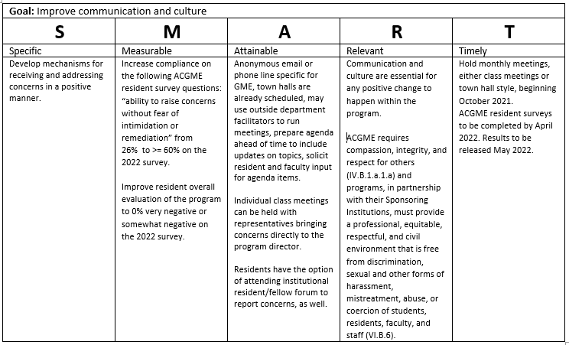
Action Item Example

Slide 15
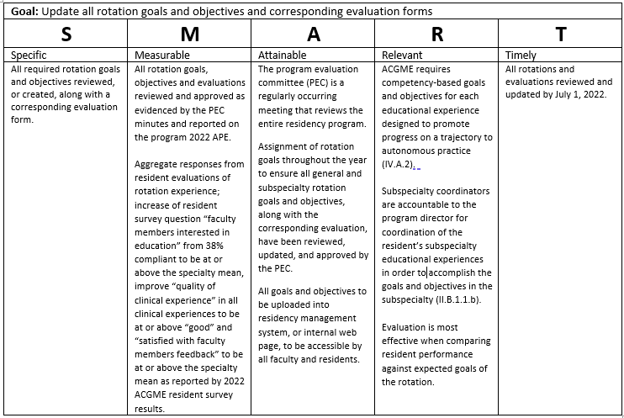
Action Item Example
More sample SMART Improvement Goals

Slide 16
Create the Report
1. Keep it short and simple
2. Limit goals to between 3-5
3. Be helpful; not hurtful
4. Use the data you collected to support your recommendations
Special Review Report Template

Slide 17
Submit to GMEC for Approval
ACGME requirements
Vote to approve report and aims
Follow-up on action items – document sufficiently in GMEC minutes
How does the ACGME confirm a Special Review took place?

Slide 18
Close the Loop
Think about all of people/groups interviewed during the special review
Residents/Fellows
Faculty
Administrative Staff
Ensure that they receive copies of the report
DIO should follow-up (in-person) regarding any major issues that came up during the review

Slide 19
Follow-up
Schedule follow-ups on the GMEC calendar
Add to “DIO form for meeting with program director”

Slide 20
Resources
Special Review Worksheet
Special Review Sample Policy Template
Special Review Sample Report Template
Action Plan Samples
Caniano, D, Martinez, S., Nace, C., & Hogan, S. (2021). Reasons for data-prompted site visits: Field staff findings and review committee decisions. J. Grad Med Educ 13(3), 447-454. Doi: 10.4300/JGME-D-21-00435.1
Accreditation Council for Graduate Medical Education. (2021). ACGME institutional requirements. Available at acgme.org.

Slide 21
Closing
Many benefits to a special review
Objective review of issues
Opportunity for education (program and SR committee)
Sharing and collaboration of solutions
Helpful; not hurtful
Reinforces ACGME requirements

Slide 22
Upcoming Live Webinar
Getting to the Next Stage – Program Improvement I
Thursday, January 6, 2022
Digging for Data IV
Tuesday, January 18, 2022
Back to Basics – GME for New Coordinators
Tuesday, February 8, 2022
Leveraging RMS Technology for the Medicare Cost Report
Thursday, February 17, 2022
The ABCs of GMEC: Part II
Thursday, March 10, 2022
Latest On-Demand Webinars
Meet the Experts – Fall Freebie
A Successful Coordinator? You Must Be C-C-Crazy!
Planning and Tracking Scholarly Activity
GME Financing: The Basics, the Strategies, and the Upcoming Changes
The Role of Coaching
Resident Wellness in the Virtual World
A Day in the Life of A DIO
Site Visits – What to Expect in 2021
ADS Update 2021
GME Grants and Funding Sources
Survey Research
Impactful AIR & APE – Bridging Data & Action
Faculty Development Series
15 Minutes to Effective Feedback
Toolbox for Teaching Millennials
Taking Supervision to the Next Level
Contact us today to learn how our Educational
Passports can save you time & money!
724-864-7320
www.PartnersInMedEd.com
Presented by Partners in Medical Education, Inc. 2021
22

Slide 23
Partners in Medical Education, Inc. provides comprehensive consulting services to the GME community.
Partners in Medical Education
724-864-7320 | info@PartnersInMedEd.com
Heather Peters, M.Ed. Ph.D.
Heather@PartnersInMedEd.com
And
Christine Redovan, MBA, MLIS
Christine@PartnersInMedEd.com
www.PartnersInMedEd.com

