Slide 1
The Millennial Learner

Slide 2
Introducing Your Presenter
Amy Lefkovic, MHA
Received her Bachelors Degree in Health Information Management from Kean University
Began her career in Graduate Medical Education (GME) at Hospital for Special Surgery as the Radiology Fellowship Program Coordinator
Received her Masters degree in Healthcare Administration from Seton Hall University
Continued her career in GME at Lutheran Medical Center as the OB/GYN Residency Coordinator
Is currently the Manager of GME and Academic Affairs at Staten Island University Hospital

Slide 3
Goals and Objectives
To review the characteristics of millennials
To examine the differences in learning styles of millennials
To explore new approaches for teaching GME to millennials

Slide 4
What is a Millennial??
Also known as Generation Y
Born after 1980 and before 1997, 2000, 2005
Newest generation to enter the workforce

Slide 5
What is a Millennial??
Casual dress
Social media obsessed
Me? A Millennial?
“No one had to tell me that!”

Slide 6
What is a Millennial?? Cont.
Communicate in snippets
Generation “me”
Assertive
Entitled

Slide 7
What is a Millennial?? Cont.
Lazy unless passionate
Rely on parents
Travel…what is onboarding??

Slide 8
Where Do They Work??
1. Microsoft
2. Walt Disney Company
3. HP
4. Google
5. Apple
6. Boeing

Slide 9
Where Do They Work?? Cont.
7. Intel
8. Caterpillar
9. Amazon.com
10. Lockheed Martin

Slide 10
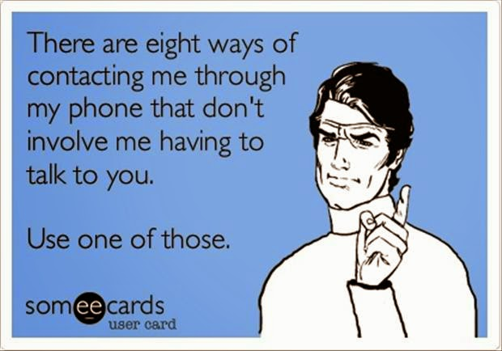

Slide 11
Millennial Trainees
Wellness committee requests
Work life balance
Call schedule
Emergency Medicine
Gym on site

Slide 12
Millennial Trainees Cont.
Remediation or probation??!!
Immediate feedback and praise
Electronic medical records

Slide 13
Millennial Trainees Cont.
Frustrated advocates
Call right after send email
Workplace conflict
Hierarchy??
“When I was a resident” – Program Directors

Slide 14
Millennial Trainees Cont.
Less communication with patients
Read a book? I’ll just look up the answer

Slide 15
We Asked Them
Decision making impact to rank #1
Location, reputation, resident satisfaction
Lowest – research experience
Affect ranking in a positive way
Salary

Slide 16
We Asked Them
3. Information received during interview
Sample Schedule

Slide 17
Appreciate and Understand
Generational differences
Nurtured by parents
September 11, school shootings
Participation trophy

Slide 18
Appreciate and Understand Cont.
Home life balance – work to live
Individuality
Do your research – learn about “them”

Slide 19
How Do “They” Work/Learn?
Cooperative learning style
Brainstorming together
Millennials ask “what is my job” and go about figuring out the best, fastest way to complete that task.

Slide 20
Changing the Way We Teach
Flipped classroom
Ask them to show you

Slide 21
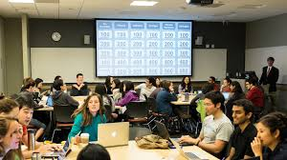
Changing the Way We Teach Cont.
Jeopardy/games
Interactive
Incorporate technology – where applicable

Slide 22
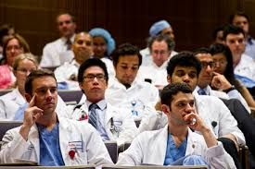

Slide 23
Important
Don't stray too far

Slide 25
Not Just the Way We Teach
Clearly defined policies and procedures
Daily structure
Goals and objectives

Slide 26
Not Just the Way We Teach
Wellness committee – we are here for you
Professionalism committee

Slide 27
Not Just the Way We Teach
Activities
Great escape room
Retreat with faculty
Movie night

Slide 28
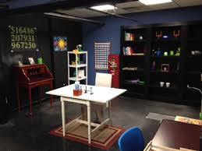
Not Just the Way We Teach
Rules
Immediate feedback
Clear boundaries

Slide 30
Disadvantages to Change
Enabling
Sabotage when become attending

Slide 31
Disadvantages to Change
Go too far
What about them?

Slide 32
Advantages to Change
We learn something new
They learn how they know
Evaluation of programs teaching techniques

Slide 33
Advantages to Change
Clear definitions
Doctors of the future
ACGME survey results

Slide 34
ACGME??
Confidentiality
Create an environment of inquiry
Satisfied with feedback after assignments

Slide 35
ACGME??
Provided goals and objectives for assignments
Appropriate balance for education
Satisfied with opportunities for scholarly activity
Conferences?
Time to work on it?

Slide 36
ACGME??
Education (not) compromised by service obligations
Electronic medical records are effective
Satisfied with process to deal with problems and concerns

Slide 37
ACGME??
Residents can raise concerns without fear
Information (not) lost during shift changes

Slide 39
You Are Not Alone

Slide 40
References
https://www.ncbi.nlm.nih.gov/pmc/articles/PMC3244307/
http://nymag.com/scienceofus/2017/04/two-types-of-millennials.html
https://www.forbes.com/sites/kaytiezimmerman/2017/08/26/top-10-companies-millennials-want-to-work-for/#616397db453c
https://www.businessknowhow.com/manage/millenials.htm

Slide 41
Upcoming Live Webinars
Quality Improvement: Are You Meeting the New Requirements Tuesday, October 10, 2017
12:00pm – 1:00pm EST
2017 Common Program Requirements Update Thursday, October 19, 2017
12:00pm – 1:00pm EST Bullying in the Workplace Thursday, November 2, 2017
12:00pm – 1:00pm EST
Meet the Experts – Fall Freebie Tuesday, November 14, 2017
12:00pm – 1:00pm EST
www.PartnersInMedEd.com
Partners® Snippets
On-Demand Webinars
What do They Do Up There in the GME Office?
Breaking Bad News to Residents: A Five Stage Process for Giving Instructive Feedback AOA to ACGME – What are you Waiting For? GMEC & Program Oversight
Lean Six Sigma for GME Support Staff Initial & Pre-Accreditation: Annual Date Updates Can I Do That? Becoming an Integral Member of the GME Education Team
Getting the Most Out of Your Resident Interview
Contact us today to learn
how our Educational Passports can save you time & money!
724-864-7320

Slide 42
Partners in Medical Education, Inc. provides comprehensive consulting services to the GME community.
Partners in Medical Education
724-864-7320 | info@PartnersInMedEd.com
Amy Lefkovic, MHA
amy@partnersinmeded.com
www.PartnersInMedEd.com

