Slide 1
STRESS FREE RECIPE Dealing with Burnout
Presented By :
Joyce Fiodembo, RN and Wellness Nurse

Slide 2

Introducing Your Presenter…
Joyce Fiodembo is a Wellness Nurse Speaker and Author. Joyce got her Nursing Degree from Cicely McDonnel School of Nursing in Nairobi, Kenya. She also holds a Bachelors Degree from the Pan Africa Christian University. She migrated to Ohio from Kenya in 2002. She is the Founder of the award-winning website; International Nurse Support. The site mentors nurses to thrive in their career.
Stress in the health field is now a huge problem that cannot be ignored. When Joyce started her nursing career, she too was excited with all the opportunities to work. But soon the long 12 to 14 hour shifts began to affect her. She started feeling the stress and exhaustion and was quickly sliding down the slope to burnout.
Joyce made a few changes that allowed her to focus and be in-charge of herself, -but more importantly, she got peace of mind. Today, through articles and speaking, Joyce coaches many nurses and health professionals on Stress Management and Self-Care.

Slide 3

Webinar Goals
How to be Stress-Free in a Busy Environment.
Learn to Recognize and Deal with Burnout.

Slide 4

Work Stress & Home

Slide 5
Objectives
Learn how stress affects your body
Learn healthy ways of dealing with stress
Get tips on stress management techniques
Learn healthy lifestyle basics

Slide 6

Stress & Burnout
STRESS
VS
BURNOUT

Slide 7

Breathe

Slide 8
Admit You Have A Problem
Poor delegation of work
Unaware of your job description
No appreciation
Pressure to meet deadlines
Working long hours
Unpredictable changes

Slide 9
Causes of Stress
No holidays
Job layoffs
Toxic environment
Financial difficulties & debts
Problems with your kids
Marital Problems

Slide 10

How Stress Affects Your Body
HEART
DIGESTIVE SYSTEM
PSYCHOLOGICALLY
IMMUNITY
ADDED WEIGHT
HEADACHES
FATIGUE

Slide 11

Frustration

Slide 12
Negotiate with your Employer
A~ Accept it & do nothing
B~ Change the Situation
C~ Walk Away
Don’t blame other people for your choice!

Slide 13
Negotiate
Write down the cause
Take time out
Recognize your limitations
Set Priorities & deal with your challenges
AVOID
Overworking
Hoping it will go away

Slide 14
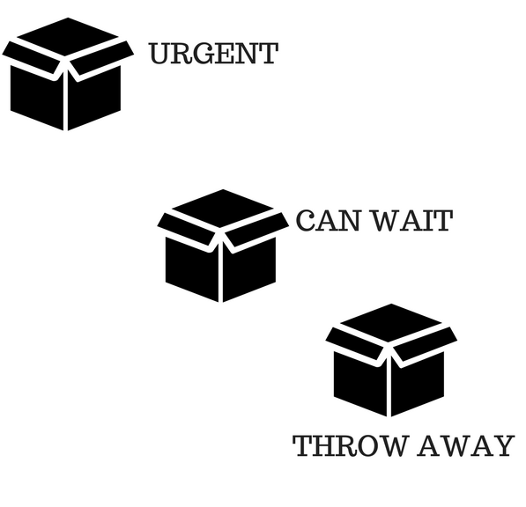
You will ALWAYS Have Email!

Slide 15
Email TIPS
Not the first thing
Unsubscribe
Separate email
15 minutes at a time
Use folders if possible
Only 3% need you to take action
They all cannot be “Priority #1”
Use auto–reply messages
Clear your inbox daily
Remember, email is other people’s agenda – Not Yours!

Slide 16

Troublemaker

Slide 17
Set Healthy Boundaries
Be clear where the boundaries lie
State your expectations
No! is a complete sentence
Setting boundaries relieves pressure at work

Slide 18

Exercises to Manage Stress

Slide 19

Practice Mindfulness

Slide 20
Work Stress & Home

Slide 21


Healthy Lifestyle Basics
Sleep enough
Positive Friends
Eat healthy
Follow an exercise routine
Gratitude
Avoid news overload

Slide 22



Healthy Lifestyle Basics
Smile and laugh
Do something meaningful
Practice meditation, relaxation & prayer
Change our attitudes and perceptions
Avoid feeling helpless
Increase your resources

Slide 23

RESOURCES
www.ACGME.org – geared towards physicians; applicable to all
Hospital Employee Wellness programs
Stress Management Questionnaire
Handout on Stress Management Techniques
Mindfulness Ted Talk - https://www.ted.com/talks/andy_puddicombe_all_it_takes_is_10_mindful_minutes
Mindfulness for Beginners
By Jon Kabat-Zinn

Slide 24

Questions & Answers

Slide 25
REVIEW
Admit the problem
How stress affects your body
Negotiate with your company
Dealing with email
Setting boundaries
Stress management techniques
Healthy lifestyle basics

Slide 26






Upcoming Live Webinars
The Forgotten SI:
Single Sponsor Institutions
Tuesday, February 21, 2017
12:00pm – 1:00pm EST
Medical Knowledge ✔ Patient Care ✔ Now What?
Thursday, March 2, 2017
12:00pm – 1:00pm EST
Ask Partners – Spring Freebie
Thursday, March 23, 2017
12:00pm – 1:00pm EST
Institutional Readiness in NAS
Tuesday, March 2, 2017
12:00pm – 1:00pm EST
www.PartnersInMedEd.com
Partners® Snippets
On-Demand Webinars
Documentation and Coding to Teaching Physicians
Keeping up with Institutional NAS Requirements
New Program Accreditation.
Let’s get Started
GME Finance – The Basics
(2016 Update)
Maximizing Resident Forums
What Every Coordinator Needs to Know about NAS
CLER
Contact us today to learn
how our Educational Passports can save you time & money!
724-864-7320

Slide 27

Partners in Medical Education, Inc. provides comprehensive consulting services to the GME community.
www.PartnersInMedEd.com
724-864-7320 | info@PartnersInMedEd.com
Joyce Fiodembo
joyce@internationalnursesupport.com

