Slide 1
Understanding Practice Data
Pam Royston, PhD
Consultant

Slide 2
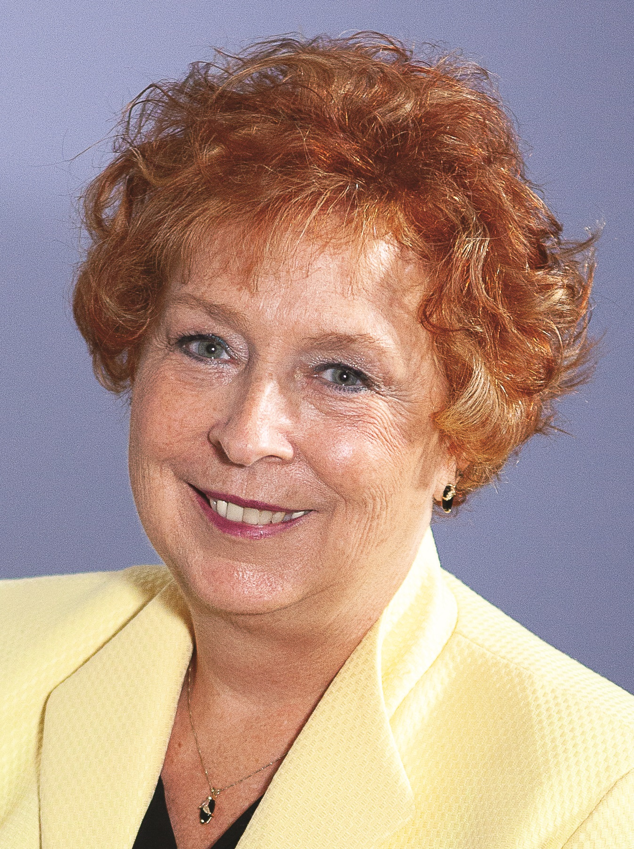
Introducing Your Presenter…
Pamela Royston, Ph.D
DIO, GME & Finance Expert
Over 25 years experience in medical education, both undergraduate and graduate
Institutional, Program, FQHC start-up and maintenance
National Speaker GME Accreditation and Financing

Slide 3
Learning Objectives
Describe what composes practice data
Discuss data which is accessible
Indicate data that may be available as a system
Identify trends in data residents need to know
Create educational sessions incorporating finance language and data

Slide 4
What is Practice Data?
Medical (clinical) data refers to health-related information that is associated with regular patient care or as part of a clinical trial program. ... Patient/disease registries, which help collect and track clinical information of defined patient populations.

Slide 5
Practice Data - Residents
Hospital
Specialty
Clinic

Slide 6
Hospital Data

Slide 7
Use data that is available!
Patient Safety
Mortality Index
Complication
Index
Harm Events
Outcome Measures

Slide 8
Available Data
Care Progression
30 Day Readmissions
ED Throughput
ED Patients left without being seen

Slide 9
Available Data
Care Variation
C-section Rate
Lab utilization metric
Bundle Compliance
Sepsis Mortality Index

Slide 10
Hospital Inpatient Data
In Patient Statistics | Actual | Budget | Variance | Var % | Actual | Prior Yr | Variance | Var %
Discharges | 1,119 | 1,209 | (89) | -7% | 1,110 | 1,292 | (173) | -13%
ED Admits | 716 | 738 | (22) | -3% | 716 | 739 | (23) | -3%
ALOS | 4.2 | 4.2 | 0 | 0 | 4.2 | 4.4 | .2 | 4%
Case Mix Index
Medicare | 1.775 | 1.7201 | .056 | 3% | 1.775 | 1.8582 | (.083) | -4%
Medicaid | .8483 | 1.0680 | (.220) | -21% | .8483 | 1.1176 | (.269) | -24%
BCBS | 1.0546 | 1.0944 | (.040) | -4% | 1.0546 | 1.0972 | (.043) | -4%

Slide 11
Inpatient Trends

Slide 12
Hospital Outpatient Data
Outpatient Statistics | Actual | Budget | Variance | Var % | Actual | Prior Yr | Variance | Var %
Visits | 19,794 | 21,011 | (1,217) | -6% | 19,794 | 21,655 | (1,861) | -9%
EM Visits | 4,771 | 4,402 | 369 | 8% | 4,771 | 4,636 | 135 | 3%
Surgical | 214 | 254 | (40) | -16% | 214 | 274 | (60) | -22%
Payor Mix Index
Medicare | 49.6% | 47% | 3% |  | 49.6% | 48% | 2%
Medicaid | 14.1% | 16.5% | -2% |  | 14.1 | 15% | -1%
BCBS | 18.5 | 18.3 | 0% |  | 18.5% | 19% | -1%
Other Comm | 16.2 | 16.7 | -1% |  | 16.2% | 17% | -1%
Self Pay | 1.6% | 1.5% | 0% |  | 1.6% | 1% | 1%

Slide 13
Clinic Data
Indicator | July | Aug | Sept
Continuity Clinic Visits | 320 | 401 | 427
Initial Visits | 67 | 93 | 123
No show rates | 33% | 39% | 28%
No show rate- Continuity Clinic | 33% | 39% | 28%
Continuity Clinic Visits | 320 | 401 | 427
Hospital Acquired Infections – teaching team | 0 | 1 | 1
Hand Washing – Teaching Team/ED/Surg | 88% | 81% | 92%

Slide 14
Effectiveness of Care- Screening
Indicator | 2019 | 2018 | 2017
Adult BMI | 93% | 87% | 85%
Childhood Immunization Status (CIS) | 63% | 68% | 54%
Breast Cancer Screen | 81% | 78% | 74%
Colorectal Cancer Screen | 56% | 51% | 48%
Depression Screen | 93% | 91% | 88%
Flu Vaccine | 83% | 81% | 80%
HEDIS® - https://www.ncqa.org/hedis/

Slide 15
Learning Activities -Clinic
Resident call backs to improve return visits
Review charts for improvement of documentation
Billing and Insurance – review billing for visits
Review of contractual payments for visits
Develop budget for clinic
  Gross and Net Revenue
  Expenses

Slide 16
Learning Activities – Hospital
LOS and affect on profitability
Review inpatient trends based on month
  January deductibles start over
  Winter – flu
  Summer – transition of providers and vacations
  EMR implementation
Review profitability based on case mix index

Slide 17
Value Based Care
Obtaining better outcomes with lower costs
https://dellmed.utexas.edu/case-studies/value-based-care
Education and activities for medical education

Slide 18
Upcoming Live Webinars
CPR 2019 Part 4 of 4: Putting It All Together
Tuesday, August 27, 2019
12:00pm – 1:00pm EST
Crafting “Top-Notch” Goals,
Objectives and Evaluations
Thursday, September 12, 2019
12:00pm – 1:00pm EST
Feedback – From The Top Down
Tuesday, September 17, 2019
12:00pm – 1:00pm EST
Evolving Resident Well-Being
Tuesday, October 8, 2019
12:00pm – 1:00pm EST
On-Demand Webinars
2019 CPR Part 1 of 4: Overview
Aims and Action Plans
SI 2025 Part 2 of 4: Changes on the Horizon
Ask Partners – Spring Freebie
Understanding the CLE
CPR 2019 Part 2 of 4: Section I & Section II
SI 2025 Part 3 of 4: GME Evolution, Funding & Future
Building Your Sponsoring Institution – The First 2 Years
Special Reviews – Helpful not Hurtful
2019 CPR Part 3 of 4: Section IV & Section V
NEW Faculty Development Series
15 Minutes to Effective Feedback
Toolbox for Teaching Millennials
Contact us today to learn how our Educational
Passports can save you time & money!
724-864-7320
www.PartnersInMedEd.com
18

Slide 19

Partners in Medical Education, Inc. provides comprehensive consulting services to the GME community.
Partners in Medical Education
724-864-7320 | info@PartnersInMedEd.com
Pamela Royston, Ph.D
pamela.royston@partnersinmeded.com
www.PartnersInMedEd.com

