Slide 1
Understanding the CLE

Slide 2
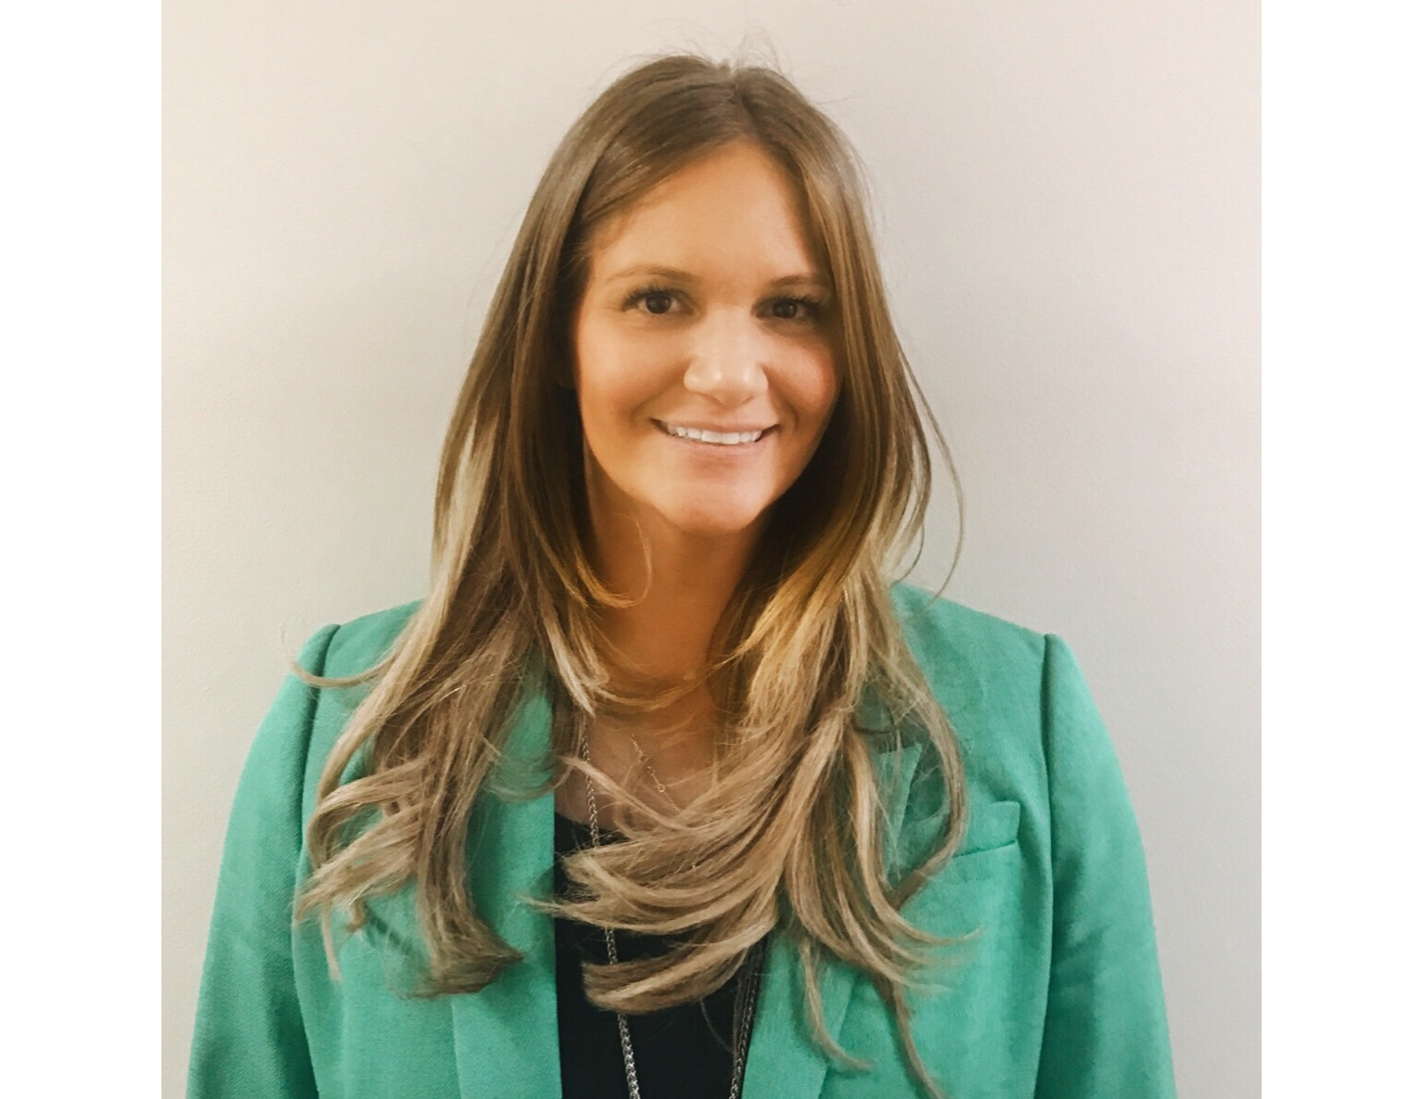
Introducing Your Presenter
Amy Durante, MHA
Received her Bachelors Degree in Health Information Management from Kean University
Began her career in Graduate Medical Education (GME) at Hospital for Special Surgery as the Radiology Fellowship Program Coordinator
Received her Masters degree in Healthcare Administration from Seton Hall University
Continued her career in GME at Lutheran Medical Center as the OB/GYN Residency Coordinator
Is currently the Manager of GME and Academic Affairs at Staten Island University Hospital

Slide 3
Goals and Objectives
To review the requirements of the CLE and CLER
To determine what can be done to ensure a robust CLE
To explore ways in which to continually maintain a positive CLE

Slide 4
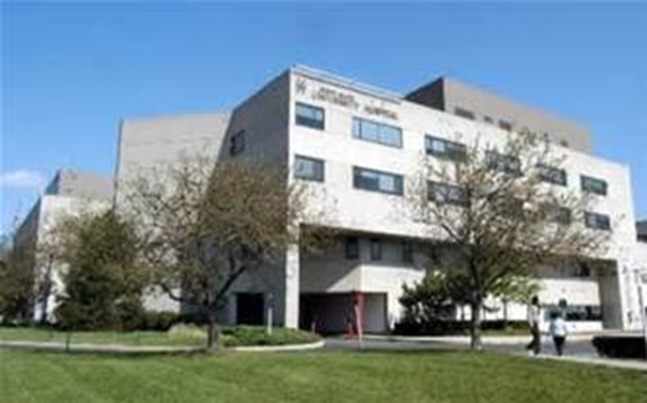
Staten Island University Hospital Northwell Health
Northwell Health
305 residents and fellows
16 programs

Slide 5
The CLER Program
Designed to provide teaching hospitals, medical centers, health systems and other clinical settings with periodic feedback that addresses the following areas:
Patient Safety
Health Care Quality
Care Transitions
Supervision
Well-being
Professionalism

Slide 6
CLER Visit
Meet with:
Executive leadership (CEO, CMO, CNO)
Leaders in patient safety
Leaders in health care quality
Leaders in GME
Groups of residents/fellows
Program directors/faculty
Other staff members on the units

Slide 7
Musts
Each sponsoring institution is required to undergo a CLER visit
The CEO and leader of GME (DIO)
Opening and closing statements

Slide 8
Feedback
Oral report at end of site visit
Written report summarizing the visitors observations
Report that provides national aggregated and de-identified data

Slide 9
What I Learned
1st and 2nd attempt to schedule
Just completed smaller programs
Sponsoring Institutions
Engage frontline staff

Slide 10
What about the before?

Slide 11
Patient Safety
Report adverse events, near misses/close calls
Culture change
Retaliation
Importance

Slide 12
Patient Safety
Report adverse events, near misses/close calls
Who does it now? - Ask
Do they know how? – Show me
Does GME know how? – Ask
Do Attendings know how – Show me Results

Slide 13
Patient Safety
Culture reinforces patient safety responsibility?
How
Poll them
ACGME survey

Slide 14
Patient Safety
Rounds
Get to know Patient Safety Officer
Education leads to contribution
Committee representation
We are working on it

Slide 15
Health Care Quality
Educated
Goals
Tools
Techniques
Experiential learning
Challenges presented
Techniques for change

Slide 16
Health Care Quality
Engagement
Interprofessional teams
“Just training”
Root Cause Analysis (RCA)
Hospital Data
Reduce Healthcare disparities

Slide 17
Health Care Quality
Education leads to contribution
Faculty aware??!!
Make friends and explain why

Slide 18
Health Care Quality
Residents are the forefront (with the appropriate tools)
Committees
RQCCC
QI project presentations
Hospital project alignment
Explain not moving mountains

Slide 19
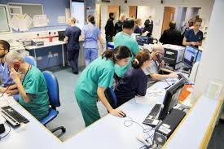
Care Transitions
Consistency
Faculty and residents
Policies and procedures
Interprofessional
Patients and family members
Locations
Consultants

Slide 20
Care Transitions
Simulation
Use of a form
Departmental policy
Hospital wide policy
Credential
Unit to floor – RQCCC

Slide 21
Supervision
Expectations
Progressive autonomy
Education on how
Understanding by all
Who are you? (Hello my name is ACGME survey)
- Patient
Workload

Slide 22
Supervision
Policies and procedures
Ask them
What is it?
Why do we do it?
Should we keep doing it?
Nurses review credentials
“We trust them”

Slide 23
One Step Further
Feedback!!
Don’t ask…won’t tell
End of the road
Simulation sessions

Slide 24
Well-Being
Supportive community
Risks, signs, symptoms of fatigue
Risks, signs, symptoms of burnout
Support programs that enhance physical and emotional well-being
Organizational expectations
Patient work load

Slide 25
Well-Being
Policies and procedures
Balint groups
Wellness committee and activities
Understand will not resolve burn out
Wellness rounds
Disrespectful

Slide 26
Well-Being
“How to identify” workshops
Chief residents
Coordinators
Faculty
Psychiatry
Share techniques
Standing agenda item

Slide 27
Well-Being

Slide 28
Professionalism
Formal activities
Interprofessional
Appropriate documentation
Support
Honesty
Faculty
Nurses

Slide 29
Professionalism
Policies and procedures
Dress code
Simulation
Video’s
Self reflective essays
If you need to, get the CMO involved

Slide 30
Professionalism
Remediation
Culture change..should have already

Slide 31
Also….
Citations!!!
3rd most frequent citations

Slide 32
Citations
Review of the 2018 Resident Survey demonstrated dissatisfaction with maximum work hours per week with the primary reason listed as schedule conflict, covering someone else’s work, and paperwork.
Be careful!!

Slide 33
Citations
Review of the 2018 Resident Survey demonstrated dissatisfaction with in-house call every third night with the primary reasons listed as schedule conflict, covering someone else’s work, and paperwork.
4.5 compliance

Slide 34
Citations
Residents overall evaluation of the program

Slide 35
What’s Next
Baseline – review of survey
Inform programs
Inform hospital staff
Send periodic updates
Update policies and procedures
Agenda items at GMEC

Slide 36
What’s Next
Previous report review
Institutional barriers to CEO
Still working on it??
Make friends
Check policies and procedures

Slide 37
And then…
Operating rooms
Patients
Share questions

Slide 38
Upcoming Live Webinars
Onboarding the New Program Director Tuesday, April 2, 2019 12:00pm – 1:00pm EST
CPR 2019 Part 2 of 4: Section I & Section II Thursday, April 18, 2019 12:00pm – 1:00pm EST
SI 2025 Part 3 of 4: GME Evolution, Funding & Future Tuesday, May 7, 2019 12:00pm – 1:00pm EST
Building Your Sponsoring Institution – The First 2 Years Thursday, May 30, 2019 12:00pm – 1:00pm EST
On-Demand Webinars
Milestones – Beyond the CCC
Mentoring the GME Coordinator: The First 3 Years
2019 CPR Part 1 of 4: Overview
SI 2025 Part 1 of 4: Introduction & Overview
Onboarding the New Coordinator
2019 CPR Part 1 of 4: Overview
AIMs and Action Plans
SI 2025 Part 2 of 4: Changes on the Horizon
NEW Faculty Development Series
Contact us today to learn how our Educational
Passports can save you time & money!
724-864-7320
www.PartnersInMedEd.com
15 Minutes to Effective Feedback
38

Slide 39
Partners in Medical Education, Inc. provides comprehensive consulting services to the GME community.
Partners in Medical Education
724-864-7320 | info@PartnersInMedEd.com
Amy Durante, MHA GME Consultant
Amy@PartnersInMedEd.com
www.PartnersInMedEd.com

