Slide 1
Using #SocialMedia and Technology in #GME
Tori Hanlon, MS, CHCP
Consultant, Partners in Medical Education

Slide 2
Introducing Your Presenter…
Tori Hanlon, MS, CHCP
GME Consultant
Over 11 years working in Medical Education
Bachelor’s in Health Services Administration
Master’s in Health Administration and Policy
Designated Institutional Official
Experienced in GME at a large academic medical center

Slide 3
Objectives and Goals
Break down barriers to social media used in GME
Examine the benefits of using social media in GME
Explore various social media platforms and other technologies that may enhance your residency program

Slide 4
What is Your Comfort Level?
Not comfortable at all…I don’t even know what social media is
A little bit comfortable…I’m on Facebook but that’s about it
Somewhat comfortable…I’m on a couple of different social media sites but don’t use consistently
Very comfortable… I regularly use and post on various social media platforms
I’m in my element… I’m so comfortable I could teach a class on social media

Slide 5
Are You Using Social Media in Your GME Programs?
No
I think so
Definitely, yes

Slide 6
What is Social Media?
Forms of electronic communication (as web sites for social networking and microblogging) through which users create online communities to share information, ideas, personal messages, and other content (as videos)
Social media. (n.d.). Retrieved March 27, 2017, from https://www.merriam-webster.com/dictionary/social media

Slide 7
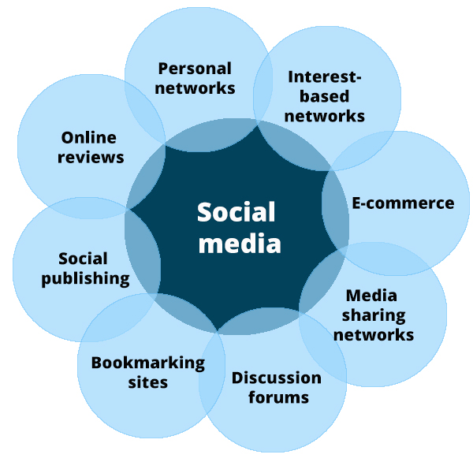
Sorokina, O. (2015, March 12). 8 Types of Social Media and How Each Can Benefit Your Business [Web log post]. Retrieved from
https://blog.hootsuite.com/types-of-social-media/

Slide 8
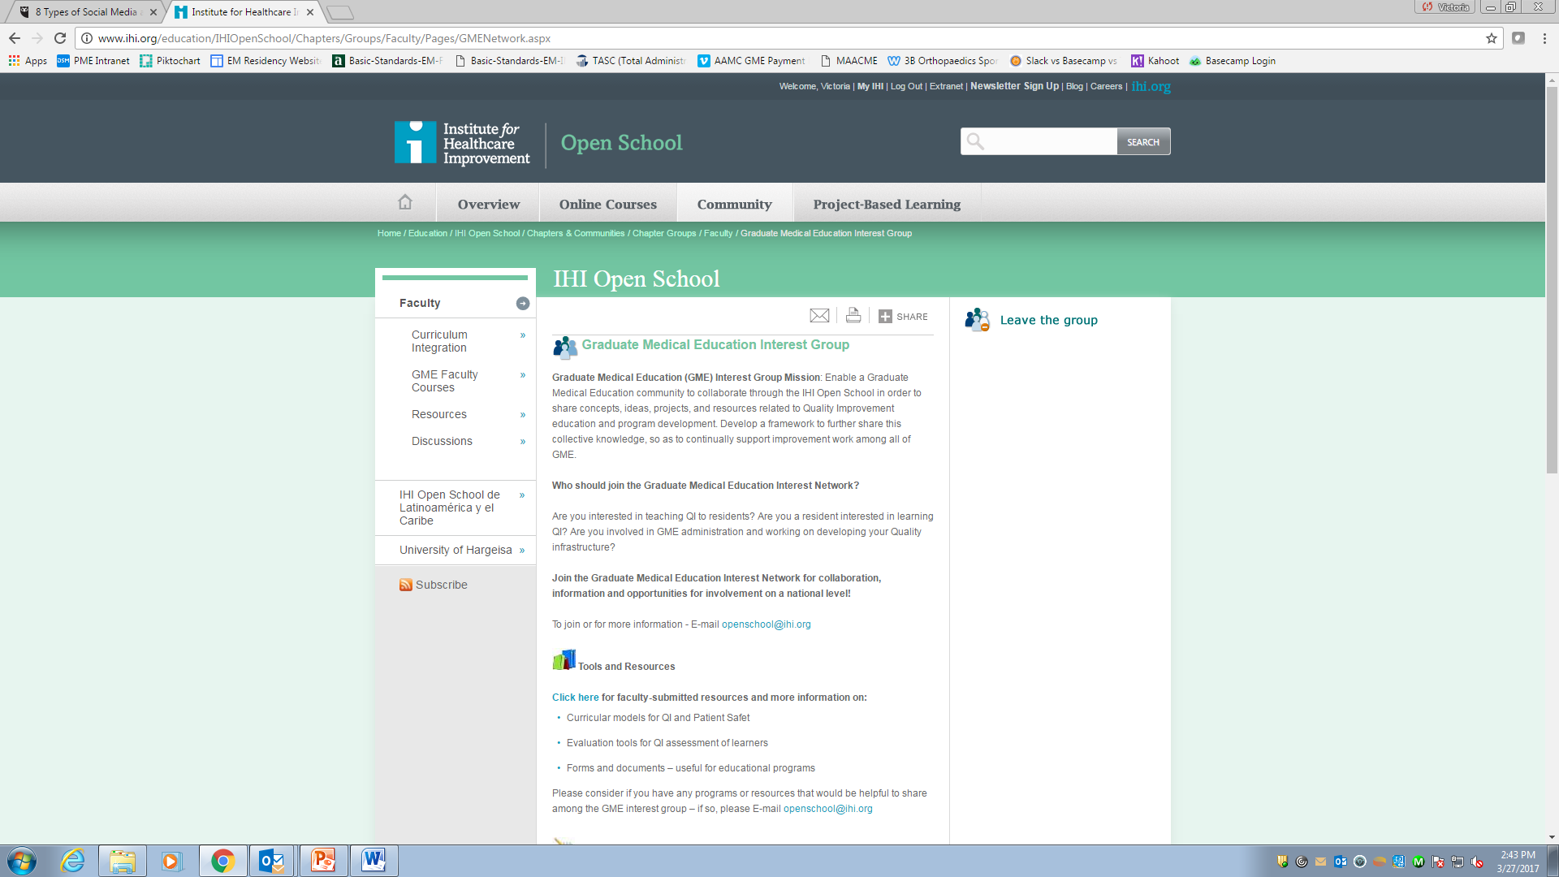

Slide 9
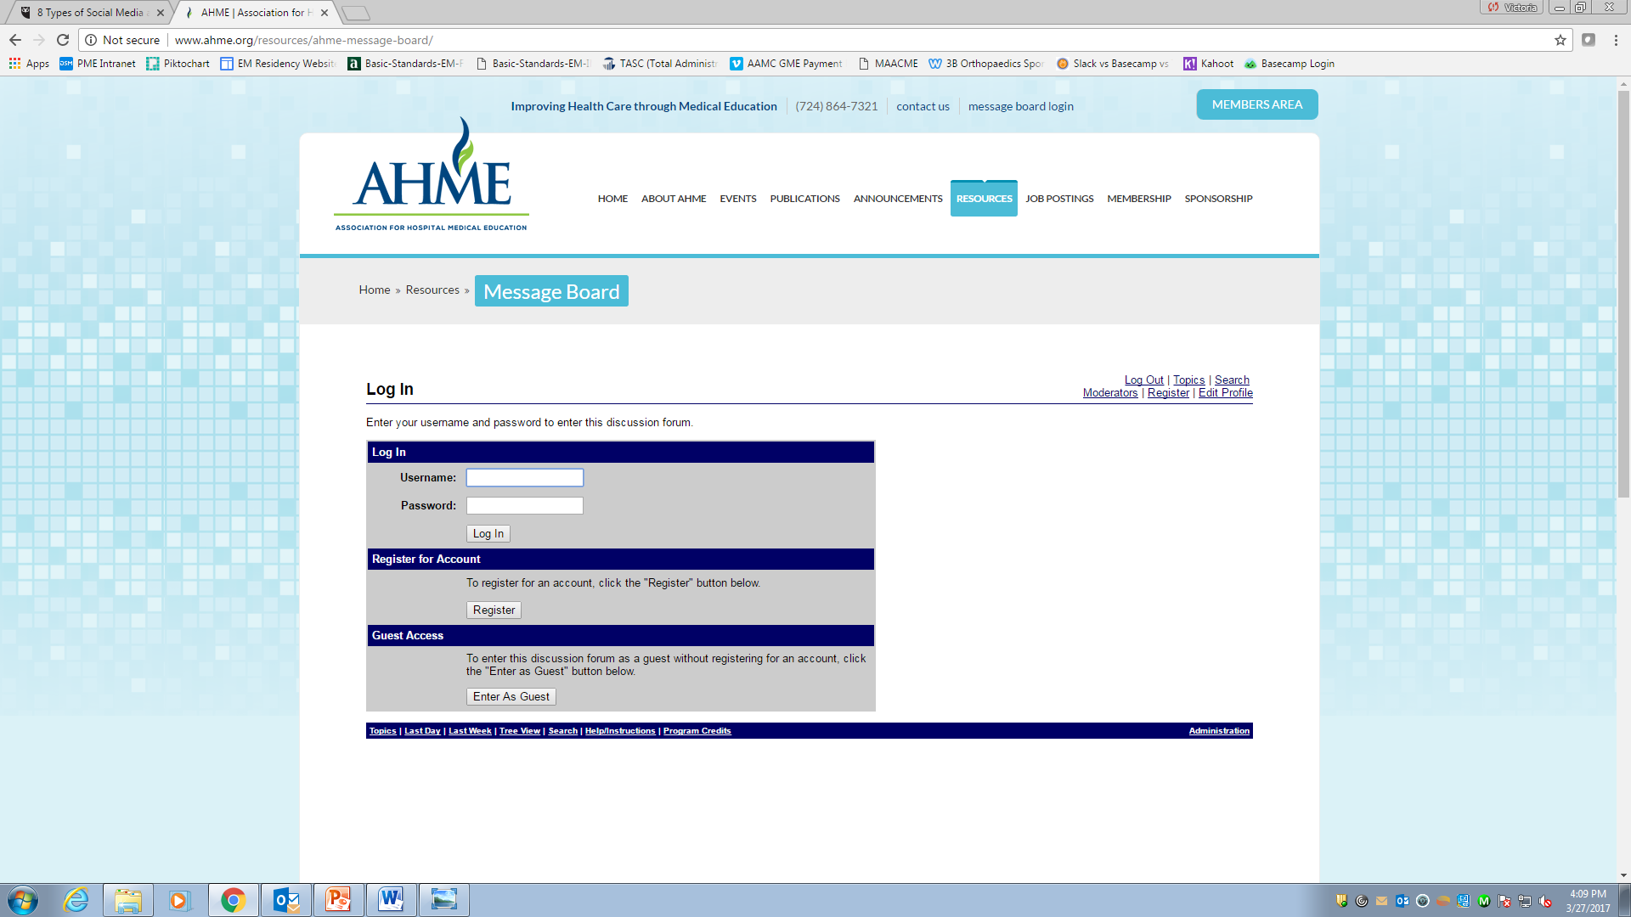

Slide 10
Types of Social Media
Personal networks |  | Connect with users on a personal level
Interest-based networks |  | Bring people together with common interests
Media sharing networks |  | Use pictures and videos usually with a common theme
Discussion forums |  | Wide reach to connect users from all over

Slide 11
Types of Social Media
Social publishing platforms |  | Create and increase awareness of your brand
Online reviews |  | Leverage reviews to build and maintain relationships

Slide 12
What Are Your Barriers?
Lack of knowledge about social media
Lack of time
Inability to control content
Compliance concerns
Engaging users
Lack of support at my institution

Slide 13
Barriers
Lack of knowledge
“This is a learning process and sometimes you have to fall in order to learn things” –Christine Korda, @christinekorda
Explore!
Knowledge is experience

Slide 14
Barriers
Lack of time
“Social media is not just an activity; it is an investment in valuable time and resources”
–Sean Gardner, @2morrowknight
Convenience
Time efficiency

Slide 15
Barriers
Inability to control content
“You can never go wrong by investing in communities and the human beings within them”
-Pam Moore, @PamMktgNut
Accept lack of control in social media
Focus on what you can control

Slide 16
Barriers
Compliance concerns
Awareness/knowledge of HIPAA and state privacy laws
Consult your compliance office
De-identify data
Obtain patient consent if/when appropriate

Slide 17
Barriers
Engaging users
“Social media is here. It’s not going away; not a passing fad. Be where your customers are: in social media” –Lori Ruff, @loriruff
Appoint a champion
Don’t be stagnant

Slide 18
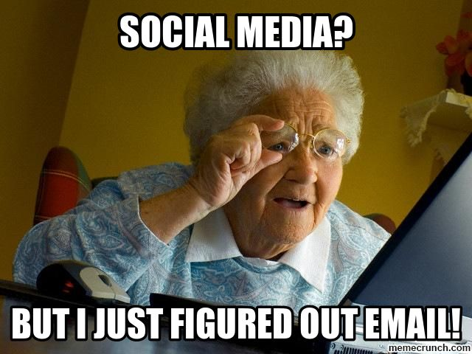
Social Media Mindset

Slide 19
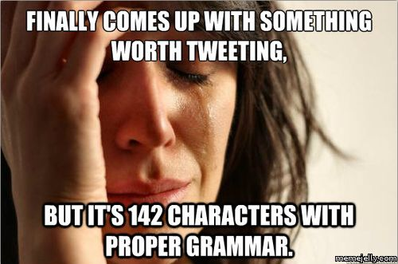
Social Media Mindset

Slide 20
Using Social Media in GME

Slide 21
Build Your Brand
“A brand is no longer what we tell the consumer it is – it is what consumers tell each other it is”
- Scott Cook, Founder, Intuit

Slide 22
Build Your Brand
Choose social media platforms that align with your objective
Provide useful and shareable content
Use network influencers to your advantage
Advertise social network links

Slide 23
Social Media as a Teaching Tool
Increases resident engagement
Facilitates discussions and sharing of ideas
Allows for easily searchable and stored content
Reinforces teaching in traditional formats

Slide 24
Social Media as a Teaching Tool
Create #hashtags on Twitter
Check out #RheumIOW
Create a Twitter page
Check out @TEACHBayview
Podcasts
Online journal clubs
Research

Slide 25
Other Uses
Resident recruitment
Make personal connections
Alumni network
Physician recruitment
Philanthropy

Slide 26
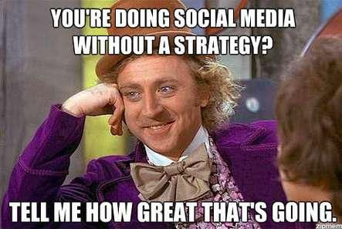
Developing Your Social Media Strategy

Slide 27
Developing Your Social Media Strategy
Identify your purpose
We will use (social network) for (purpose of this social network) in order to help (goal).
Identify your customers
Interact with customers

Slide 28
Other Technologies
Kahoot! - https://getkahoot.com
Slack - https://slack.com
Basecamp - https://basecamp.com
Google hangout - https://hangouts.google.com
http://www.werockyourweb.com/slack-vs-basecamp-vs-trello-vs-asana-vs-teamwork/

Slide 29
“We don’t have a choice on whether we DO social media, the question is how well we DO it”
- Erik Qualman, Author, Socialnomics

Slide 30
Homework Assignment
Go to www.youtube.com and type in “graduate medical education” in the search box function
Read How to Utilize Blogs for Residency Education http://www.jgme.org/doi/pdf/10.4300/JGME-D-16-00357.1?code=gmed-site
Create a Twitter account

Slide 31
Impact of Twitter
313 million | # of active monthly users on Twitter
30% | % of urology residency programs with a Twitter account
1,600 | # of tweets in a 48 period containing “meded”
2,104 | # of followers following @ACGME on Twitter

Slide 32
Resources
Basraon, J.S., Simpson, D, & Gupta, A. (2015). Use of social media to promote continuous learning: a phased strategy for graduate medical education fellowship implementation. Journal of Patient-Centered Research and Reviews, 2(2), 69-72. doi: 10.17294/2330-0698.1034
Galiatsatos, P., Porto-Carreiro, F., Hayashi, J., Zakaria, S., & Christmas, C. (2016). The use of social media to supplement resident medical education – the SMART-ME initiative. Medical Education Online, 21, 10.3402/meo.v21.29332. http://doi.org/10.3402/meo.v21.29332
Hausmann, J. (2016, September 15). How I use social media for medical education (and why you should, too!) [Web log post]. Retrieved from http://autoinflammatorydiseases.org/social-media-2/how-i-use-social-media-for-medical-education/
Hennessy, C.M., Kirkpatrick, E., Smith, C.F., & Border, S. (2016). Social media and anatomy education: using twitter to enhance the student learning experience in anatomy. Anatomical Sciences Education, 9(6), 505-515. doi: 10.1002/ase.1610
Mansoor, H. (2017, February 22). 7 ways to build your brand with social media marketing. Retrieved from https://www.business.com/articles/7-ways-to-build-your-brand-with-social-media-marketing/
Palter, J. (2013, July 9). Four barriers to social media engagement and how to overcome them. Retrieved from http://www.thedigitalfa.com/jaypalter/four-barriers-to-social-media-engagement-and-how-to-overcome-them/
Tinti-Kane, H. (2013, April 1). Overcoming hurdles to social media in education. Retrieved from http://er.educause.edu/articles/2013/4/overcoming-hurdles-to-social-media-in-education
Ventola, C. L. (2014). Social media and health care professionals: benefits, risks, and best practices. Pharmacy and Therapeutics, 39(7), 491-499. Retrieved from https://www.ncbi.nlm.nih.gov/pmc/articles/PMC4103576/pdf/ptj3907491.pdf

Slide 33
Follow us…
@partnersinmeded
@toriliedel
https://www.youtube.com/channel/UC6Dfif9Pqqt8XgVnPWWKt0g
http://partnersinmeded.com/blog/

Slide 34
Upcoming Live Webinars Leading the Team: Project Management Basics
Tuesday, May 2, 2017
12:00pm – 1:00pm EST What do they do up there in the GME office?
Tuesday, May 23, 2017
12:00pm – 1:00pm EST
Breaking Bad News to Residents:
A five-stage process for
giving Instructive Feedback
Tuesday, May 30, 2017
12:00pm – 1:00pm EST
www.PartnersInMedEd.com
Partners® Snippets
On-Demand Webinars
Initial ACGME Accreditation? Now What?
ABC’s of Remediation
The Stress Free Recipe:
Dealing with Burnout
The Forgotten SI: Single-Sponsor Institutions
Medical Knowledge, Patient Care,
Now What?
Ask Partners – Spring Freebie
Dissecting the ICE Bundle
Contact us today to learn
how our Educational Passports can save you time & money!
724-864-7320

Slide 35
Partners in Medical Education, Inc. provides comprehensive consulting services to the GME community.
Partners in Medical Education
724-864-7320 | info@PartnersInMedEd.com
Tori Hanlon, MS, CHCP
tori@partnersinmeded.com
www.PartnersInMedEd.com

