Slide 1
We all need scholarly activity, including coordinators!
Pam Royston, PhD
Consultant

Slide 2
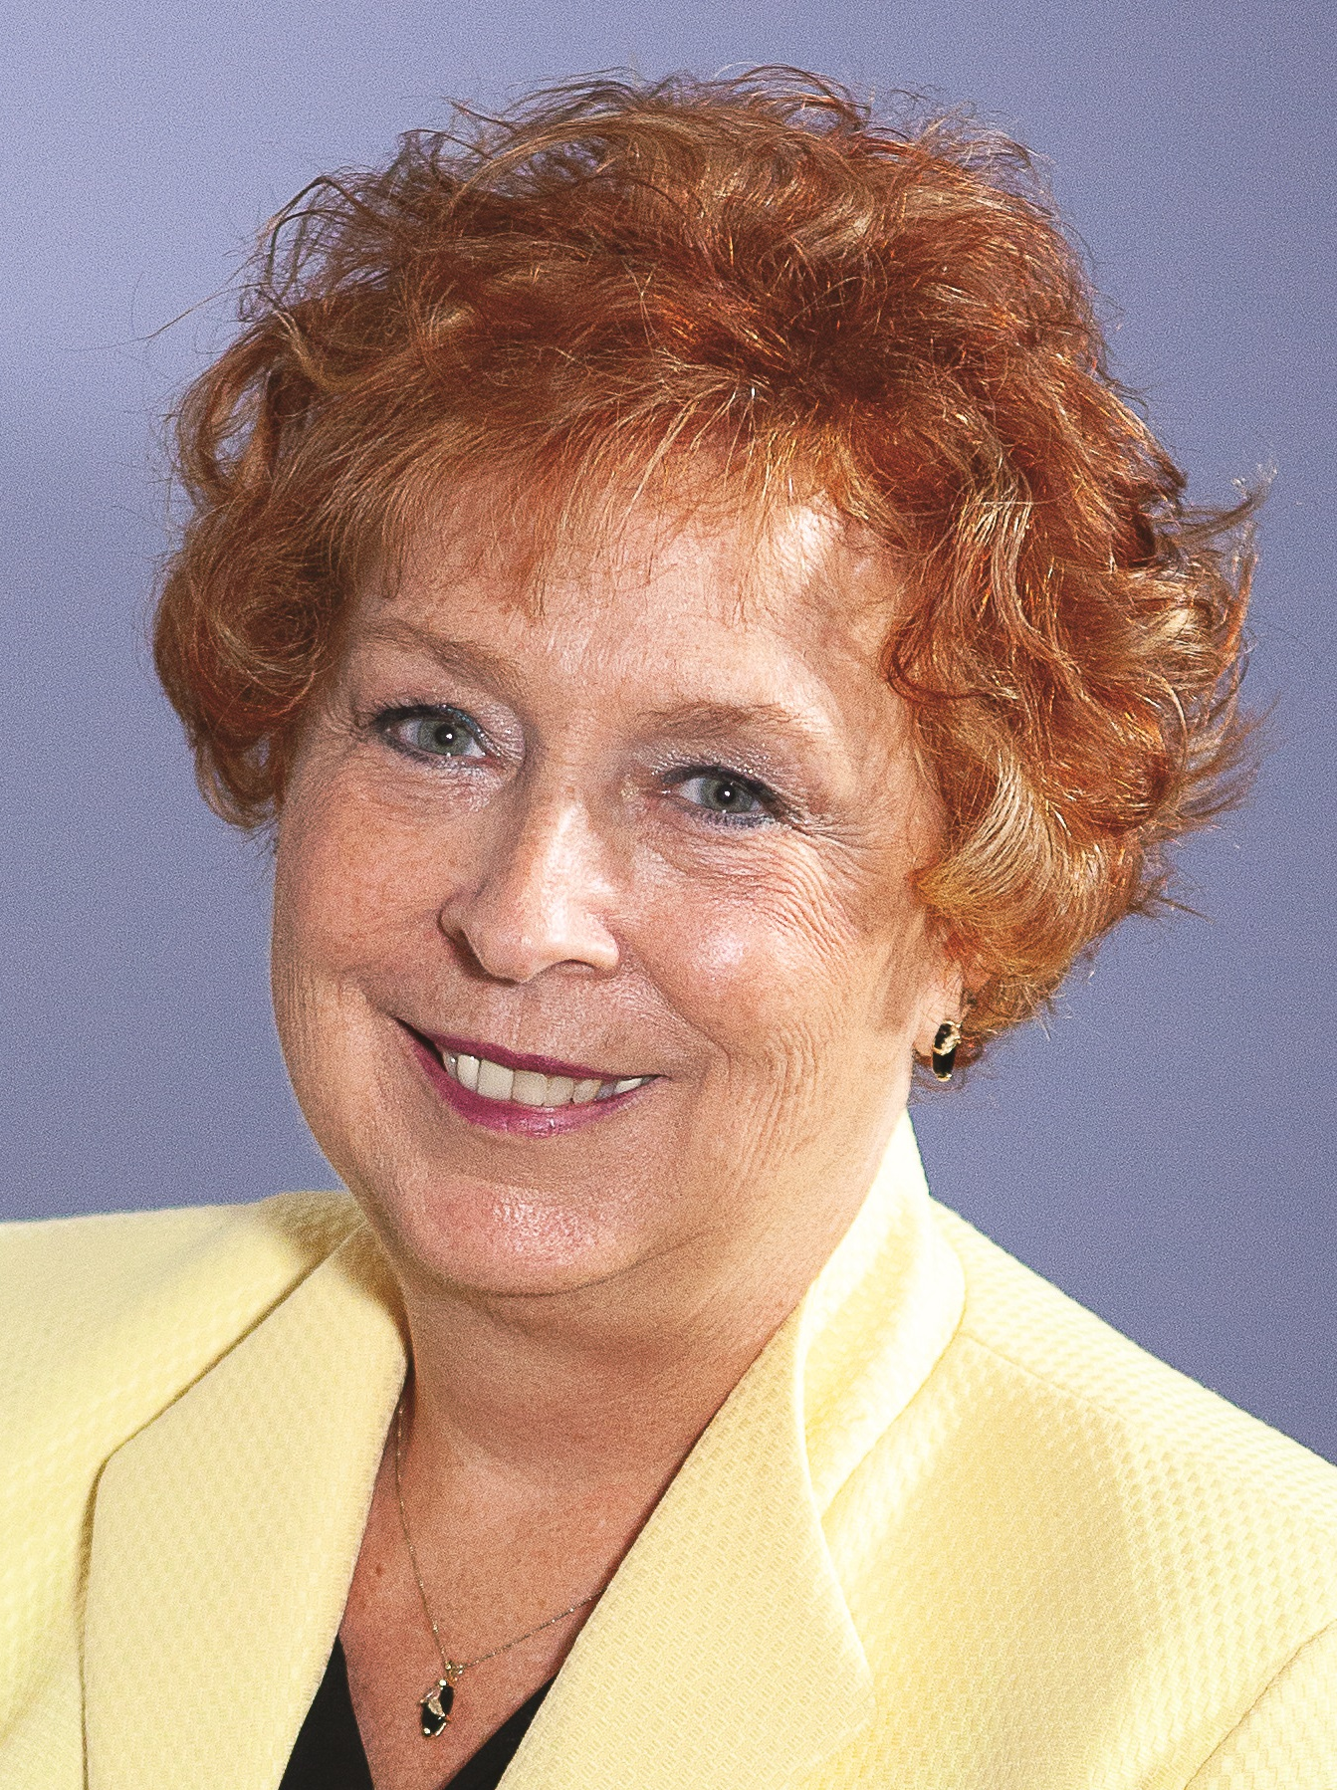
Introducing Your Presenter…
Pamela Royston, Ph.D
DIO, GME & Finance Expert
Over 25 years experience in medical education, both undergraduate and graduate
Institutional, Program, FQHC start-up and maintenance
National Speaker GME Accreditation and Financing

Slide 3
Learning Objectives
Discuss the need for life-long learning
Formulate work and task revisions into problem statements, questions, hypothesis or aims
State the need to work effectively with a team approach
Follow steps in quality improvement projects
Identify where information can be disseminated

Slide 4

Why do we need scholarly activity?

Slide 5
We make changes all the time!
Evaluations
Orientation
Didactics
Rotation Schedules
Curriculum

Slide 6
How can we make these changes into a QI project???

Slide 7
Measures
Area | Measure 1 | Measure 2
Evaluations | Length of time to complete | Central tendency
Didactics | Board passage rate | In-training exams
Communication | Completion rates annual training | Response to emails
Well-being | Score improvement on self administered assessments | Number of activities Service to community Resident activities
Orientation | Pre and post assessment on changes | Faculty assessment of activities

Slide 8
Quality Improvement Projects

Slide 9
P - Plan
Identify the problem or opportunity
Develop the hypotheses about what the issues may be
Decide which one to test

Slide 10
Our QI Project
Plan
Improve evaluation response time
Do
Check
Act

Slide 11
D - Do
Test the solution
Measure the result

Slide 12
Our QI Project
Plan
Improve evaluation response time
Do
Check
Act
Set up workstation physician lounge for three months

Slide 13

C - Check
Check
Try more?
Results
Analyze the project's results against the expectations
Don't settle for a less-than-satisfactory solution. Move on to the final phase (Act) only when you're genuinely happy with the trial's outcome.

Slide 14
Our QI Project
Plan
Improve evaluation response time
Do
Check
Act
Set up workstation physician lounge for three months
Analyze results
Make modifications

Slide 15
A - Act
Measure the results
Make
recommendations
Implement/refine

Slide 16
Our QI Project
Plan
Improve evaluation response time
Do
Check
Act
Set up workstation physician lounge for three months
Analyze results
Make modifications
Measure improvement
Implement

Slide 17

What do we do now???

Slide 18
We need to share our project!
Poster
Presentation
Publication
And Where????

Slide 19
Poster
Advantage
  Quite a few venues
  Conferences able to take more posters
  Disadvantage
    Limited amount of space to convey data

Slide 20
Presentation
Typically need to submit 6-12 months prior
Sometimes the project is in the development phase
Be prepared to talk for an hour

Slide 21
Publication
Publication
Journal
Structured
Manuscript

Slide 22

We just need good ideas!!
On-line journal clubs
Video conference networking
What are your ideas?

Slide 23
Upcoming Live Webinars
We All Need Scholarly Activity, Including Coordinators
Thursday, October 24, 2019
12:00pm – 1:00pm EST
Preparing For The 10 Year Site Visit
Tuesday, November 5, 2019
12:00pm – 1:00pm EST
Meet the Experts – Fall Freebie
Thursday, November 21, 2019
12:00pm – 1:00pm EST
Jump Start Your GME
Thursday, December 5, 2019
12:00pm – 1:00pm EST
On-Demand Webinars
2019 CPR Part 1 of 4: Overview
Aims and Action Plans
SI 2025 Part 2 of 4: Changes on the Horizon
Ask Partners – Spring Freebie
Understanding the CLE
CPR 2019 Part 2 of 4: Section I & Section II
SI 2025 Part 3 of 4: GME Evolution, Funding & Future
Building Your Sponsoring Institution – The First 2 Years
Special Reviews – Helpful not Hurtful
2019 CPR Part 3 of 4: Section IV & Section V
NEW Faculty Development Series
15 Minutes to Effective Feedback
Toolbox for Teaching Millennials
Contact us today to learn how our Educational
Passports can save you time & money!
724-864-7320
www.PartnersInMedEd.com
23

Slide 24

Partners in Medical Education, Inc. provides comprehensive consulting services to the GME community.
Partners in Medical Education
724-864-7320 | info@PartnersInMedEd.com
Pamela Royston, Ph.D
pamela.royston@partnersinmeded.com
www.PartnersInMedEd.com

