Slide 1
Please Note…
Please make sure your Start Video is OFF when logging into the WebEx platform.
Here is what it should look like
ALSO
It is NORMAL to not hear any sound until the webinar starts at 12:00 noon EST.
Your phone line is muted, but you can always chat to the host, BJ Schwartz, if you have any questions or concerns during this time.

Slide 2
Wellness is a Team Sport
Cheryl Haynes, BA
GME Consultant

Slide 3
Introducing Your Presenter…
Cheryl Haynes, BA
GME Consultant
Seasoned Program Coordinator with 18 years experience
Experienced speaker on well-being topics
Published research on coordinator well-being and job satisfaction

Slide 4
OBJECTIVES
This Photo by Unknown Author is licensed under CC BY-ND
Recognize the impact of team member well-being
Understand the elements of well-being
Discuss team activities to encourage team well-being
Be inspired to make a positive impact on your team

Slide 5
Focus on Well-Being
“The ACGME is committed to supporting graduate medical education programs to develop a Culture of Well-Being, not just the absence of burnout and depression. The central feature in this culture is the well-being of all members of the health care team, including faculty and staff members, and residents and fellows.”
July 1, 2019 ACGME Blog¹
This Photo by Unknown Author is licensed under CC BY-SA-NC

Slide 6
What is well-being?
“…combination of feeling good and functioning well…”²
This Photo by Unknown Author is licensed under CC BY-SA

Slide 7
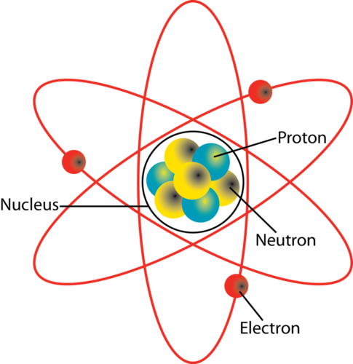
Elements of Well-Being³
Career Well-being – liking what you do, being motivated to work toward your goals
Social well-being – having supportive relationships and love in your life
Financial well-being – managing your economic life to reduce stress and increase security

Slide 8
This Photo by Unknown Author is licensed under CC BY
Physical Well-being – having good health and enough energy to get things done
Community Well-being – liking where you live, feeling safe and having pride in your community
This Photo by Unknown Author is licensed under CC BY-SA

Slide 9
What is well-being?
“…the experience of positive emotions such as happiness and contentment as well as the development of one’s potential, having some control over one’s life, having a sense of purpose, and experiencing positive relationships.”²

Slide 10
Wellness Assessments
Just another annual requirement
What do they do with the results?
Outcomes?
This Photo by Unknown Author is licensed under CC BY-SA-NC

Slide 11
Impact of Resident Well-Being Activities
Annual Retreat
Residents & Faculty – fun, albeit begrudgingly
Coordinators – another work day with added stress and responsibility, and yes, a little bit of fun
Clinical Staff – resentment, isolation, being left out

Slide 12
Who’s on Your Team?
Residents & Faculty
Administrative Staff
Clinical Staff
Support Staff
Students
This Photo by Unknown Author is licensed under CC BY-SA-NC

Slide 13
Develop a Culture of Team Well-Being
The attitudes and behavior characteristics of a particular group.
Focus on Team Activities
Include Everyone
Not once a year, not by assignment
Model Team Well-being every day!

Slide 14
Team Culture Ideas
The FISH! Philosophy
Be There – be emotionally present
Play – be creative, enthusiastic and fun
Make Their Day - find meaningful ways to make team members’ day
Choose Your Attitude – are you contributing to the happiness and well-being of others?
This Photo by Unknown Author is licensed under CC BY-NC

Slide 15
Three Good Things for Teams
Identify three good things that happened this week
Employee Accomplishments, Achievements
Clinic or Program Milestones
Celebrate them!
Video Board
Portals
Bulletin Boards

Slide 16
It’s a Culture, not an activity.
Whatever you do…
Be consistent, ongoing behavior, not annual activities
Be inclusive, everyone is on your team.
Be positive, it’s contagious!
Be your Team Captain, aren’t you already?!
This Photo by Unknown Author is licensed under CC BY-SA-NC

Slide 17
References
¹https://www.acgme.org/newsroom/blog/2019/1/the-culture-of-well-being/
²Ruggeri, K., Garcia-Garzon, E., Maguire, Á. et al. Well-being is more than happiness and life satisfaction: a multidimensional analysis of 21 countries. Health Qual Life Outcomes 18, 192 (2020). https://doi.org/10.1186/s12955-020-01423-y
Wellbeing: The Five Essential Elements; Rath & Harter, ISBN: 978-59562-040-8
https://www.fishphilosophy.com/what-is-fish/
https://accelerate.uofuhealth.utah.edu/explore/how-to-practice-three-good-things

Slide 18
Resources
https://dl.acgme.org/pages/well-being-tools-resources
https://gme.wustl.edu/wellness/
https://www.webmdhealthservices.com/resources/tools-guides/

Slide 19
Upcoming Live Webinar
GME Educational Program Design I
Thursday, September 15, 2022
Back to Basics: Intermediate Topics for New Coordinators
Thursday, September 29, 2022
Sponsoring Institution 2025: 2022 Check-up
Thursday, October 6, 2022
Site Visit Are Coming!
Thursday, October 20, 2022
GME Educational Program Design II
Thursday, November 3, 2022
Lights, Camera…Zoom!
Thursday, November 17, 2022
Latest On-Demand Webinars
ACGME Complaint Letter: Now What?
Here We Grow Again – And With Our Community
The ABCs of GMEC: Part II
ADS 2022: Part I
Ask Partners – Spring Freebie
Getting to the Next Stage – Program Improvement II
The ABCs of GMEC: Part I
Leveraging RMS Technology for the Medicare Cost Report
Back to Basics – GME for New Coordinators
Digging for Data IV
Getting to the Next Stage - Program Improvement I
Faculty Development Series
15 Minutes to Effective Feedback
Toolbox for Teaching Millennials
Taking Supervision to the Next Level
Contact us today to learn how our Educational
Passports can save you time & money!
724-864-7320
www.PartnersInMedEd.com
Presented by Partners in Medical Education, Inc. 2022
19

Slide 20
Partners in Medical Education, Inc. provides comprehensive consulting services to the GME community.
Partners in Medical Education
724-864-7320 | info@PartnersInMedEd.com
Cheryl Haynes, BA
Cheryl@PartnersInMedEd.com
www.PartnersInMedEd.com

