Slide 1
2016 What Every Coordinator Needs to Know About NAS
Presented by:
Christine Redovan, MBA GME Consultant
Heather Peters, M.Ed, Ph.D
Tori Hanlon, MS, CHCP
Amy Lefkovic, MHA

Slide 2
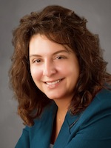
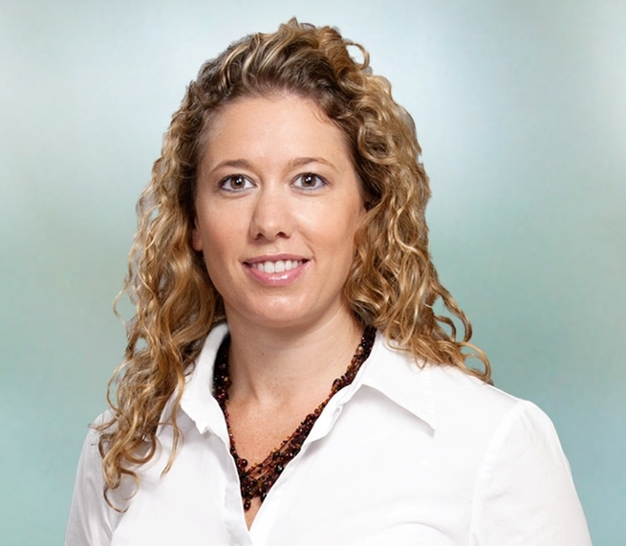
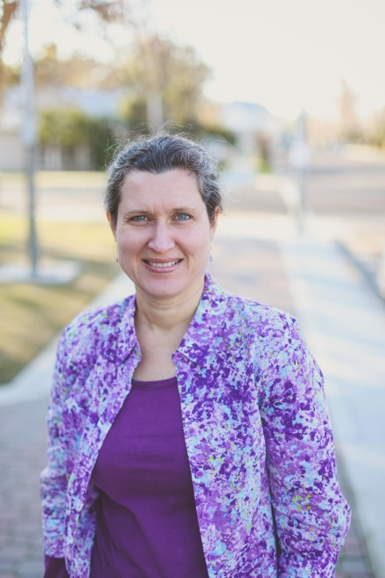
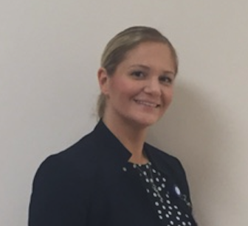
Partners Consulting Team
Christine Redovan, MBA
GME Consultant
Tori Hanlon, MS, CHCP
Heather Peters, M.Ed, Ph.D
GME Consultant
Amy Lefkovic, MHA
10+ years GME Operations, Accreditation and Management success
Focused on continual readiness and offering timely and useful GME resources
Over 11 years working in Medical Education
Bachelor’s in Health Services Administration
Master’s in Health Administration and Policy
Designated Institutional Official
Experienced in GME at a large academic medical center
GME Director & DIO
Seasoned speaker at ACGME & sub-specialty national meetings
Institutional and Program accreditation experience
3 decades in education; Masters of Education in curriculum & evaluations, PhD concentration in secondary education & adult learning theories
Received her Bachelors Degree in Health Information Management from Kean University
Began her career in Graduate Medical Education (GME) at Hospital for Special Surgery as the Radiology Fellowship Program Coordinator
Received her Masters degree in Healthcare Administration from Seton Hall University
Continued her career in GME at Lutheran Medical Center as the OB/GYN Residency Coordinator
Is currently the Manager of GME and Academic Affairs at Staten Island University Hospital

Slide 3
Coordinator Professional Development
Presented by:
Christine Redovan, MBA
GME Consultant

Slide 4

Goals & Objectives
Understand why professional development is important
Identify professional development opportunities

Slide 5

Professional Development
Process of improving and increasing capabilities of staff through access to education and training opportunities in the workplace, through outside organization, or through watching others perform the job. Professional development helps build and maintain morale of staff members, and is thought to attract higher quality staff to an organization. Also called staff development.
from: http://www.businessdictionary.com/definition/professional-development.html

Slide 6
Why?
You
Hospital
Sharpen knowledge
Learn something new
Keep up to date
Networking
Reenergize
Develop new skills
Increase collective knowledge
Increased job satisfaction
Reduce turnover
Succession planning

Slide 7

Opportunities
Specialty groups
Leadership training
  internal and external
Toastmasters
TAGME
National meetings
Local meetings

Slide 8

Opportunities
Other institutions
  Visit your colleagues
Mentoring
  Get a mentor; be a mentor
AHME (councils)
ACGME/AOA
Partners webinars

Slide 9

Challenges
Time and funding
Many choices
  What will work for you?
  Try different venues
Taking that first step
Obtaining buy-in from supervisor

Slide 10
Communicating With Your GME Office
Presented by:
Tori Hanlon, MS, CHCP

Slide 11
Collaboration
Institutional GME Office
Programs
(Coordinators, PDs)

Slide 12
Goals & Objectives
To understand how to effectively collaborate and communicate with your institutional GME office to meet institutional and program requirements in NAS

Slide 13
Communication
GME Office
Program Directors
Coordinators

Slide 14

KNOW THE ACGME
REQUIREMENTS!

Slide 15

NAS
Annual accreditation cycle
  ADS
Program oversight
  APR
CLER

Slide 16
Annual Program Review
GME office notifies program of APR
Program will provide documents to GME office
GME office to meet with program
GME to provide APR report to program
Program to provide response/action plan to GME office as needed

Slide 17
NAS
Annual accreditation cycle
  ADS
Program oversight
  APR
CLER

Slide 18

Tips
Stay engaged
Ask questions/Speak up
Network

Slide 19
Project Management for GME Support Staff
Presented by:
Heather Peters, M.Ed, Ph.D

Slide 20
Goals & Objectives
Define GME project management and discuss how this skillset will be useful as a program coordinator.

Slide 21
Project
A temporary endeavor with a start and finish undertaken to create a unique product, service or result.*
*Project Management for the Unofficial Project Manager; K. Kogon, S. Blakemore & J. Wood; BenBella Books, Inc.; Dallas, Texas; 2015.

Slide 22
Unofficial Project Manager
If most of your work time is spent on projects and you’ve never been exposed to formal project management training, you are an unofficial project manager.
According to PMI (Project Management Institute), most projects do not succeed:
Only 8% of organizations are “high performers” in managing projects
45% of projects are either overdue or canceled altogether
Only 45% of projects actually meet the goals they’re supposed to meet

Slide 23

Why do projects fail?
Lack of communication/support
Unrealistic timelines
Too many competing priorities
Unclear outcomes/expectations
Unrealistic resources
People pulled away from the project
Politics/legislation
Lack of the “big picture” for the team
Poor planning
Lack of leadership
Changing standards
Lack of or mismanaged budget

Slide 24
A successful project…
Meets or exceeds expectations
Optimizes resources, and
Builds team confidence and morale for future projects

Slide 25
“Manage Projects, Lead People” Steven Covey
You will manage things:
  Deliverables
  Deadlines
  Schedules
  Scope
You will lead people:
  Team members (faculty, residents, other GME support staff)
  Customers (faculty, residents, other GME support staff)
  “higher ups” (program leadership)

Slide 26

Leading people…
Formal vs Informal Authority
  Formal comes from a title or position
  Informal comes from the character and capabilities of a leader
Four foundational behaviors
  Demonstrate respect
  Listen first
  Clarify expectations
  Practice accountability

Slide 27

More to come…
Join us in December 2016 for the rest of the story

Slide 28
Self-Study
What’s My Role?
Presented by:
Amy Lefkovic, MHA
Manager, GME & Academic Affairs, Staten Island University Hospital

Slide 29
Goals & Objectives
To determine the difference between the self-study review, self-study template and self-study visit.
To review the important role the Program Coordinator plays in the self-study process.
To explore what can be done throughout the year to prepare for the self-study.

Slide 30

Self Study Definition
The self-study is an objective, comprehensive evaluation of the residency or fellowship program, with the aim of improving it.

Slide 31
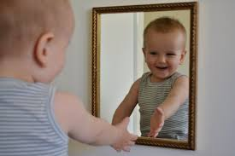
Self Study Definition
A longitudinal evaluation of the program and its learning environment, facilitated through sequential annual program evaluations that focus on the required components, with an emphasis on program strengths and “self-identified” areas for improvement

Slide 32

Self-Study Breakdown
Self-study review
Self-study template
Self-study visit

Slide 33

8 Steps to Success
1. Assemble a self study group
2. Engage program leaders and constituents in a
discussion of program aims
3. Examine opportunities and threats
4. Aggregate and analyze data to generate a
longitudinal assessment of the program’s
improvement

Slide 34
8 Steps to Success cont.
5. Obtain stakeholder input
6. Interpret the data and aggregate the self-study
findings
7. Discuss the findings with stakeholders
8. Develop a self-study document for use in further
program improvement and as documentation for
the program’s 10 year site visit

Slide 35

What Is Needed??
Annual Program Evaluations (APE)
ACGME Resident and Faculty Surveys
Program Evaluations
Annual Institutional Review (AIR)

Slide 36

What Is Needed?? Cont.
Confirmation Evaluation
Meetings with Faculty – Academic Affairs
Meetings with Residents – Academic Affairs

Slide 37
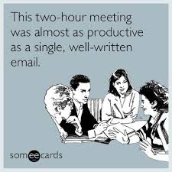
I Have That, Now What??
The important role of the Program Coordinator
  Getting things done!!
  Data collection
  Data analysis
  Areas already improved upon
  Possible threats

Slide 38

Now What?? Cont.
Confirmation and other “secret questions”
Schedule self-study meeting
Program aims
Present findings
Begin action plan grid for their input
Complete template – include hints
Begin the improvement

Slide 39

Yearly Self-Study
ACGME survey analysis grid
  Determine cut off and flag
Action plans for APE progress since last year
CCC meeting actions
Update action plan grid

Slide 40






Upcoming Live Webinars
“Meet the Experts” Fall Freebie
Thursday, November 17, 2016
12:00pm – 1:00pm EST
CLER
Thursday, December 1, 2016
12:00pm – 1:00pm EST
www.PartnersInMedEd.com
Partners® Snippets
On-Demand Webinars
GMEC Check-Up: Is your GMEC
meeting its responsibilities?
A Proactive Approach to Supervising Residents Improves Patient Safety
New Institutional Accreditation:
Let’s Get Started!
Dealing Effectively with the
Struggling Medical Learner
Special Review: Required and Useful
Osteopathic Recognition
Fatigue Management & Mitigation
Contact us today to learn
how our Educational Passports can save you time & money!
724-864-7320

Slide 41

Partners in Medical Education, Inc. provides comprehensive consulting services to the GME community.
Partners in Medical Education
724-864-7320 | info@PartnersInMedEd.com
www.PartnersInMedEd.com

