Slide 1
Partners Webinar Alert
Reminder…Because of the amount of individual logins for this webinar. Please DO NOT Unmute your Microphone after you enter this webinar.

Slide 2
Working with Struggling Learners
PARTNERS IN MEDICAL EDUCATION, INC.
Heather Peters, M.Ed., Ph.D.

Slide 3
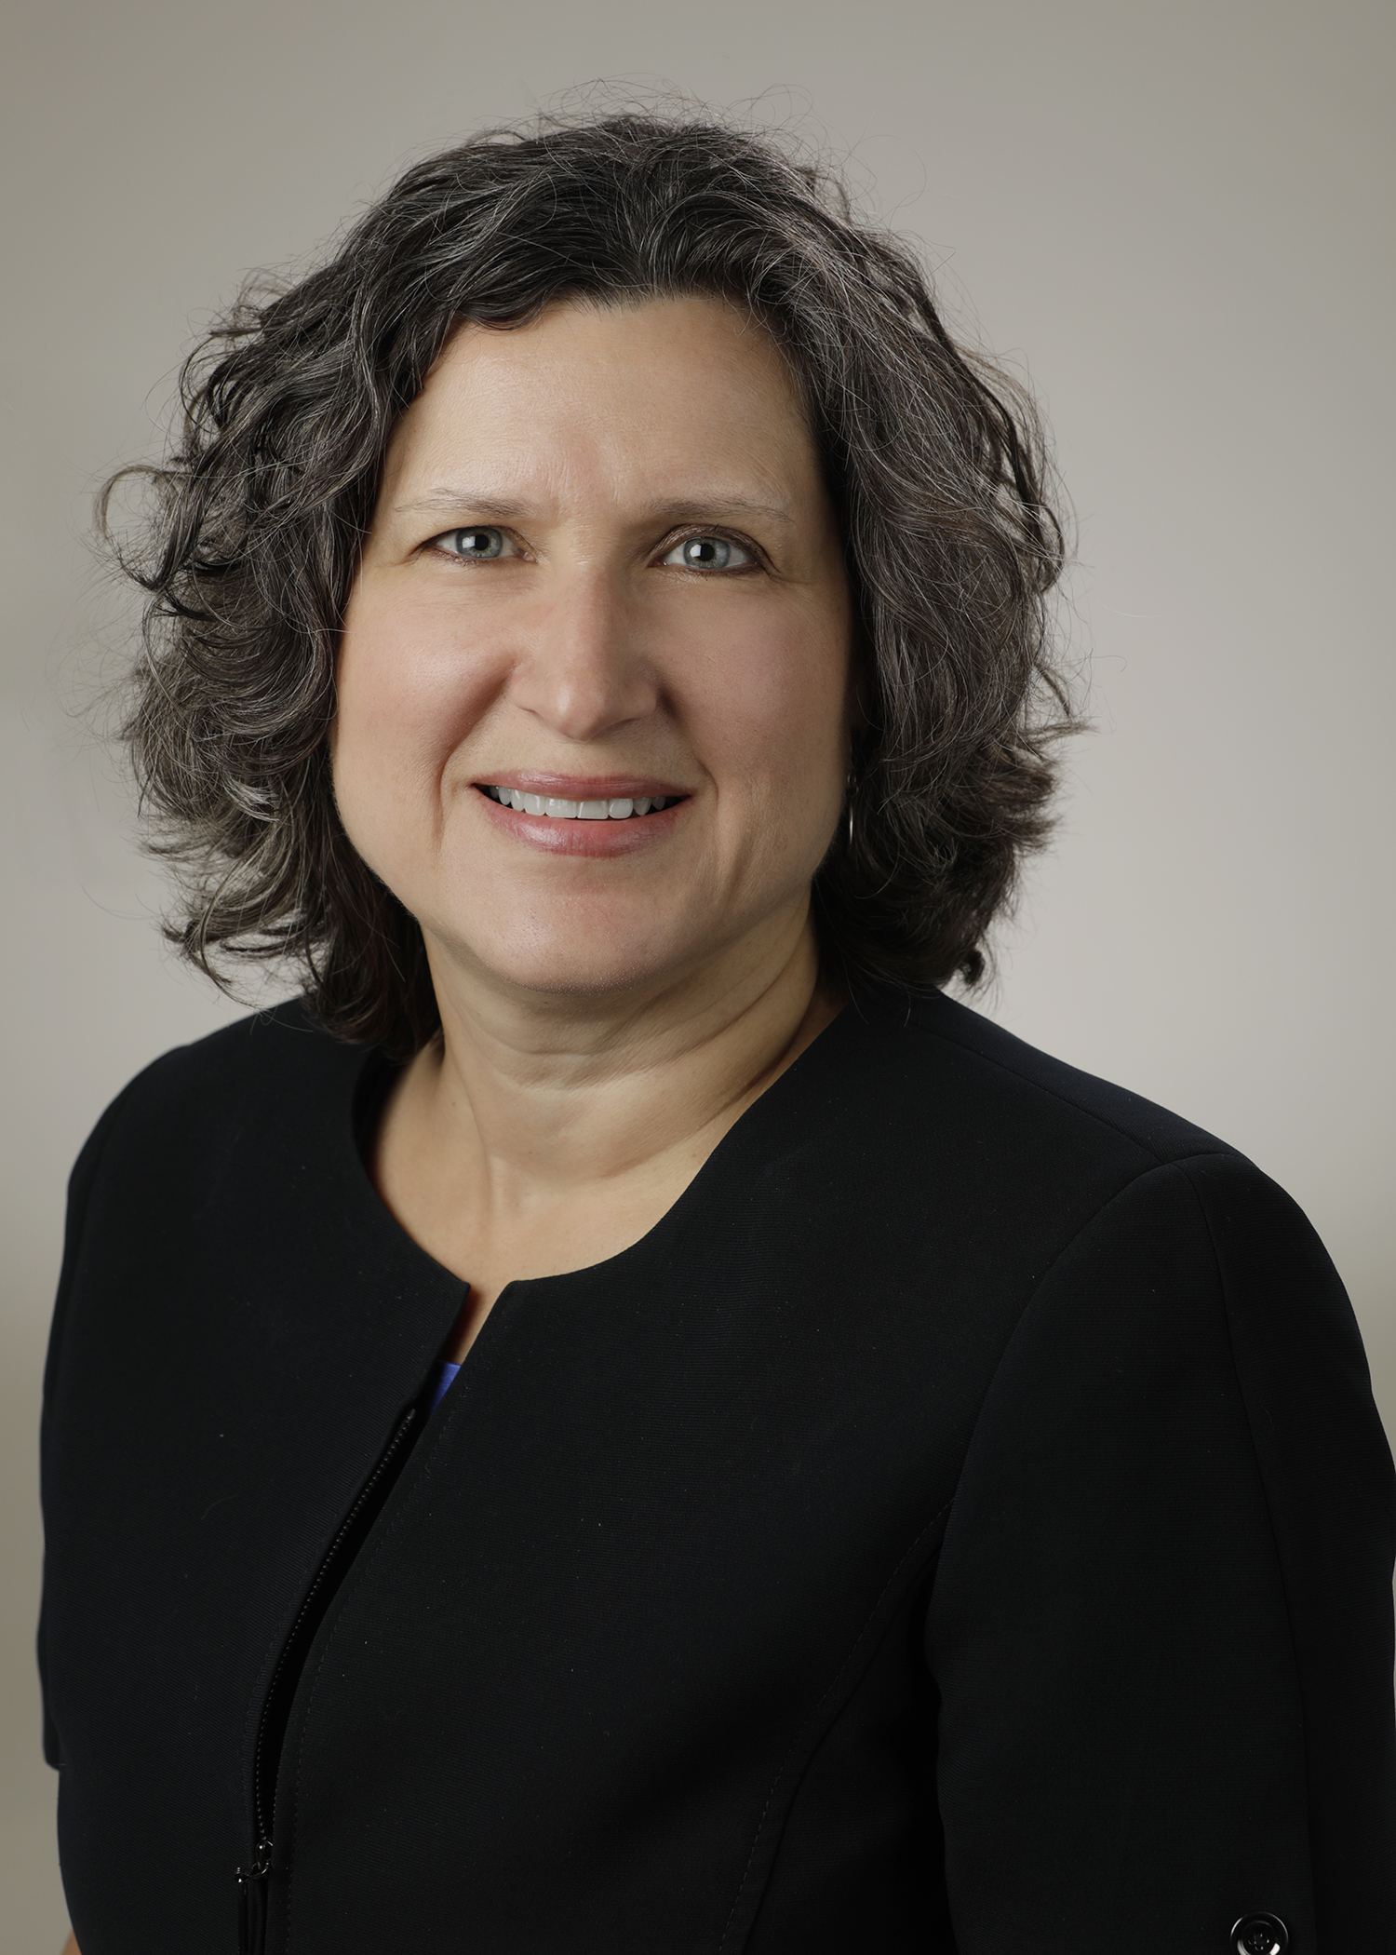
Introducing Your Presenter…
Heather Peters, M.Ed, Ph.D
GME Consultant
Former GME Director & DIO
Seasoned speaker at ACGME & subspecialty national meetings
Areas of Expertise: GME Strategic Planning; Program Evaluation; and Faculty Development
3 decades in education; Masters of Education in curriculum & evaluations, PhD concentration in secondary education & adult learning theories
Presented by Partners in Medical Education, Inc. 2020

Slide 4
Webinar Goals
Review foundational knowledge about struggling learners in GME training programs
Provide guidance to the Sponsoring Institution regarding meeting the needs of the programs for meeting the needs of the struggling learner, including initial identification
Discuss the following types of struggling learners:
Medical Knowledge
Communication and Interpersonal Skills
Additional Resources for working with struggling learners
Presenting Behaviors for Competency Deficits
Early vs Late Identifiers
Educational Interview Overview
Sample Improvement Plan

Slide 5
Some statistics…
Of the
50%
50%
7-15%
needing Intervention
will seek help
will NOT seek help
1/3
60%
OF PROGRAM DIRECTORS
STRUGGLE
OF GENERAL SURGERY
RESIDENTS NEED
INTERVENTION
WITH REMEDIATION DUE TO INADEQUATE DOCUMENATION
>
>
>
>
References:
ABIM estimates & General Surgery estimates reported in
Guerrasio J. Remediating the Struggling Medical Learner, AHME Publication, 2013.
Remediation in Medical Education: A mid-course correction, Kalet & Chou Ed, 2014

Slide 6
Ignoring Learner Issues…
Leads to more issues
Time required to remediate learner issues will increase
Frustrated faculty
Negative impact on program reputation
Other learners with issues will not request help
Negative impact on morale
Negative impact on patient safety and quality of care

Slide 7
PREVALENCE
50%
17-20% of medical trainees will experience difficulty during residency due to learning and/or behavior issues

Slide 8
Guidelines & Policy
Early vs Late Identifiers
Faculty Development
Barriers
Graduation
Struggling Learners Ahead
Faculty Development &
Orientation

Slide 9
Early Identification to Provide Intervention, the Step BEFORE Remediation
Faculty development principles
Guidelines for initial identification phase
PROVIDE every learner with FREQUENT FEEDBACK and establish authentic learner dialogue to uncover academic and behavioral issues early
REVIEW expectations for educational experience with learners to allow them to see where they might be deviating from the norm
NOTIFY appropriate persons when an issue is detected to obtain guidance
DOCUMENT with examples whenever possible to guide the intervention process
Meet with new learners one-on-one (PD, APD)
Hold CCC meetings – new residents & transfers
01
02
04
Establishing early and late identifiers
03
Barriers
See Initial vs Late Identifiers Table Hand-out
Inadequate documentation
No established procedures
Mental health issues
Psychosocial stressors, psychiatric diagnoses, substance abuse and
Learning disabilities

Slide 10
Working with Learners with Medical Knowledge Deficits

Slide 11
It is a medical knowledge deficit?
Comments such as “needs to read more” from faculty may point to a medical knowledge deficit, but never assume…
Investigate by interviewing the struggling learner
How did you score on your USMLE step 1 and 2?
How did you score on other standardized tests, such as the SAT, MCAT, GRE compared with your peers
Was your performance consistent across all areas of the exam, or did you score low in one area and high in others?
Was your performance on exams throughout medical school consistent?
Can you identify a time when your performance significantly worsened? If so what was happening in your life at that time, and did your study habits change?
Is your knowledge gap global or related to a specific topic or set of topics?
What approaches have you been using to study? Can you describe your study habits in detail?
Do you have a previously diagnosed disability?

Slide 12
Planning the Support
Resident A: Distracted with Chronic Low-Test Scores
Resident B: Lack of Committed Study Time with Chronic Low-Test Scores
Resident C: Anxiety, Confidence, and Chronic Low-Test Scores

Slide 13
Maybe it’s a neuropsychiatric issue…
If the learner reports that they have always been a a “bad test taker” or had an injury or illness that resulted in a change in performance

Slide 14
Who came to mind?
Take a moment during this cognitive break and jot down who came to mind while we were talking about medical knowledge deficits.
What is their profile?
Distracted with Chronic Low-Test Scores
Lack of Committed Study Time
Anxiety, Confidence, and Chronic Low-Test Scores

Slide 15
Working with Learners that Possess Interpersonal and Communication Skills Challenges

Slide 16
Interpersonal and Communication Skills
Where this might identified:
Clinical skills examinations
Observation of the trainee in everyday clinical situations
Possible obstacles to successful communication:
Knowledge deficit
Attitude deficit
Skills deficit
Psychological and Psychiatric factors
Interaction style
Diversity

Slide 17
COACHING PROCESS
Learners with Communication Skills Deficits
7. Determine a period of time for implementation followed by checking in on progress, revisiting learning plans, and modifying learning goals for continuous improvement
1. Establish a supportive learning environment
7
1
6
2. Demonstrate your expertise on the topic and process of communication skills by modeling those techniques with the learner
6. Emphasize that is important for the learner to initiate the development of his/her own learning plan that is based on both self-reflection and feedback
2
5. Share one or more objective observations of learner performance and encourage self-reflection
5
3
3. Listen to and acknowledge the learner’s emotions and understand his/her perspective
4
4. Encourage reflection on strengths

Slide 18
Who came to mind?
Take a moment and put down anyone who came to mind while we were talking about challenges with interpersonal and communication skills.
Start to identify which factors might be contributing this to this issue:
Knowledge deficit
Attitude deficit
Skills deficit
Psychological and Psychiatric factors
Interaction style
Diversity
Who could be a coach for this learner?

Slide 19
Working with Learners with Clinical Reasoning Issues

Slide 20
Bloom’s Taxonomy of Educational Goals
Able to create, construct or formulae a new or unique point of view
Create
Evaluate
Analyze
Remember
Apply
Understand
Able to evaluate, defend, or judge a decision
Able to compare and contrast in order to differentiate between similar concepts
Able to demonstrate or illustrate a concept
Able to describe, explain and translate concepts
Able to define, recall, or memorize information

Slide 21
How to assess clinical reasoning skills
“Think aloud” Experiences
Direct observations
One-minute preceptor
Small group presentations
Reading and giving feedback on patient notes in the setting of clinical care

Slide 22
Other Competencies or Areas of Clinical Practice
Presenting Behaviors Table

Slide 23
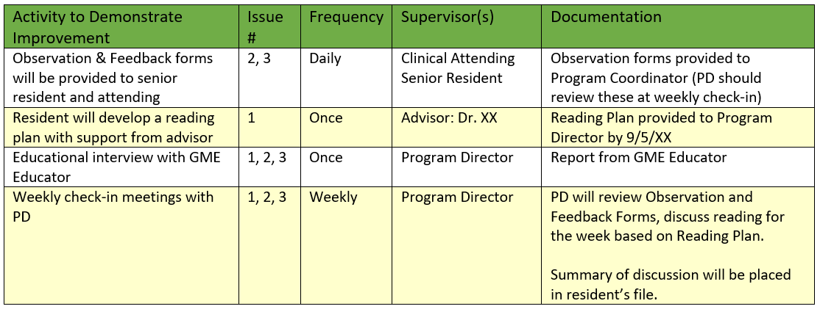
Sample Improvement Plan

Slide 24
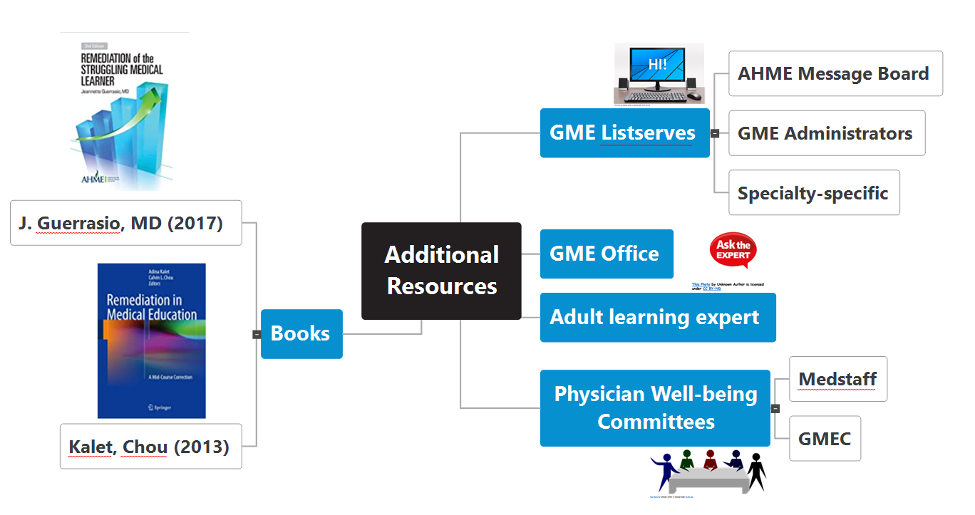
Additional Resources

Slide 25
Questions

Slide 26
Upcoming Live Webinar DIO Role and Responsibilities: Keys to Success
Thursday, December 17, 2020 12:00pm – 1:00pm EST
How to Manage Virtual Site Visit Tuesday, January 5, 2021 12:00pm – 1:00pm EST
How to Maximize Virtual Learning Part 1 Thursday, January 21, 2021 12:00pm – 1:00pm EST
DIO Role and Responsibilities: Keys to Success Thursday, December 17, 2021 12:00pm – 1:00pm EST
Latest On-Demand Webinars
Working with your Governing Board
Recognizing & Addressing Precursors of Burnout: The Value of Shame Resiliency Training to Support Resident Well-Being
Working with your IRB
Digging for Data II
Demystifying Diversity
Faculty Development Planning: Sponsoring Institution Role
ADS Annual Update: Best Practices
Graduate Medical Education Financing
Artificial Intelligence in Medicine: Its Impact on GME
Faculty Development – A More Specific Approach
NEW Faculty Development Series
15 Minutes to Effective Feedback
Toolbox for Teaching Millennials
Taking Supervision to the Next Level
Contact us today to learn how our Educational
Passports can save you time & money!
724-864-7320
www.PartnersInMedEd.com
Presented by Partners in Medical Education, Inc. 2020
26

Slide 27
Partners in Medical Education, Inc. provides comprehensive consulting services to the GME community.
Partners in Medical Education
724-864-7320 | info@PartnersInMedEd.com
Heather Peters, M.Ed, Ph.D
Heather@PartnersInMedEd.com
www.PartnersInMedEd.com
Presented by Partners in Medical Education, Inc. 2020

