Slide 1
Working with the Governing Board
Heather Peters, M.Ed, Ph.D -- GME Consultant
Christine Redovan, MBA, MLIS

Slide 2
Partners Consulting Team
Heather Peters, M.Ed, Ph.D
GME Consultant
Christine Redovan, MBA, MLIS
GME Consultant
GME Director & DIO
Seasoned speaker at ACGME & sub-specialty national meetings
Institutional and Program accreditation experience
3 decades in education; Masters of Education in curriculum & evaluations, PhD concentration in secondary education & adult learning theories
15+ years GME Operations, Accreditation and Management success
Focused on continual readiness and offering timely and useful GME resources

Slide 3
Learning Objectives
Discuss the rationale for educating the board on their oversight responsibilities
Develop a clear understanding of the mandatory AIR Executive Summary
Provide tips to making your presentations to the board “heard”
Special Section:
How to help the Board understand the COVID-19 affect on GME programs

Slide 4
Rationale for “Managing Up”

Slide 5
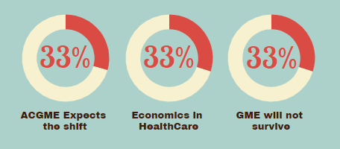
Rationale
In the next decade, the governing board will be taking a more “hands-on” role in GME
ACGME expects this shift
Economics in healthcare are forcing this shift
GME will not survive if the governing board does not see its value and support its growth

Slide 6
AIR Executive Summary

Slide 7
ACGME Requirement
I.B.5. The GMEC must demonstrate effective oversight of the Sponsoring Institution’s accreditation through an Annual Institutional Review (AIR). (Outcome)
I.B.5.a) The GMEC must identify institutional performance indicators for the AIR, to include, at a minimum: (Core)
I.B.5.a).(1) the most recent ACGME institutional letter of notification; (Core)
I.B.5.a).(2) results of ACGME surveys of residents/fellows and core faculty members; and, (Core)
I.B.5.a).(3) each of its ACGME-accredited programs’ ACGME accreditation information, including accreditation statuses and citations. (Core)

Slide 8
ACGME Requirement
I.B.5.b) The DIO must annually submit a written executive summary of the AIR to the Sponsoring Institution’s Governing Body. The written executive summary must include: (Core)
I.B.5.b).(1) a summary of institutional performance on indicators for the AIR; and, (Core)
I.B.5.b).(2) action plans and performance monitoring procedures resulting from the AIR. (Core)

Slide 9
Sample AIR Executive Summary Template
Please refer to
handout

Slide 10
What is an indicator?
Clues, signs or markers that measure an aspect of a program and shows how close the program is to its desired path and outcome
Realistic measures of progress
Quantitative
Qualitative

Slide 11
Institutional Indicators
Specific to YOUR institution
What matters to your GMEC
What matters to your C-Suite
What matters to your Governing Body

Slide 12
Potential Institutional Indicators
Survey Results
Work Hours
Citation Progress
Recruitment
Diversity
Accreditation Status
Board Pass Rates
Attainment of Aims and/or SI mission
GME Expansion or Reduction
CLE Initiatives
Infrastructure
Scholarship
SI Self-Study

Slide 13
Roles & Responsibilities of Governing Body
Hiring and retaining an effective CEO
Mission development and long-range planning
Ensuring high quality care
Oversight of medical staff credentialing
Financial oversight
Board education and development, including self-evaluation
Where do you see GME fitting in?
What indicators will the board want to see?
https://www.mnhospitals.org/Portals/0/Documents/Trustees/briefs-resources/roles.pdf

Slide 14
Example 1: Alignment of QI projects with SI mission
Indicator | Will the board care?
Number of Quality Improvement Projects | Maybe; if involves patient care/safety
Number of QI Projects aligned with mission | Yes; responsible for meeting mission
Number of QI Projects poster or podium presentation | Maybe.
Number of QI Projects published in non-peer reviewed journals | Yes; indicates name recognition and positive publicity for hospital
Number of QI Projects published in peer-reviewed journals | Yes; demonstrates outcomes directly rated to patient care/safety; positive publicity for hospital
Number of residents involved in QI Projects | Maybe.
Number of faculty involved in QI Projects | Maybe.

Slide 15
QI Projects with SI Mission

Slide 16
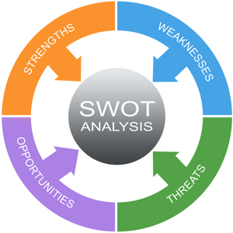
SWOT Analysis
Not required; highly recommended
Useful for identifying action items
Provides broader view for governing body
Highlights most serious issues affecting GME
Demonstrates GME reach
Opportunity for goal alignment
Opportunity for resource procurement
Drive strategic analysis/planning
Framework for high level discussions

Slide 17
Action Plans
Keep around two or three items
Make your items SMART
Specific
Measurable
Attainable
Relevant
Timely
How will your action plans align with SI goals?
Would the board like updates?

Slide 18
Other Reports

Slide 19
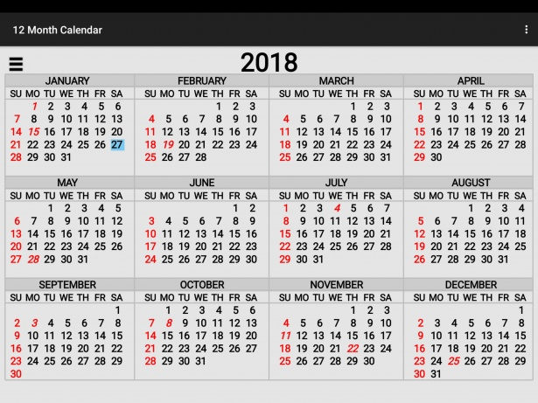
PURPOSE OF REPORTS:
1. Educate the governing board about GME
2. Keep them engaged in GME
Quarterly Reports
GMEC Summary Reports
Ad Hoc
Accreditation Decisions
ACGME Survey Results
Other
APE Summaries
Annual GME Budget

Slide 20
Quarterly Reports
NOT REQUIRED but RECOMMENDED
GMEC summary reports
POINT to PONDER:
Most SI structures mandate that GMEC minutes are sent to the Med Exec Committee and then to the Board. So why would you want to do a special quarterly review of GMEC?
Clinical learning environment issues
AIR action items follow-up
GME policies approved

Slide 21
Ad Hoc Reports
NOT REQUIRED but RECOMMENDED
 | Accreditation Decisions | ACGME Survey Results
WHEN | April (After all LONs have been received) | Late Summer
WHY | Necessary information that often is misunderstood | Indicator of issues & quality
HOW | Citation table for each program (see sample) | Color-coded summary
Program | Citation (Req) | Progress | Additional Needed Resources to Resolve Citation
Family Medicine
Internal Medicine

Slide 22
Other
NOT REQUIRED but RECOMMENDED
 | APE Summaries | GME Budget
WHEN | Fall | Varies by institution
WHY | Each program has unique strengths and challenges that are often lost in the sweeping overviews of the AIR | Provide an opportunity for the board to understand the rising costs of GME and how to fund needed resources
HOW | Program Director/DIO collaboration | DIO

Slide 23
Unique Circumstances

Slide 24
COVID-19 & AIR
Pre-, intra-, and post-analysis
Documentation will be critical for SI, Programs, ACGME, ABMS, Licensing and other bodies
Include a special section in your executive summary

Slide 25
COVID-19 & AIR
How programs adapted
Programs will have to document during ADS annual update
Resident files require documentation
Communication with C-Suite & Board
2. Issues we are seeing
Work from home issues
Residents deployed to inpatient
Distance learning
Telemedicine
Internet access
PPE

Slide 26
COVID-19 & AIR
3. What will be needed to get current trainees back on track?
Can residents get back on track?
What are the implications?
CCC importance; Documentation of
competency
4. What will be needed next time?
Review disaster plan; what worked, what didn’t
What data was used to inform your decisions
Lots of research and best practices will be coming out
Importance of knowing your community

Slide 27
Information during a crisis
JAMA Surgery article - Roadmap for residency programs during a pandemic
Zarzaur BL, Stahl CC, Greenberg JA, Savage SA, Minter RM. (2020, April 14). Blueprint for restructuring a department of surgery in concert with the health care system during a pandemic: The University of Wisconsin experience. JAMA Surg [Published Online] doi:10.1001/jamasurg.2020.1386
Reminder: Verify and use only trusted sources for information.

Slide 28
Presentation Tips

Slide 29
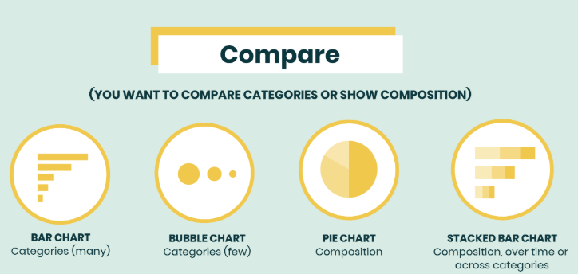
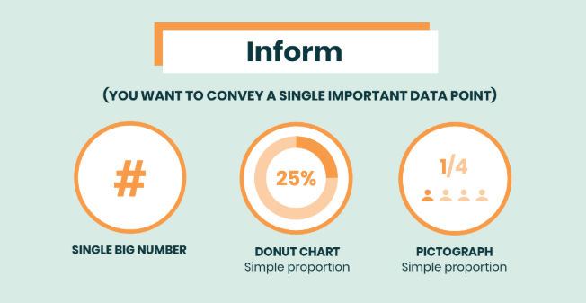
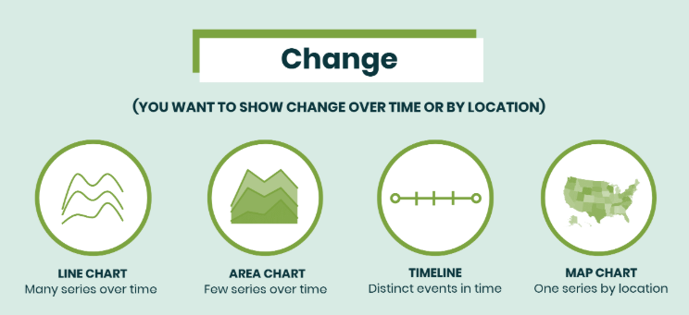
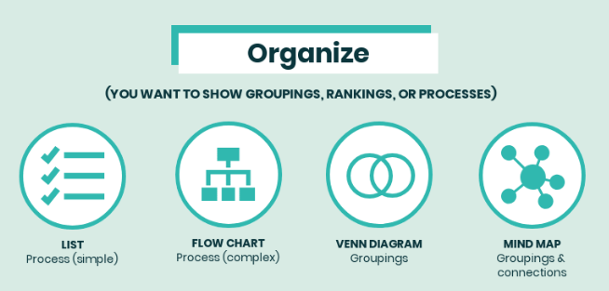
KEY CONCEPTS FOR PRESENTATIONS
Visuals
Less reading required
Conveys a concept quickly
CONS:
PROS:
Takes time to craft visuals

Slide 30
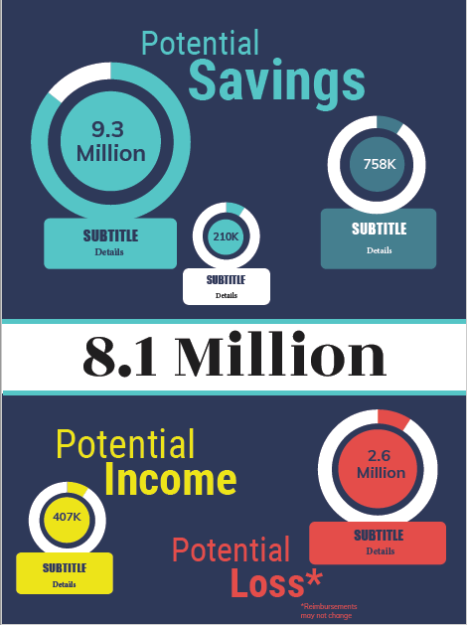

Slide 31
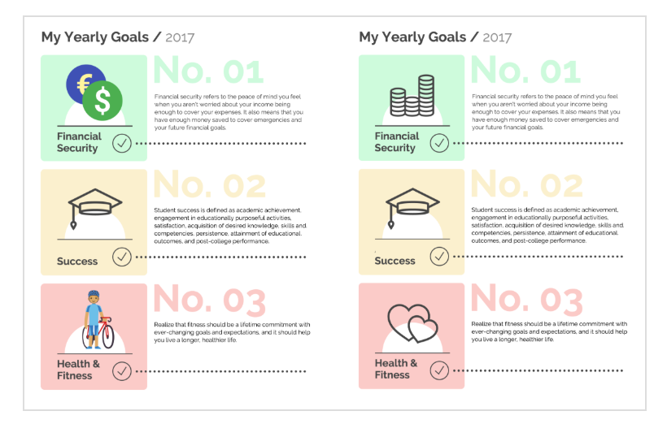
KEY CONCEPTS FOR PRESENTATIONS
Key Take-Aways
PROS:
CONS:
People like take-away slides
May be difficult to summarize complex issues in a key take-away or two
Can be matched with icons to further impact
Finding icons to match may be challenging

Slide 32
KEY CONCEPTS FOR PRESENTATIONS
Don’t Use Abbreviations
PROS:
CONS:
Doesn’t assume a certain level of understanding
Does not create a common vocabulary
Instead of… | Use…
ACGME | Our accrediting body/accreditation agency
IRIS, DGME or IME | CMS reimbursement tracking or funding
APE | Program Evaluations
AIR | Institutional Review
DIO | GME Leadership
GMEC | GME Oversight Committee
Rotations | Clinical experiences
Sponsoring Institution | GME educational structure
PGY | Training years (first years, 2nd years, 3rd years)

Slide 33
Closing Comments
Its’ a marathon, not a sprint
Find a “champion” on the board to help you communicate with the governing board on their level
Keep a balance between positivity and truthfulness

Slide 34
Questions??

Slide 35
Upcoming Live Webinars
Recognizing & Addressing Precursors of Burnout: The Value of Shame Resiliency Training to Support Resident Well-Being Thursday, May 28, 2020 12:00pm – 1:00pm EST
Working with your IRB Thursday, June 4, 2020 12:00pm – 1:00pm EST
Digging for Data 102 Tuesday, June 11, 2020 12:00pm – 1:00pm EST
Latest On-Demand Webinars
We All Need Scholar Activity, Including Coordinators
Preparing for the 10 Year Site Visit
Meet the Experts – Fall Freebie
Jump Start Your GMEC
Creating a Diverse Workforce
APE Reconstructed
Digging for Data 101
PEC: Best Practices Research and Scholarly Process in a Nutshell: Getting Started Ask Partners – Spring Freebie
NEW Faculty Development Series
15 Minutes to Effective Feedback
Toolbox for Teaching Millennials
Taking Supervision to the Next Level
Contact us today to learn how our Educational
Passports can save you time & money!
724-864-7320
www.PartnersInMedEd.com
35

Slide 36
Partners in Medical Education, Inc. provides comprehensive consulting services to the GME community.
Partners in Medical Education
724-864-7320 | info@PartnersInMedEd.com
Heather Peters, M.Ed, Ph.D
Heather@PartnersInMedEd.com
Christine Redovan, MBA, MLIS
Christine@PartnersInMedEd.com
www.PartnersInMedEd.com
Presented by Partners in Medical Education, Inc. 2020

