Slide 1
Partners Webinar Alert
Reminder…Because of the amount of individual logins for this webinar. Please DO NOT Unmute your Microphone after you enter this webinar.

Slide 2
Working With Your IRB
Grace Brannan, PhD
GME QI and Research Consultant

Slide 3
Introducing Your Presenter…
Grace Brannan, PhD GME QI and Research Consultant Partners Consulting Member
13+ years in GME Research and QI Leadership and 3 decades in population-based research.
Seasoned in setting QI and Research Strategy.
ACGME success in QI and scholarly requirements for multiple residencies.
Experienced in making research doable and feasible.
Focused on high value care, patient safety, embedding GME scholarly activities in hospital initiatives.

Slide 4
Learning Objectives
At the end of the session, participants will learn about:
The importance and function of an IRB
Ways to effectively work with your IRB

Slide 5
Some Feedback from Researchers
“The IRB does not understand what we are doing.”
“I don’t think the IRB understands that these are clinically low risk procedures.”
“This is a QI project, why does it need to go through the IRB?”
”It took a good six to nine months to come up with a protocol that would appease them.” (Babb, 2017)

Slide 6
Some Feedback from the IRB
“The researchers do not understand the role of the IRB in protecting human subjects”
“The explanation was not clear.”
“The proposal was poorly written.”

Slide 7
IRB and its Basic Functions
Ethics committee for research
IRB approval is a must for human subjects research.
Federal mandate for federally-funded human subjects research.
Common for institutions to have federally and non-federally-funded human subjects research to obtain IRB permission before proceeding with the project.
Monitoring
Once approved, study must be conducted as approved by the IRB.
Kim WO. Institutional review board (IRB) and ethical issues in clinical research. Korean J Anesthesiol. 2012;62(1):3‐12. doi:10.4097/kjae.2012.62.1.3

Slide 8
ACGME Requirement on IRB?
There is no specific language that dictates a program must have an IRB
However, the scholarly outcomes ACGME require are not possible without an IRB or access to an IRB.

Slide 9
Why Do We Need an IRB?
Ethical Reason: History of Human Subjects Protection
Nazi experiments
Tuskegee Syphilis Study
1999, Death of Jesse Gelsinger
Current Violations
Babb, S., Birk, L. and Carfagna, L., 2017. Standard bearers: qualitative sociologists’ experiences with IRB regulation. The American Sociologist, 48(1), pp.86-102.

Slide 10
Why Do We Need an IRB?
Human Subjects Research
An activity that involves a systematic investigation with a goal to contribute to generalizable knowledge and involves a living individual about whom an investigator conducting research obtains data
Journal Requirement
Ethical Review
Impacts meeting ACGME scholarly requirements
Retractions

Slide 11
Why Do We Need an IRB?
Federal- Minimum requirements
NIH
Department of Health and Human Services “The Common Rule”
The FDA
The Privacy Rule (HIPAA)
Institutional- similar to federal or may go above and beyond federal guidelines
Not following IRB requirements constitutes federal and institutional violation.

Slide 12
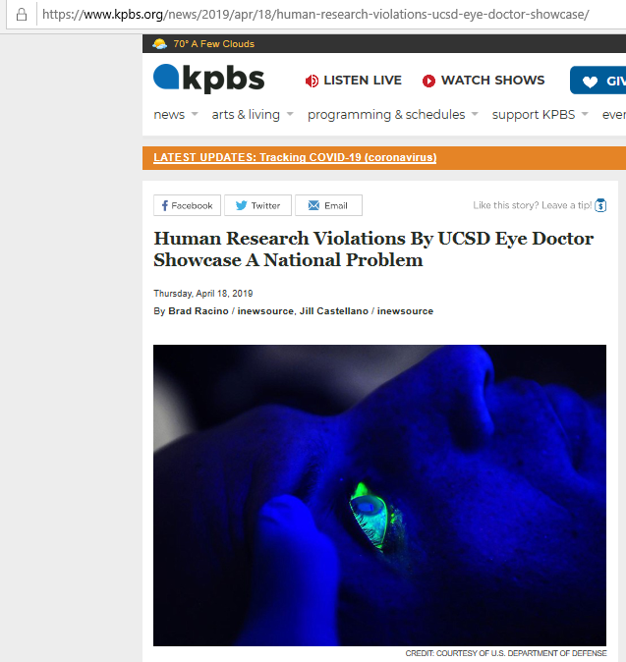
Why Do We Need an IRB?
Protect Patients, Researchers and Institutions

Slide 13
When Should IRB Approval be Obtained?
Prior to conducting human subjects research
There is no such thing as a retroactive IRB approval.
Important: Do not start research without IRB approval.

Slide 14
Common IRB Challenges
Tension between researchers and IRB.
Delays
Lack of standardization from one IRB to another

Slide 15
Solutions

Slide 16
Solution 1: Cultivate a Positive Investigator-IRB Relationship
Communication, communication, communication
Keep up with and follow the requirements
Avoiding conflict
Cartwright, J.C., Hickman, S.E., Nelson, C.A. and Knafl, K.A., 2013. Investigators' successful strategies for working with institutional review boards. Research in nursing & health, 36(5), pp.478-486.

Slide 17
Solution 2: A Well- Written Proposal
IRB Problems with Clinical Studies
Proposal Component | Percentage
Objectives | 46%
Study Design | 46%
Research Methodology | 92%
Data Collection | 85%
Work with seasoned researchers, statisticians, and methodologists.
Adams, P., Kaewkungwal, J., Limphattharacharoen, C., Prakobtham, S., Pengsaa, K. and Khusmith, S., 2014. Is your ethics committee efficient? Using “IRB Metrics” as a self-assessment tool for continuous improvement at the Faculty of Tropical Medicine, Mahidol University, Thailand. PloS one, 9(11).

Slide 18
Solution 3: Watch Out for Deadlines
IRB Approval Timeline of Non-Exempt Studies
 | Clinical | Non-Clinical
Days From Protocol Submission to Investigator’s Notification for Revisions | 27 | 31
Total Days From Submission to Final Approval | 77 | 70
Start early and allow a lot of time for delays.
Adams, P., Kaewkungwal, J., Limphattharacharoen, C., Prakobtham, S., Pengsaa, K. and Khusmith, S., 2014. Is your ethics committee efficient? Using “IRB Metrics” as a self-assessment tool for continuous improvement at the Faculty of Tropical Medicine, Mahidol University, Thailand. PloS one, 9(11).

Slide 19
Solution 4: Understand Their Language
Ongoing education
Distinction between research and treatment
IRB Processes and Requirements
Ask questions
Exempt: One of the most misunderstood IRB terms.
Cartwright, J.C., Hickman, S.E., Nelson, C.A. and Knafl, K.A., 2013. Investigators' successful strategies for working with institutional review boards. Research in nursing & health, 36(5), pp.478-486.

Slide 20
Solution 5: Understand The Process and Forms
Steps involved
Forms to complete
Cartwright, J.C., Hickman, S.E., Nelson, C.A. and Knafl, K.A., 2013. Investigators' successful strategies for working with institutional review boards. Research in nursing & health, 36(5), pp.478-486.

Slide 21
Implications of Bad Relationship Between Researchers and IRB
Delay
Decreased Number of Studies
Deception
Violations
Retraction of Publications

Slide 22
A Few Commonly Asked Questions

Slide 23
Chart Reviews Have to Go Through the IRB?
Yes, even if it is de-identified data.

Slide 24
What About QI Projects?
Quality Improvement (QI) projects are small scholarly activities aimed at improving processes or outcomes.
Institutional policies determine whether QI projects go through an IRB or not.

Slide 25
Exempt Projects Do Not Need to Go Through the IRB, Right?
Sorry, but those projects need to.
IRB Review Levels
Exempt
Expedited
Full Review

Slide 26
Who Determines IRB Review Levels?
Not the Researchers.
Your IRB determines this.

Slide 27
How About Working with Multiple IRBs?
Every IRB is Different
Multi-site studies
Inter-institutional Agreement

Slide 28
After IRB Approval, I Do Not Need to Do Anything Anymore, Right?
No, there are still a few things you need to address.
Examples
Project End Date
Continuing Review
Modification
Closing the Project

Slide 29
What are IRBs Doing to Streamline the Process?
A study explored how IRBs respond to PIs
Formal and informal
Educating PIs
Helping PIs
The approach varies
Klitzman, R., 2012. From anonymity to “open doors”: IRB responses to tensions with researchers. BMC research notes, 5(1), p.347.

Slide 30
Ways Administrators Could Help
Establishing a working relationship with the IRB
Requirements
IRB checklist
Deadline reminder
Forms

Slide 31
Best Practices
Do
Have a positive working relationship with your IRB.
Know the requirements.
Keep in mind that the IRB, not the researchers, decides which projects should get approval.
Ask the IRB for deadlines and timelines.
Don’t
Forget that IRB has additional requirements after approval.
Assume that Exempt means a project does not have to go through IRB.
Assume that QI projects do not need to go through IRB.

Slide 32
Key Take-Away
A positive and effective working
relationship with the IRB ensure meeting federal and institutional requirements to protect participants, institutions, and the community we serve.

Slide 33
References
Adams, P., Kaewkungwal, J., Limphattharacharoen, C., Prakobtham, S., Pengsaa, K. and Khusmith, S., 2014. Is your ethics committee efficient? Using “IRB Metrics” as a self-assessment tool for continuous improvement at the Faculty of Tropical Medicine, Mahidol University, Thailand. PloS one, 9(11).
Babb, S., Birk, L. and Carfagna, L., 2017. Standard bearers: qualitative sociologists’ experiences with IRB regulation. The American Sociologist, 48(1), pp.86-102.
Boser, S., 2007. Power, ethics, and the IRB: Dissonance over human participant review of participatory research. Qualitative Inquiry, 13(8), pp.1060-1074.
Bledsoe, C.H., Sherin, B., Galinsky, A.G. and Headley, N.M., 2007. Regulating creativity: Research and survival in the IRB iron cage. Nw. UL Rev., 101, p.593.
Byerly, W.G., 2009. Working with the institutional review board. American Journal of Health-System Pharmacy, 66(2), pp.176-184.
Cartwright, J.C., Hickman, S.E., Nelson, C.A. and Knafl, K.A., 2013. Investigators' successful strategies for working with institutional review boards. Research in nursing & health, 36(5), pp.478-486.
Ellis, A., Center, C.L. and Campus, W.T., 2012. The Institutional Review Board “Working with the Institutional Review Board (IRB)”.
Getz, K.A., 2011. Frustration with IRB bureaucracy & despotism. Applied Clinical Trials, 20(1), p.26.
Grady, C., 2015. Institutional review boards: Purpose and challenges. Chest, 148(5), pp.1148-1155.

Slide 34
References
Graham, D.G., Spano, M.S. and Manning, B., 2007. The IRB challenge for practice-based research: strategies of the American Academy of Family Physicians National Research Network (AAFP NRN). The Journal of the American Board of Family Medicine, 20(2), pp.181-187.
Henry, S.G., Romano, P.S. and Yarborough, M., 2016. Building trust between institutional review boards and researchers.
Jerry Menikoff MD, J.D., 2010. The paradoxical problem with multiple-IRB review. The New England journal of medicine, 363(17), p.1591.
Katz, Jack. 2007. "Toward a Natural History of Ethical Censorship." Law & Society Review 41(4):797-810.
Kim WO. Institutional review board (IRB) and ethical issues in clinical research. Korean J Anesthesiol. 2012;62(1):3‐12. doi:10.4097/kjae.2012.62.1.3
Klitzman, R., 2012. From anonymity to “open doors”: IRB responses to tensions with researchers. BMC research notes, 5(1), p.347.
Liberale, A.P. and Kovach, J.V., 2017. Reducing the Time for IRB Reviews: A Case Study. Journal of Research Administration, 48(2), pp.37-50.
Schrag, Zachary M. 2010. Ethical Imperialism: Institutional Review Boards and the Social Sciences 1965-2009. Baltimore, MD: Johns Hopkins University Press.
Stark, Laura J. M. 2007. "Victims in our Own Minds? IRBs in Myth and Practice.(Institutional Review Boards)(Response to Article by Malcolm M. Feeley in this Issue, p. 757)." Law & Society Review, 12/01, pp. 777.
Whitney, S.N., Alcser, K., Schneider, C.E., McCullough, L.B., McGuire, A.L. and Volk, R.J., 2008. Principal investigator views of the IRB system. International journal of medical sciences, 5(2), p.68.

Slide 35
Download your Summer/ Fall Webinar Education Schedule
https://partnersinmeded.com/educational-resources/

Slide 36
Upcoming Live Webinar
Digging for Data 102 Tuesday, June 11, 2020 12:00pm – 1:00pm EST
Demystifying Diversity Tuesday, July 7, 2020 12:00pm – 1:00pm EST
Faculty Development Planning: Sponsoring Institution Role Thursday, July 16, 2020 12:00pm – 1:00pm EST
ADS Annual Update: Best Practices Tuesday, July 28, 2020 12:00pm – 1:00pm EST
Latest On-Demand Webinars
Creating a Diverse Workforce
APE Reconstructed
Digging for Data 101
PEC: Best Practices Research and Scholarly Process in a Nutshell: Getting Started Ask Partners – Spring Freebie Lessons Learned: Accepting Displaced Orphan Residents
Is your Coordinator Well Enough: Coordinators as Role Models of Wellness
Research Proposal Development: Tips for Success Working with your Governing Board
NEW Faculty Development Series
15 Minutes to Effective Feedback
Toolbox for Teaching Millennials
Taking Supervision to the Next Level
Contact us today to learn how our Educational
Passports can save you time & money!
724-864-7320
www.PartnersInMedEd.com
36

Slide 37
Partners in Medical Education, Inc. provides comprehensive consulting services to the GME community.
Partners in Medical Education
724-864-7320 | info@PartnersInMedEd.com
Grace Brannan, PhD
gdbconsulting@outlook.com
www.PartnersInMedEd.com

